Slide 1
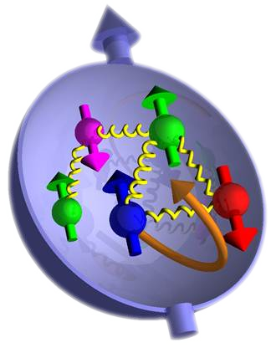


Understanding The Nature of Normal Matter
Elena Long
#GHOSeminar
University of Central Arkansas
March 12th, 2015

Slide 2

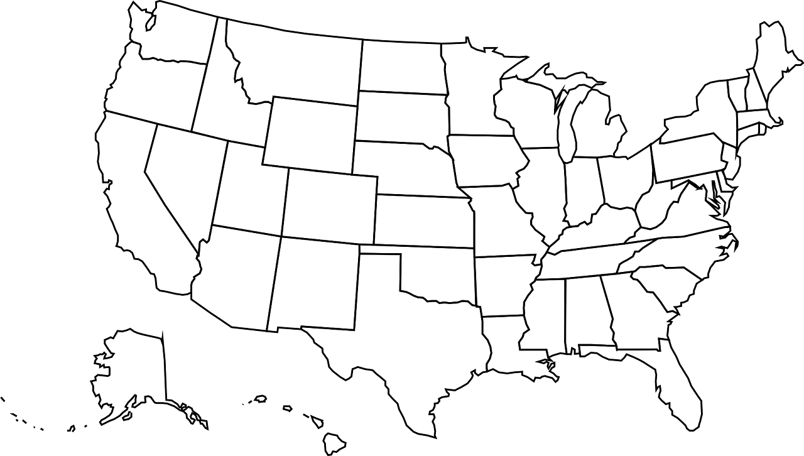



A Little About @Elena_Long
lgbtphysicists.org
Career Path
Unpaid Career Path
’80s-2002
Growing up
2009(ish)
Founded
lgbt+physicists
2002-2006
Undergrad:
Juniata College
2011(ish)
Joined
2006-2008
Grad School (Classes):
Kent State University
2014(ish)
Helped start
APS C-LGBT
March 2015, Page 25
2008-2012
Grad School (Research):
KSU @ Jefferson Lab
2013-Present
Post Doc:
University of
New Hampshire

Slide 3
Enough About Me…
Onto the Physics!
  The Structure of Matter – A Sense of Size
  Electron Scattering Experiments
  Nucleon Structure:
    Electromagnetic Form Factors
    Structure Functions
    The Future through Tensor Polarization

Slide 4
The Structure of Matter
Electron
Atom
< 10⁻²² m
Nucleus
Proton/Neutron
Quark
10⁻¹⁴ m
10⁻¹⁰ m
10⁻¹⁵ m
< 10⁻¹⁸ m
A sense of scale: http://htwins.net/scale

Slide 5
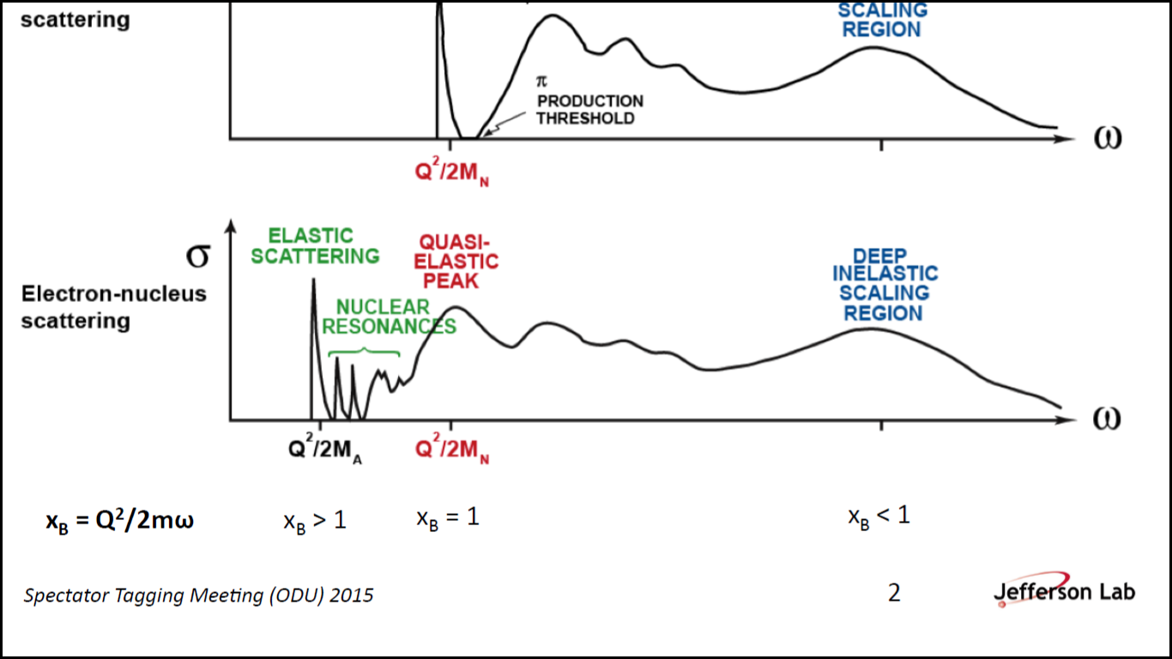
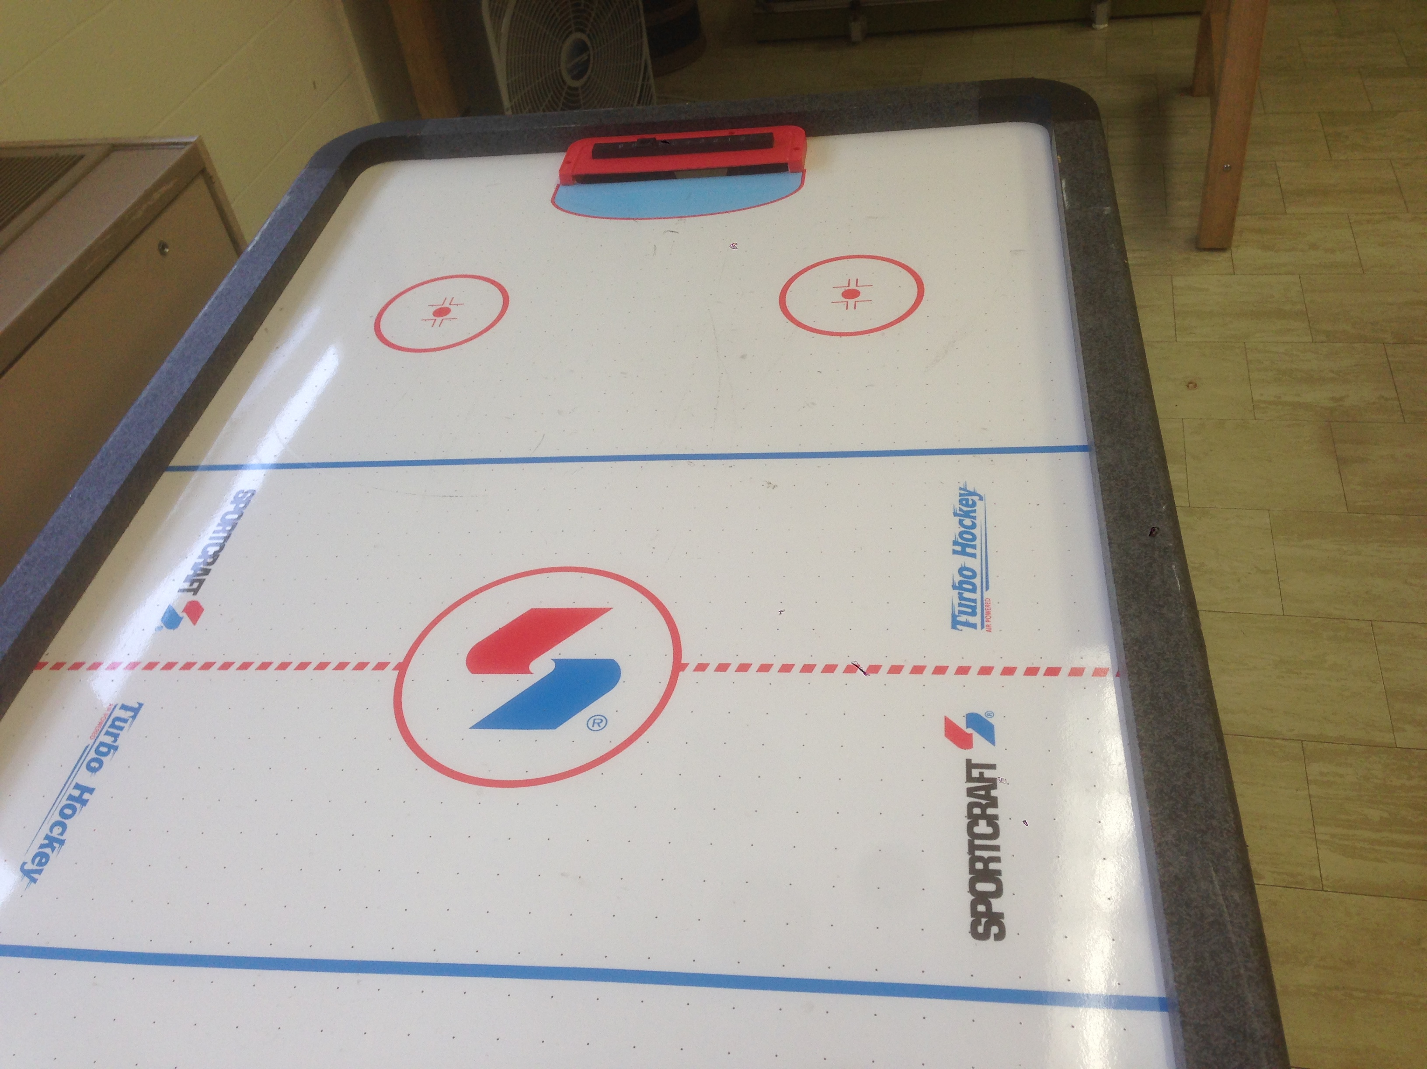
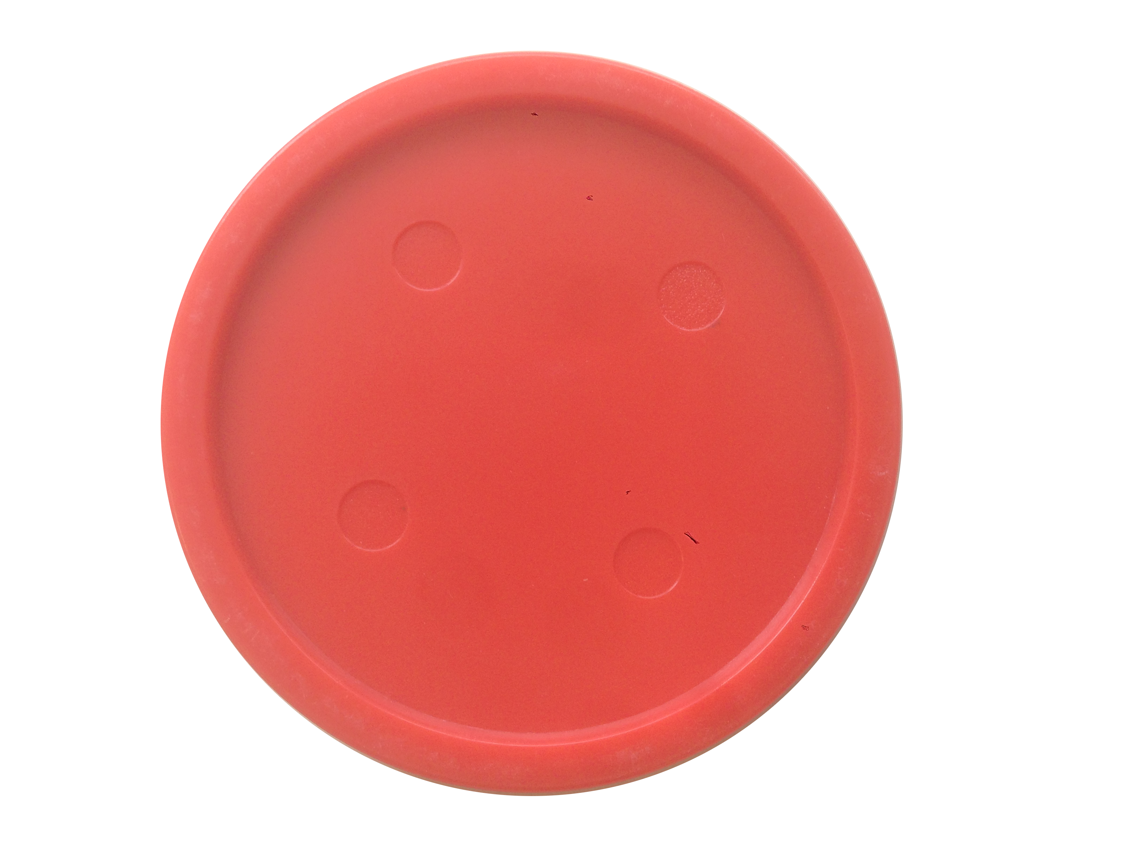
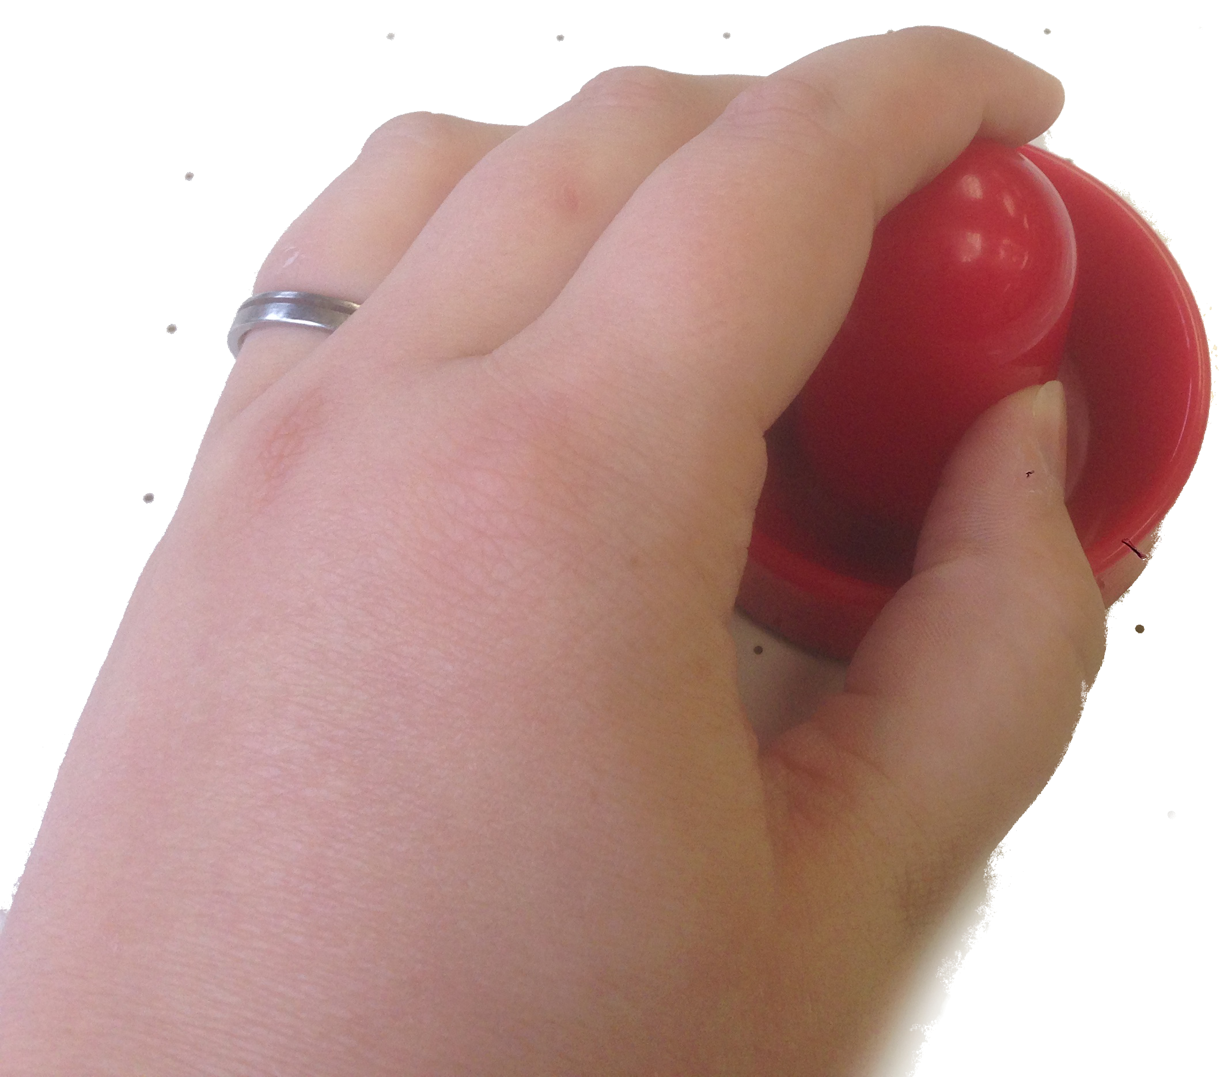






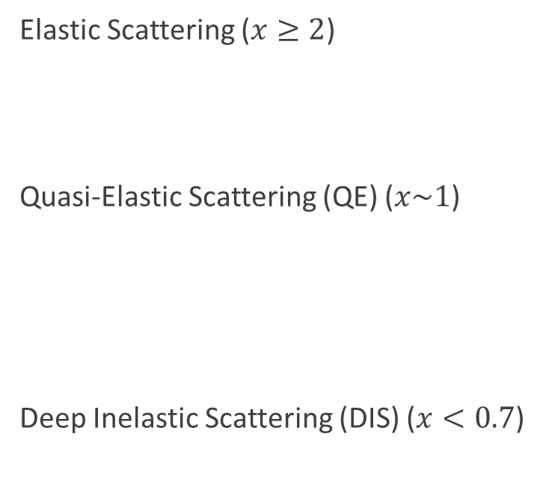


Electron Scattering
$$υ$$
Elastic Scattering ($x≥2$)
Quasi-Elastic Scattering (QE) ($x\sim 1$)
Deep Inelastic Scattering (DIS) ($x<0.7$)
Detector
e
Probes
Nuclear
Effects
e
e
Target
$$θ$$
e
e
Probes
Nucleon
Effects
e
$ν$=E-E’
$$Q^{2}=4EE^{′}\sin^{2}{\frac{θ}{2}}$$
$$λ∝\frac{1}{\sqrt{Q^{2}}}$$
Higher $Q^{2}→$ Better Resolution
e
Probes
Quark
Effects
$$x=\frac{Q^{2}}{2mν}$$
e
$→$ Scaled Momentum Fraction of Scattered Particle

Slide 6
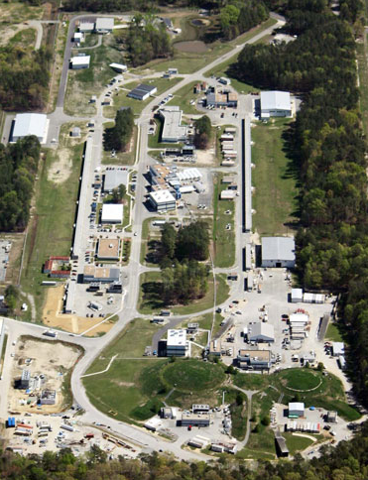
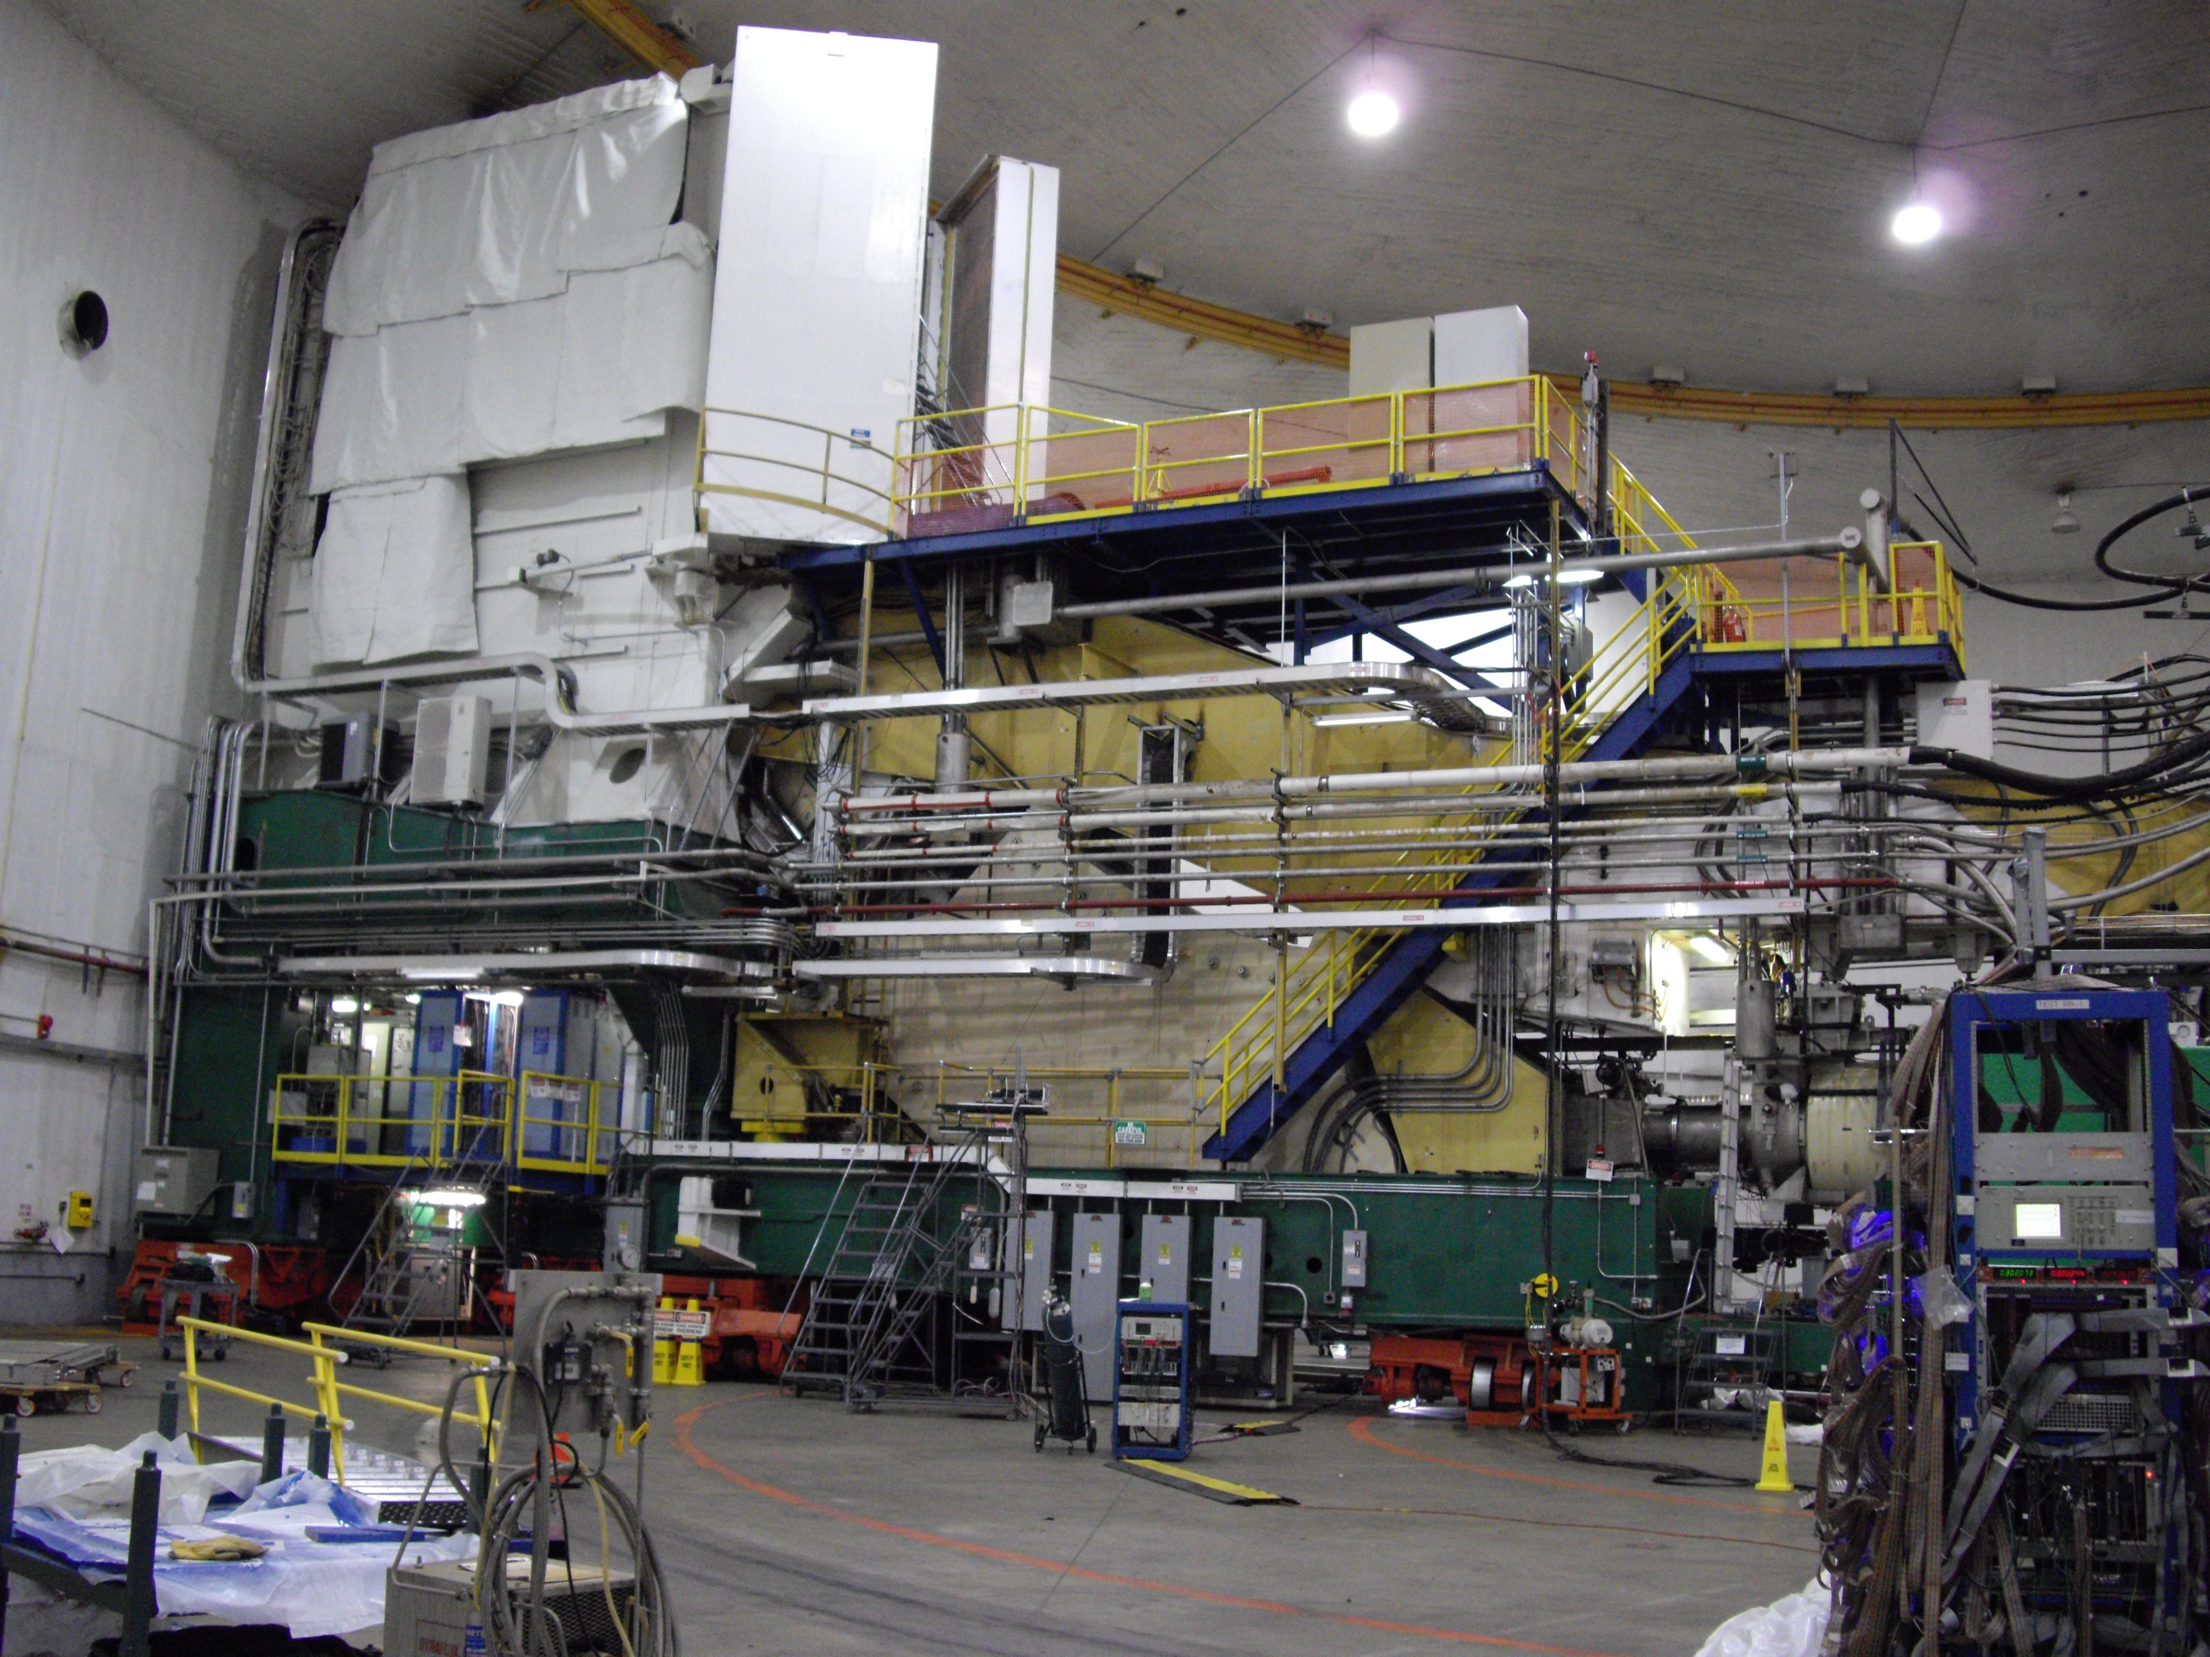

Electron Scattering at Jefferson Lab
  Fixed target electron accelerator
  Recently completed 12 GeV upgrade – First new physics in 3 years!
  World leader in polarized beam and polarized targets
  Mission includes: “To deliver discovery-caliber research by exploring the atomic nucleus and its fundamental constituents, including precise tests of their interactions”
e
e
A
C
$$θ$$
B
e

Slide 7



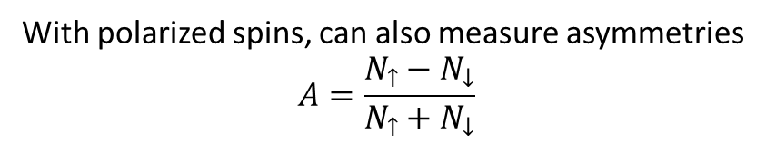





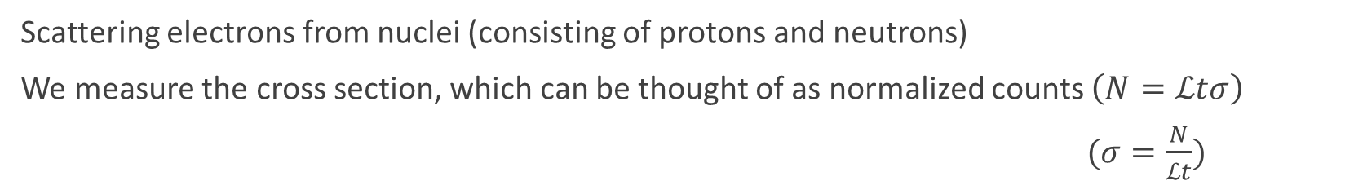

Electron Scattering – Measuring Structure
Scattering electrons from nuclei (consisting of protons and neutrons)
We measure the cross section, which can be thought of as normalized counts $\left(N=ℒtσ\right)$
$(σ=\frac{N}{ℒt})$
$$N$$
$$t$$
  $$\left[\frac{Q^{2}}{4M^{2}}G_{M}^{2}\left(Q^{2}\right)+εG_{E}^{2}(Q^{2})\right]$$
Detector
  $${σ=σ}_{Mott}$$
Spin-½
Particles
$$ℒ$$
e
m = +½
Target
$$θ$$
Deviation from
a point-like nucleon
e
Scattering from
a point-like nucleon
$$ℒ$$
m = -½
With polarized spins, can also measure asymmetries
$$A=\frac{N_{↑}−N_{↓}}{N_{↑}+N_{↓}}$$
e
$$\sim \frac{σ_{↑}−σ_{↓}}{σ_{↑}+σ_{↓}}$$
e
e
e

Slide 8
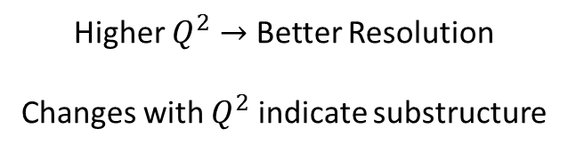

Electromagnetic Form Factors
e
e
Scatter electrons from a proton or a neutron
  $${σ=σ}_{Mott}\left[\frac{Q^{2}}{4M^{2}}G_{M}^{2}\left(Q^{2}\right)+εG_{E}^{2}(Q^{2})\right]$$
  At $Q^{2}=0$,
  $G_{M}^{p}→μ_{p}$ $G_{M}^{n}→μ_{n}$
  $G_{E}^{p}→1$ $G_{E}^{n}→0$
Scattering from
a point particle
Deviation due
to charge distribution
Deviation due
to magnetic moment
distribution
Higher $Q^{2}→$ Better Resolution
Changes with $Q^{2}$ indicate substructure

Slide 9
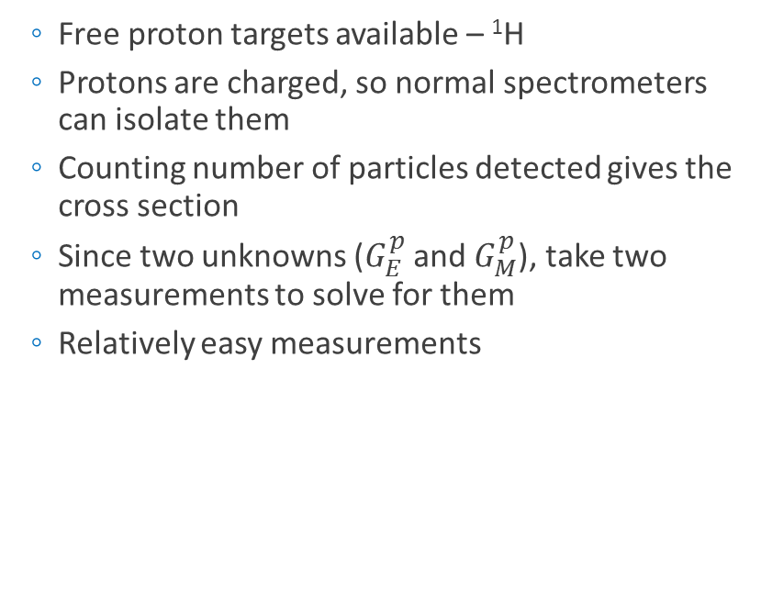
Proton Form Factors
e
e
  Free proton targets available – ¹H
  Protons are charged, so normal spectrometers can isolate them
  Counting number of particles detected gives the cross section
  Since two unknowns ($G_{E}^{p}$ and $G_{M}^{p}$), take two measurements to solve for them
  Relatively easy measurements
Detector
Focusing
Magnets
e
e
Bending
Magnet

Slide 10
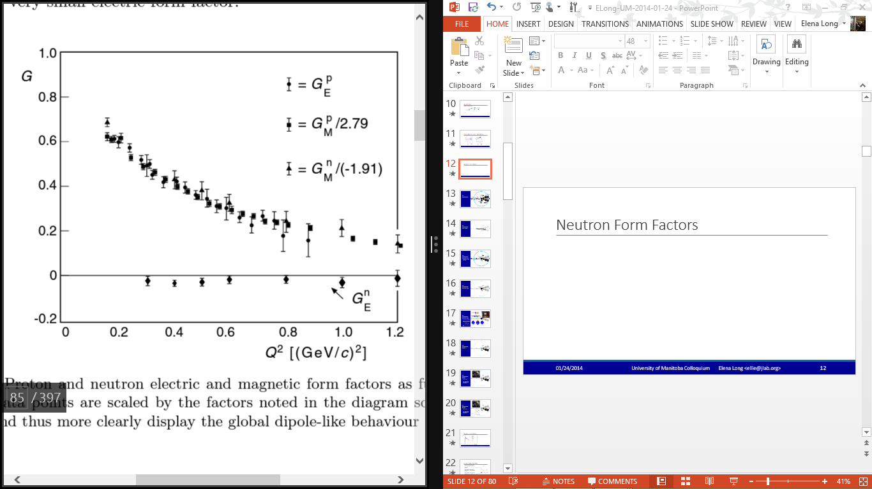

Proton Form Factors – World Data
e
e
  For ease, we compare data to electric and magnetic dipoles
  If dipole-like, then $\frac{G_{P}}{G_{D}}=1$
N
S
B Povh, et al, Particles and Nuclei, 6th ed. (2008)

Slide 11
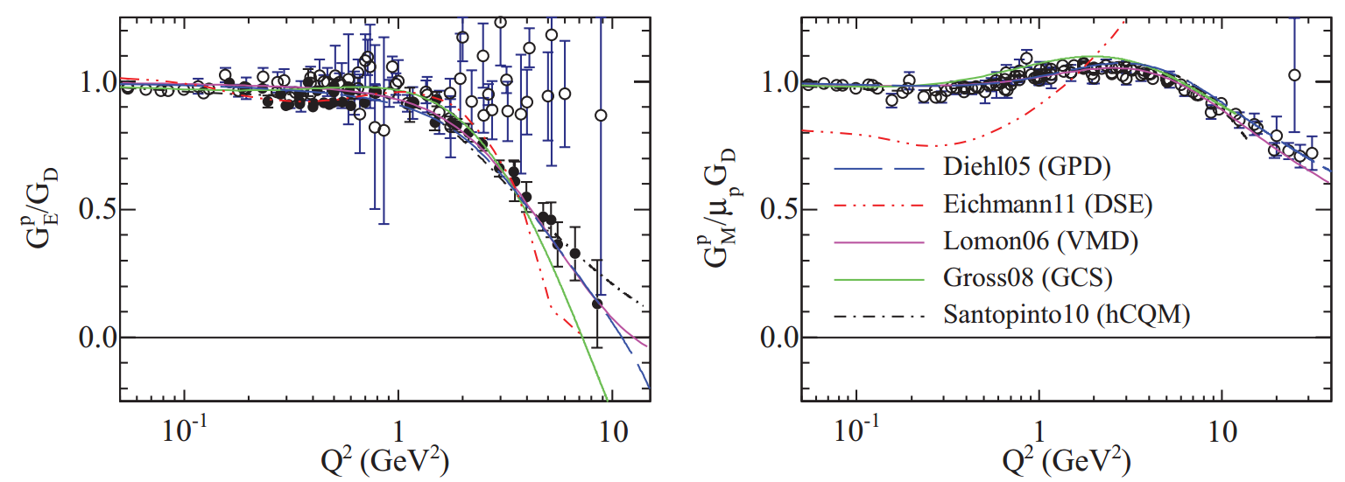
Proton Form Factors – World Data
e
e
Electric Form Factor / Dipole
Magnetic Form Factor / Dipole
A. Puckett, et al, Phys. Rev. C 85, 045203 (2012)

Slide 12
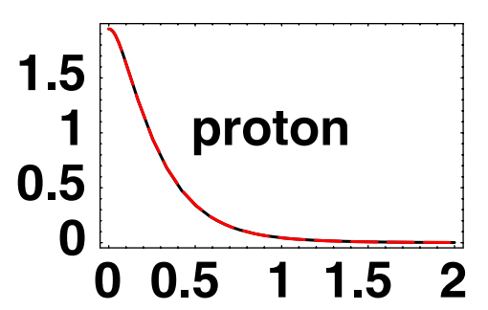

Proton Form Factors – World Data
e
e
Electric Form Factor / Dipole
+
+
+
+
+
+
+
+
Fourier
Transform
(Momentum $→$ Position)
+
ρ(b)
[fm⁻²]
A. Puckett, et al, Phys. Rev. C 85, 045203 (2012)
G.A. Miller, PRL 99, 112001 (2007)
b [fm]

Slide 13
Neutron Form Factors
e
e
Neutron electric form factor is much smaller than proton’s
No free neutron target is available
  Requires small-nuclei targets, such as ²H or ³He
Neutrons, being neutral, cannot be directly detected using standard spectrometers
e
e
B Povh, et al, Particles and Nuclei, 6th ed. (2008)

Slide 14

Neutron Form Factor, $G_{E}^{n}$ Measurement
Neutron Detector
e
e
p

Slide 15
Neutron Form Factor, $G_{E}^{n}$ Measurement
Neutron Detector
e
e
n

Slide 16
Neutron Form Factor, $G_{E}^{n}$ Measurement
Neutron Detector
e
e
p
p
p
p
p
p
p
p
p
p
p
p
p
p
p
p
p
p
n
p
p
p
p
p
p
p
p
p
p
p
p
p
p
p
p
p
p
p
p

Slide 17


Neutron Form Factor, $G_{E}^{n}$ Measurement
e
e
Neutron
Detector
n
Target
$$θ_{n}$$
e
$$θ_{e′}$$
e
Electron
Detector

Slide 18
Neutron Form Factor, $G_{E}^{n}$ Measurement
e
e
HAND
Pion Rejectors
(Pb Glass)
Scintillators
VDCs
Polarized ³He
Target
Compton
Polarimeter
Møller
Polarimeter
Q
D
Q
Raster
Q
Gas Cerenkov
ARC
BCM
eP
BPM
Preshower
Right HRS
Shower

Slide 19
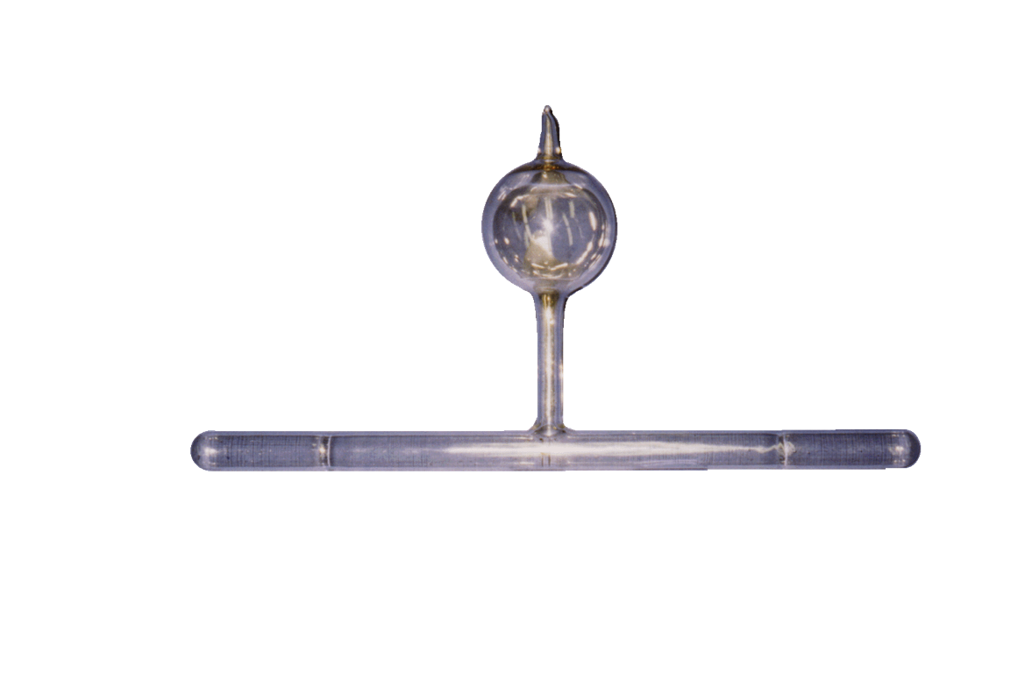
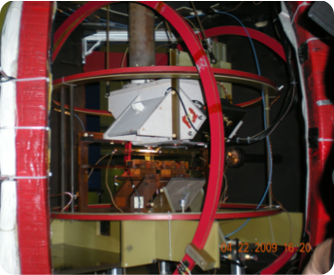
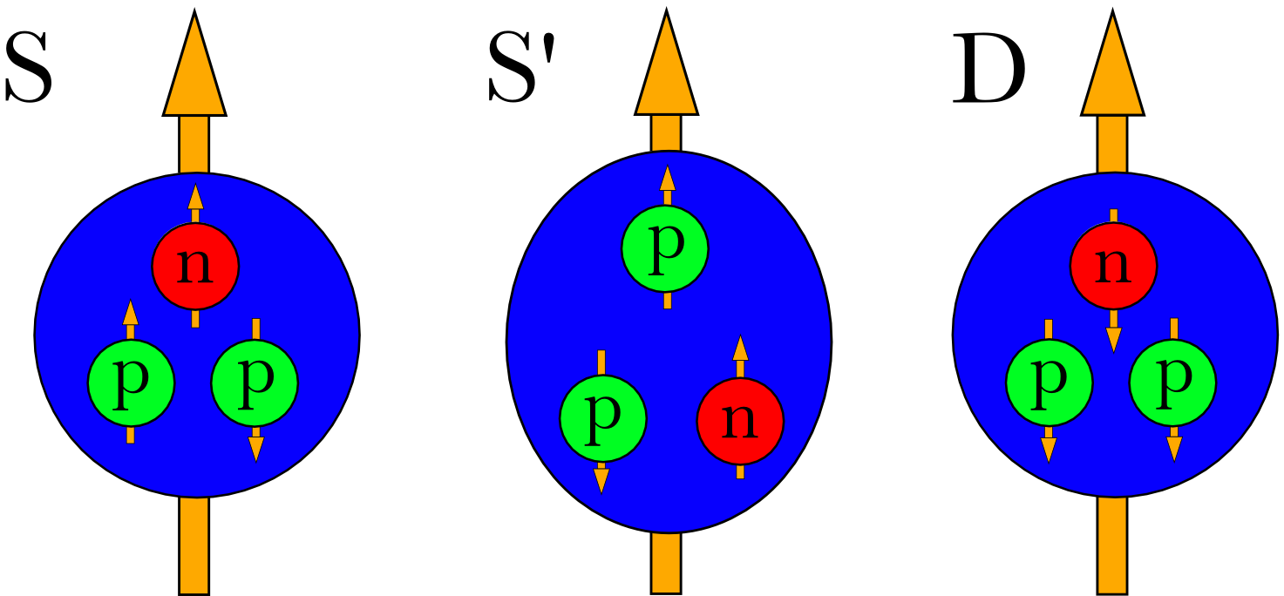


Neutron Form Factor, $G_{E}^{n}$ Measurement
e
Pumping
Chamber
e
Target Chamber
(Nuclear Physics Happens Here)
Polarized ³He Target
Optically pumped Rb and K vapor used to polarized ³He via spin exchange (SEOP)
NMR and EPR used to measure P_{t}
N present in cell to absorb photons from spin-exchange
$D_{N}=\begin{matrix} \\ 5.3±0.8\% at Q^{2}=0.1 \\ 2.4±0.3\% at Q^{2}=0.5 \\ 2.8±1.2\% at Q^{2}=1.0\end{matrix}$
Achieved P_{t} of $51.4 ±0.4±2.8 \%$
Details in Y. Zhang, Ph.D. Thesis, Rutgers, 2013
$$A=\frac{N_{↑}−N_{↓}}{N_{↑}+N_{↓}}$$
E. Long, Ph.D. Thesis arXiv:1209.2739 (2012)

Slide 20
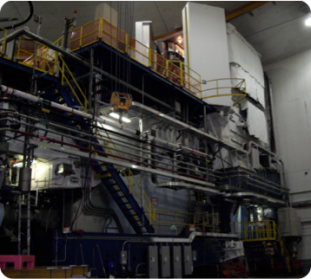
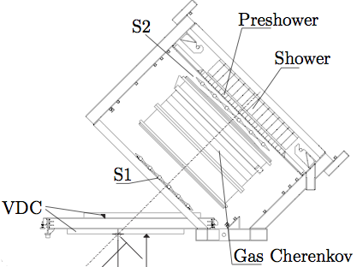
Neutron Form Factor, $G_{E}^{n}$ Measurement
e
e
Right HRS
Detected scattered electrons from ³He(e,e’n) and ³He(e,e’)
Detector package included VDCs, trigger scintillators, gas Cherenkov, and lead-glass calorimeters
Right HRS

Slide 21
Neutron Form Factors – World Data
e
e
B Povh, et al, Particles and Nuclei, 6th ed. (2008)

Slide 22
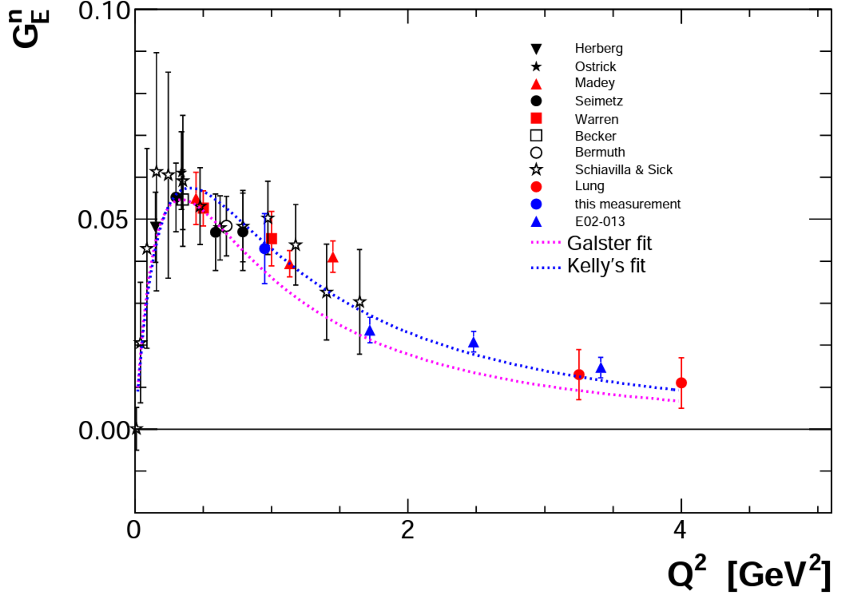
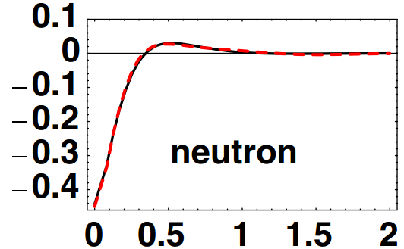
Neutron Form Factors – World Data
e
e
-
-
+
+
-
-
+
+
-
ρ(b)
[fm⁻²]
Fourier
Transform
V. Sulkowsky, G. Jin, E. Long, et al, PRL (in prep.)
b [fm]

Slide 23
Electromagnetic Form Factors
e
e
e
e
+
-
+
-
+
+
+
+
+
+
Constituents of
nucleons are
charged particles
+
+
-
-
+
+
+
-
ρ(b)
[fm⁻²]
ρ(b)
[fm⁻²]
b [fm]
b [fm]

Slide 24
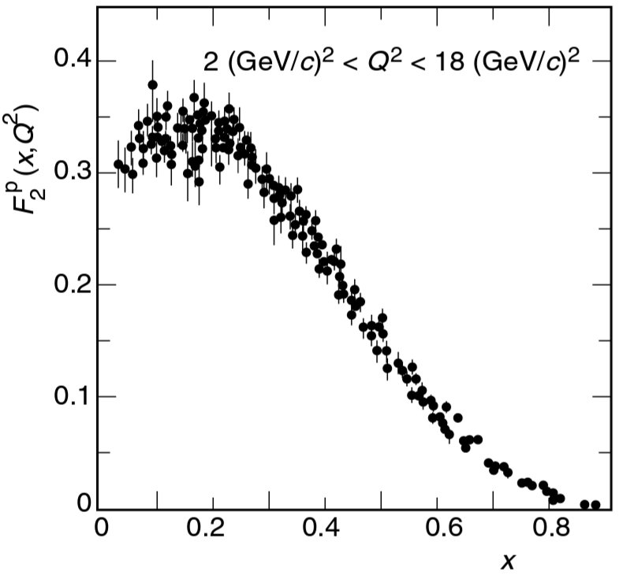

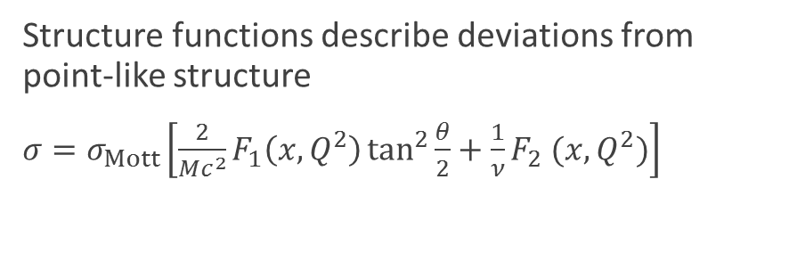


Structure Functions - Unpolarized
e
e
Structure functions describe deviations from point-like structure
  ${σ=σ}_{Mott}\left[\frac{2}{Mc^{2}}F_{1}\left(x,Q^{2}\right)\tan^{2}{\frac{θ}{2}}+\frac{1}{ν}F_{2} (x,Q^{2})\right]$
Deviation from
a point-like nucleon
Gives insight to
proton substructure
Scattering from
a point-like nucleon
$$F_{2}$$
Single Quark
q
$$1$$
$$x$$
F Halzen, A Martin, Quarks and Leptons (1984)
B Povh, et al, Particles and Nuclei, 6th ed. (2008)

Slide 25

Structure Functions - Unpolarized
e
e
Structure functions describe deviations from point-like structure
  ${σ=σ}_{Mott}\left[\frac{2}{Mc^{2}}F_{1}\left(x,Q^{2}\right)\tan^{2}{\frac{θ}{2}}+\frac{1}{ν}F_{2} (x,Q^{2})\right]$
Gives insight to
proton substructure
3 Valence Quarks
$$F_{2}$$
q
q
q
$$1/3$$
$$1$$
$$x$$
F Halzen, A Martin, Quarks and Leptons (1984)
B Povh, et al, Particles and Nuclei, 6th ed. (2008)

Slide 26
Structure Functions - Unpolarized
e
e
Structure functions describe deviations from point-like structure
  ${σ=σ}_{Mott}\left[\frac{2}{Mc^{2}}F_{1}\left(x,Q^{2}\right)\tan^{2}{\frac{θ}{2}}+\frac{1}{ν}F_{2} (x,Q^{2})\right]$
Gives insight to
proton substructure
3 Interacting Quarks
$$F_{2}$$
q
q
Valence
q
$$1/3$$
$$1$$
$$x$$
F Halzen, A Martin, Quarks and Leptons (1984)
B Povh, et al, Particles and Nuclei, 6th ed. (2008)

Slide 27
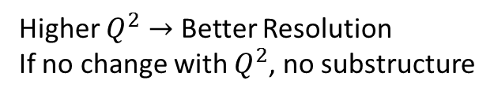
Structure Functions - Unpolarized
Higher $Q^{2}→$ Better Resolution
If no change with $Q^{2}$, no substructure
e
e
Structure functions describe deviations from point-like structure
  ${σ=σ}_{Mott}\left[\frac{2}{Mc^{2}}F_{1}\left(x,Q^{2}\right)\tan^{2}{\frac{θ}{2}}+\frac{1}{ν}F_{2} (x,Q^{2})\right]$
Gives insight to
proton substructure
3 Interacting Quarks
$$F_{2}$$
Sea
q
q
Valence
q
q
$$1$$
$$x$$
With Sea Quarks
$$1/3$$
q
F Halzen, A Martin, Quarks and Leptons (1984)
B Povh, et al, Particles and Nuclei, 6th ed. (2008)

Slide 28
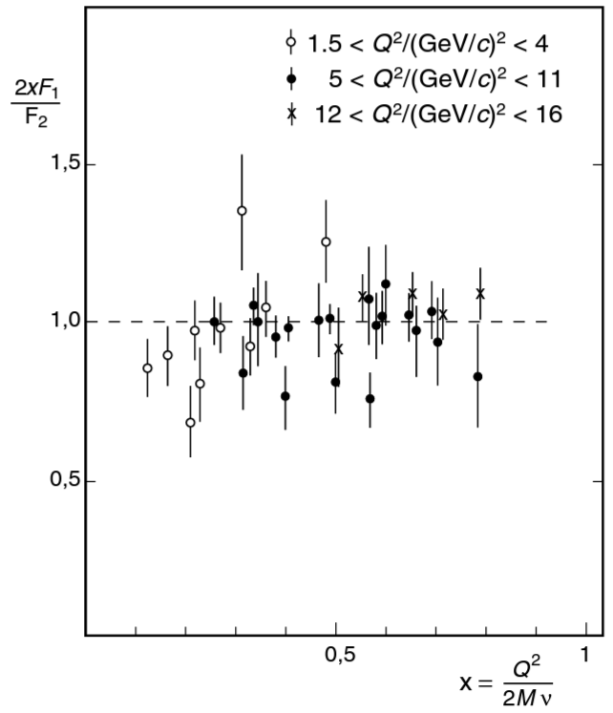
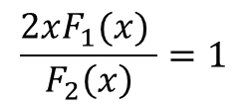
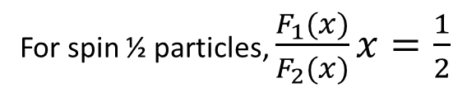
Structure Functions - Unpolarized
e
e
Structure functions describe deviations from point-like structure
  ${σ=σ}_{Mott}\left[\frac{2}{Mc^{2}}F_{1}\left(x,Q^{2}\right)\tan^{2}{\frac{θ}{2}}+\frac{1}{ν}F_{2} (x,Q^{2})\right]$
For spin ½ particles, $\frac{F_{1}(x)}{F_{2}(x)}x=\frac{1}{2}$
Derives from
magnetic interaction
B
$$\frac{2xF_{1}(x) }{F_{2}\left(x\right)}=1$$
m = +½
+
m = -½
B Povh, et al, Particles and Nuclei, 6th ed. (2008)

Slide 29
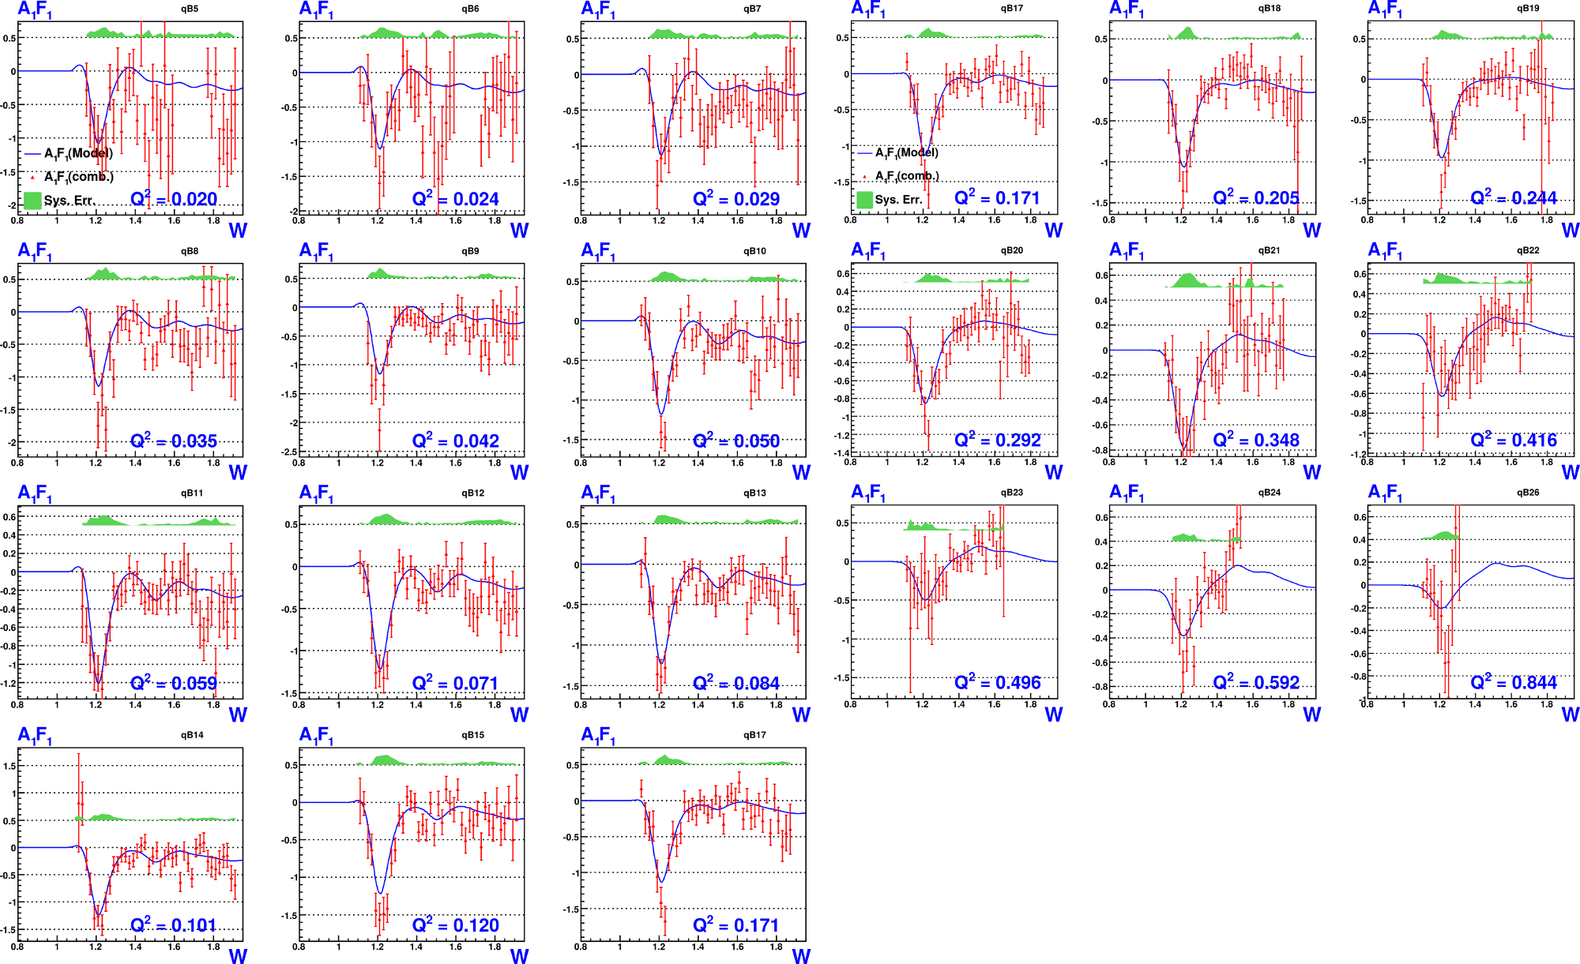
Structure Functions - Unpolarized
K. Adhikari, Ph.D. thesis, ODU
e
e
Preliminary
Deuteron Data

Slide 30
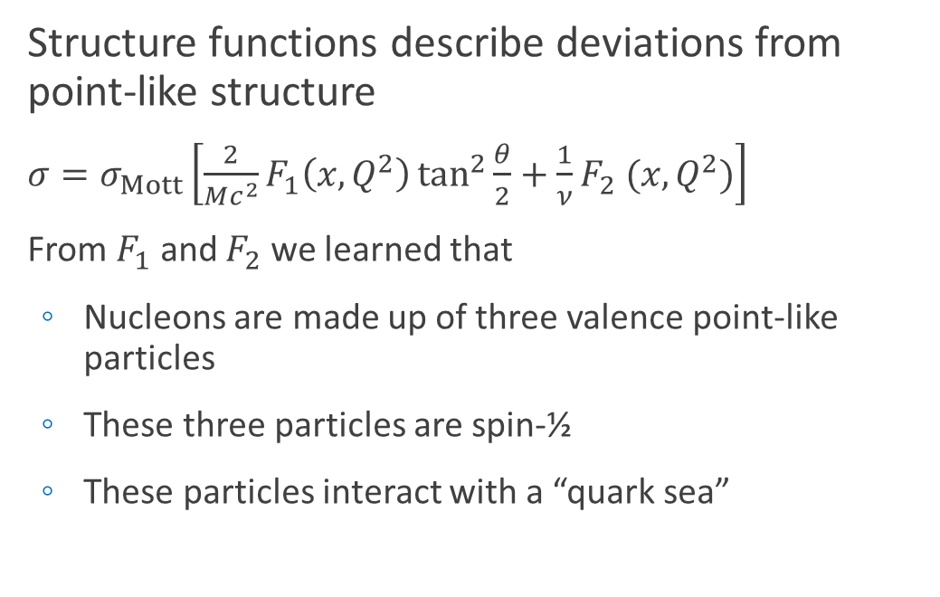
Structure Functions - Unpolarized
e
e
Structure functions describe deviations from point-like structure
  ${σ=σ}_{Mott}\left[\frac{2}{Mc^{2}}F_{1}\left(x,Q^{2}\right)\tan^{2}{\frac{θ}{2}}+\frac{1}{ν}F_{2} (x,Q^{2})\right]$
  From $F_{1}$ and $F_{2}$ we learned that
    Nucleons are made up of three valence point-like particles
    These three particles are spin-½
    These particles interact with a “quark sea”
+
*
+
+
+
+
+
+
+
+
* From $F_{1}$ and $F_{2}$, we know they’re in there, but not where they are

Slide 31

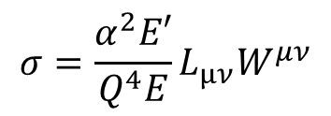

Structure Functions - Polarized
e
e
Structure functions describe deviations from point-like structure
  ${σ=σ}_{Mott}\left[\frac{2}{Mc^{2}}F_{1}\left(x,Q^{2}\right)\tan^{2}{\frac{θ}{2}}+\frac{1}{ν}F_{2} (x,Q^{2})\right]$
e'
e
γ∗
$${σ=\frac{α^{2}E′}{Q^{4}E}L}_{μν}W^{μν}$$
W
P
$$W^{μν}=−{αF}_{1}+{βF}_{2}$$
Scattering on Unpolarized Nucleons
$$+iγg_{1}+iδg_{2}$$
Scattering on Polarized Nucleons (spin up or down)

Slide 32
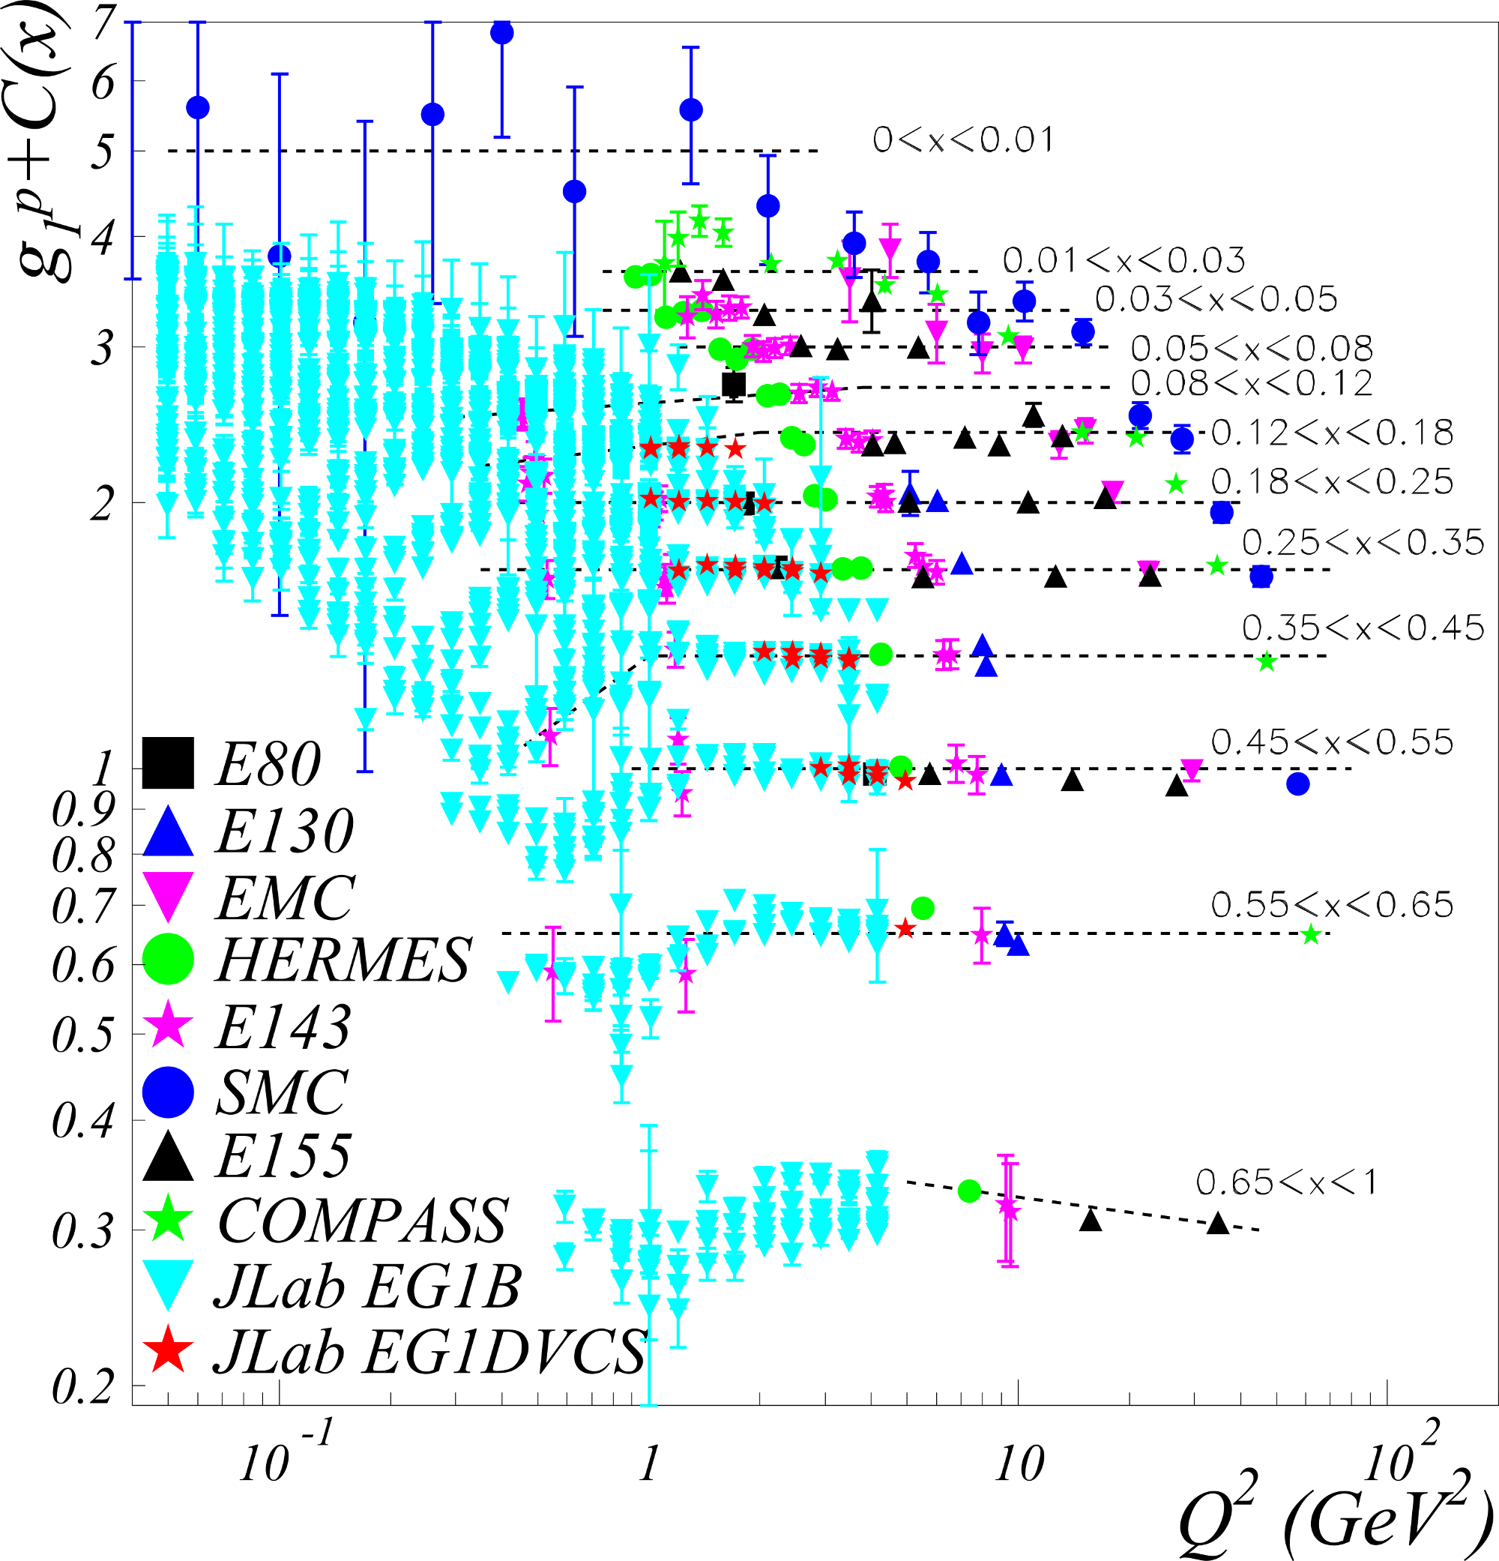


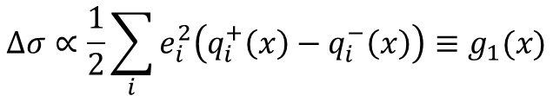

Structure Functions - Polarized
e
e
e'
Using a polarized target, we can gain access to more information
e
γ∗
Tells us where valence quarks
with a certain spin are located
W
P
$$Δσ= −$$
$$σ_{++}$$
$$σ_{+−}$$
$$Δσ∝\frac{1}{2}\sum_{i}{e_{i}^{2}\left(q_{i}^{+}\left(x\right)−q_{i}^{−}\left(x\right)\right)≡g_{1}(x)}$$

Slide 33
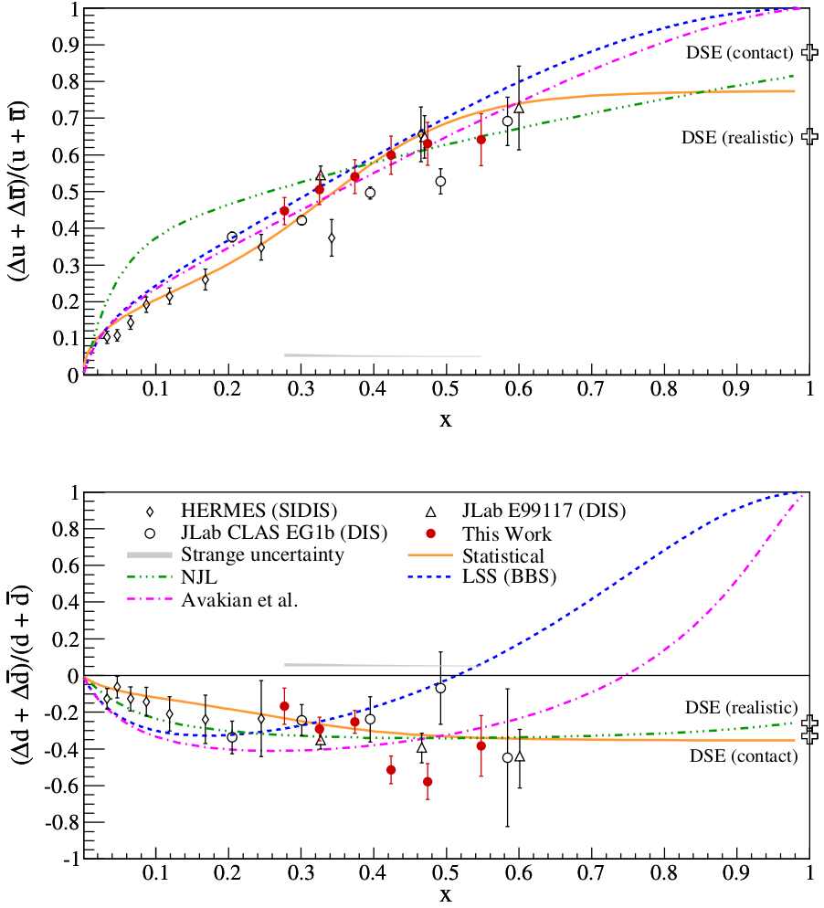
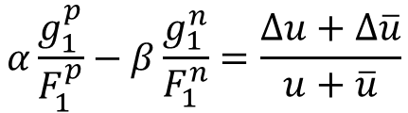

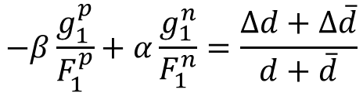
Structure Functions - Polarized
e
e
  Ratio of $\frac{g_{1}}{F_{1}}$ gives information on where valence quarks are
  Difference in proton (uud) and neutron (udd) can separate information of a particular flavor of quark
-
p
n
u
$$α\frac{g_{1}^{p}}{F_{1}^{p}}−β\frac{g_{1}^{n}}{F_{1}^{n}}=\frac{Δu+Δ\overline{u}}{u+\overline{u}}$$
-
n
p
d
$$−β\frac{g_{1}^{p}}{F_{1}^{p}}+α\frac{g_{1}^{n}}{F_{1}^{n}}=\frac{Δd+Δ\overline{d}}{d+\overline{d}}$$
D.S. Parno, et al, arXiv:1406.1207 (2014)

Slide 34
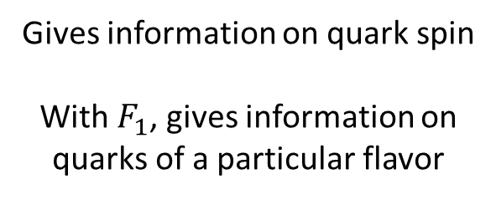
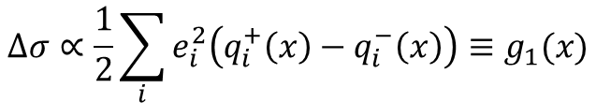
Structure Functions - Polarized
e
e
Using a polarized target, we can gain access to more information
*
+
+
+
Gives information on quark spin
With $F_{1}$, gives information on quarks of a particular flavor
+
+
+
+
+
$$Δσ∝\frac{1}{2}\sum_{i}{e_{i}^{2}\left(q_{i}^{+}\left(x\right)−q_{i}^{−}\left(x\right)\right)≡g_{1}(x)}$$
+
* Sum of valence quark spin ≠ nucleon spin

Slide 35
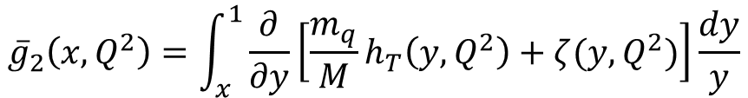

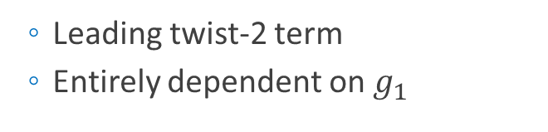
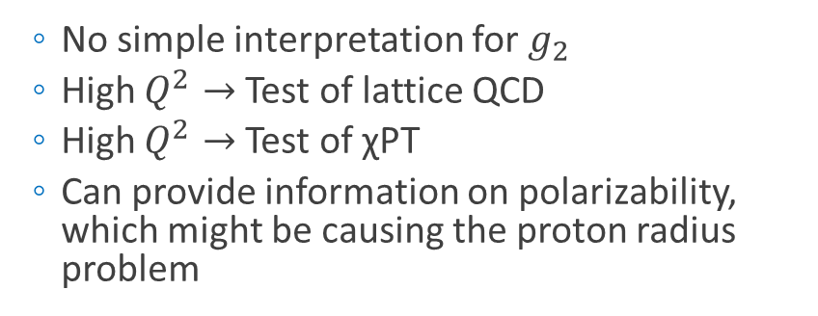
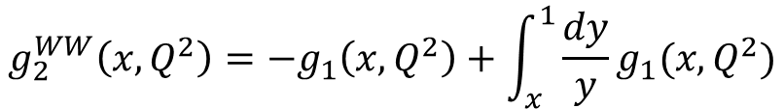


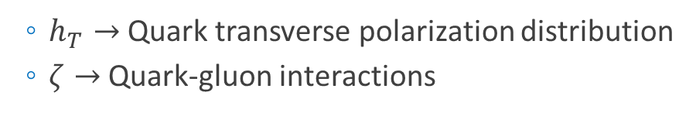
Structure Functions - Polarized
$$W^{μν}=−{αF}_{1}+{βF}_{2}$$
e
$$+iγg_{1}+iδg_{2}$$
e
  No simple interpretation for $g_{2}$
  High $Q^{2}→$ Test of lattice QCD
  High $Q^{2}→$ Test of χPT
  Can provide information on polarizability, which might be causing the proton radius problem
$$g_{2}\left(x,Q^{2}\right)=g_{2}^{WW}\left(x,Q^{2}\right)+{\overline{g}}_{2}(x,Q^{2})$$
$$g_{2}^{WW}\left(x,Q^{2}\right)=−g_{1}\left(x,Q^{2}\right)+\int_{x}^{1}{\frac{dy}{y}g_{1}(x,Q^{2})}$$
$${\overline{g}}_{2}\left(x,Q^{2}\right)=\int_{x}^{1}{\frac{∂}{∂y}\left[\frac{m_{q}}{M}h_{T}\left(y,Q^{2}\right)+ζ(y,Q^{2})\right]\frac{dy}{y}}$$
  Leading twist-2 term
  Entirely dependent on $g_{1}$
  $h_{T}→$ Quark transverse polarization distribution
  $ζ→$ Quark-gluon interactions

Slide 36


Structure Functions - Polarized
e
e
*
+
+
+
+
+
+
+
+
+
* Sum of valence quark spin ≠ nucleon spin

Slide 37
The Tensor Polarized Future of Nucleon Structure

Slide 38




Tensor Structure Functions
e
e
For tensor polarization, need spin-1 particles
Protons and neutrons are spin-½ particles, but a system of two gives a ½ + ½ = spin-1 system
We can tensor polarize deuterons, which are made up of one neutron and one proton
Spin-1
System
Spin-½
System
m = +1
m = +½
m = 0
m = -½
m = -1
Vector $P_{z}=p_{+}−p_{−}$
Tensor $P_{zz}={(p}_{+}+p_{−})−2p_{0}$
-
( + )-2

Slide 39









Dynamic Nuclear Polarization (DNP)
Tensor Structure Functions
e
e
  Start with simple case: Protons with spin-½
  Start with solid material (ammonia, LiD, butanol, plastic, etc.)
  Drop the temperature (1 K)
  Insert in large (5+ T) magnetic field
    Now you have polarized electrons!
  Flood with millimeter wave
  radiation to transfer polarization to
  protons
  Build-up proton polarization and measure with NMR!
Millimeter
Wave
Generator
Helium
Fridge
Superconducting
Magnet

Slide 40




Tensor Structure Functions
e
e
  Dynamic Nuclear Polarization of ND₃
  Goal: $P_{zz} \sim 30\%$
  5 Tesla at 1 K
  3cm Target Length
  $p_{f} \sim 0.65$
  $f_{dil} \sim 0.27$
“Brute Force” Tensor Polarization
( + )-2
-

Slide 41



Tensor Structure Functions
e
e
  Dynamic Nuclear Polarization of ND₃
  Goal: $P_{zz} \sim 30\%$
  5 Tesla at 1 K
  3cm Target Length
  $p_{f} \sim 0.65$
  $f_{dil} \sim 0.27$
“Hole Burning” Tensor Enhancement
32.4
32.5
32.6
32.7
32.8
32.9
MHz
$k∙$ mV
-0.4
-0.3
-0.2
-0.1
0.0
D Keller, HiX Workshop (2014)
UVA Tensor Enhancement on Butanol (2014)
$$υ_{D}−3υ_{D}$$
$$υ_{D}+3υ_{D}$$

Slide 42


Tensor Structure Functions
e
e
Structure functions describe deviations from point-like structure
  ${σ=σ}_{Mott}\left[\frac{2}{Mc^{2}}F_{1}\left(x,Q^{2}\right)\tan^{2}{\frac{θ}{2}}+\frac{1}{ν}F_{2} (x,Q^{2})\right]$
e'
e
γ∗
W
P
$$W_{μν}=−{αF}_{1}+{βF}_{2}$$
Scattering on Unpolarized Targets
$$+iγg_{1}+iδg_{2}$$
Scattering on Vector Polarized Targets (Up or Down)
$$−εb_{1}+ζb_{2}+ηb_{3}+κb_{4}$$
Scattering on Tensor-Polarized Targets ((Up and Down) or 0)

Slide 43


Tensor Structure Functions
e
e
$b_{1}→$ Leading twist
$b_{1}$ is the measure of quark distributions when the nucleus is in a particular spin state
Looks at nuclear effects at the resolution of quarks!
If there are no nuclear effects, then $b_{1}$ vanishes.
Even with D-state admixture, it’s expected to be vanishingly small
Deuteron
=
n
+
p
$$b_{1}=0$$
Khan & Hoodbhoy, PRC 44 1219 (1991)
Umnikov, Phys. Lett. B 391 177 (1997)

Slide 44




Tensor Structure Functions
e
e
All conventional models predict small or vanishing values of b₁ in contrast with the HERMES data
All conventional models predict small or vanishing values of b₁ in contrast with the HERMES data
Any measurement of a b₁<0 indicates exotic physics
A Airapetian, et al, PRL 95 242001 (2005)

Slide 45

Close-Kumano Sum Rule
Tensor Structure Functions
e
e
  $\int{b_{1}\left(x\right)dx=0}$
    Related to the electric quadrupole structure
    Fails in any model with an unpolarized sea
  $b_{1}=\frac{1}{36}δ_{T}w\left[5\left\{u_{v}+d_{v}\right\}\right]+4α_{\overline{q}}\left[2\overline{u}+2\overline{d}+s+\overline{s}\right]$
  Looked at difference between unpolarized ($α_{\overline{q}}=0$) and polarized ($α_{\overline{q}}≠0$) antiquarks in the sea
  Found $α_{\overline{q}}=3.20±0.212$ improved $χ^{2}$, indicating significant tensor polarization in antiquark distributions
Quarks
Sea Strange and Anti-Quarks
S Kumano, PRD 82 017501 (2010)

Slide 46



Close-Kumano Sum Rule
Tensor Structure Functions
e
e
$$χ^{2}/dof=1.57$$
$$χ^{2}/dof=2.83$$
S Kumano, PRD 82 017501 (2010)

Slide 47

6-Quark, Hidden Color
Tensor Structure Functions
e
e
  Deuteron wave function can be expressed as
    $\left.|6q\right\rangle =\sqrt{\frac{1}{9}}\left.|NN\right\rangle +\sqrt{\frac{4}{45}}\left.|∆∆\right\rangle +\sqrt{\frac{4}{5}}\left.|CC\right\rangle$
  Early hidden color calculations gave small results, but author noted “as experimental techniques have improved dramatically,
  the meaning of small has changed.”
  Even though experimental upper limit of $P_{6q}<1.5\%$, a much smaller value (0.15%) can have a significant effect on $b_{1}$
Proton-
Neutron
Higher Nuclear Effects
(Delta-Delta)
Hidden Color
Probability of Hidden-Color Effects
G Miller, PRC 89 045203 (2014)

Slide 48


6-Quark, Hidden Color
Tensor Structure Functions
e
e
  Pionic effects alone would violate Close-Kumano Sum Rule $\int{b_{1}\left(x\right)dx=0}$
G Miller, PRC 89 045203 (2014)

Slide 49


6-Quark, Hidden Color
Tensor Structure Functions
e
e
  6-quark, hidden color states predict large negative $b_{1}$ at large $x$
Blue = Central
Others = $±0.1R$
G Miller, PRC 89 045203 (2014)

Slide 50



6-Quark, Hidden Color
Tensor Structure Functions
e
e
  First theory to reproduce anomalous HERMES result
  $b_{1}^{π}+b_{1}^{6q}$predictions made for upcoming JLab $b_{1}$ measurement
G Miller, PRC 89 045203 (2014)

Slide 51


Tensor Structure Functions
e
e
Measured by ratio method
$$=−\frac{3}{2}F_{1}A_{zz}$$

Slide 52

Tensor Structure Functions
e
e
Using Hall C
SHMS
SHMS
Slow
Raster
Faraday
Cup
Lumi
Unpolarized
Beam
Fast
Raster
Polarized
Target
HMS
Detector
e'
e
γ∗
W

Slide 53

Tensor Structure Functions
e
e
All conventional models predict small or vanishing values of b₁ in contrast with the HERMES data
All conventional models predict small or vanishing values of b₁ in contrast with the HERMES data
Any measurement of a b₁<0 indicates exotic physics

Slide 54

Tensor Structure Functions – JLab
^{[1]} FE Close, S Kumano, Phys. Rev. D42, 2377 (1990)
^{[2]} G Miller, Phys. Rev. C89, 045203 (2014)
^{[3]} SK Taneja et al, Phys. Rev. D86, 036008 (2012)
^{[4]} S Kumano, Phys. Rev. D82, 017501 (2010)
e
e
Measuring $b_{1}$ will give insight into
  Exotic effects in tensor-polarized systems
  Close-Kumano Sum Rule ^{[1]}
  Hidden color from 6-quark configuration ^{[2]}
  OAM and spin crisis ^{[3]}
  Pionic effects ^{[2,4]}
  Polarization of the quark sea ^{[4]}
-
-
+
+
+
+
+
+
-
-
+
+
+
+
+
+
Approved JLab Experiment E12-13-011
Spokespersons: K. Slifer, E. Long, D. Keller, P. Solvignon, J.P. Chen, O.R. Aramayo, N. Kalantarians
-
+

Slide 55





Quasi-Elastic Tensor Structure
e
e
Repeat same experiment, only look at $A_{zz}$ in the quasi-elastic region
Can give insight to short range deuteron structure
Total
S-state
AV18
Light
Cone
AV18
  $$A_{zz}∝\frac{\frac{1}{2}D^{2}−SD}{S^{2}+D^{2}}$$
Virtual
Nucleon
D-state
cdBonn
cdBonn
M Sargsian, M Strikman, J. Phys.: Conf. Ser. 543, 012099 (2014)
$$x$$
L. Frankfurt, M. Strikman, Phys. Rept. 160 235 (1988)

Slide 56




Quasi-Elastic Tensor Structure
e
e
Repeat same experiment, only look at $A_{zz}$ in the quasi-elastic region
Can give insight to short range correlations
K. S. Egiyan et al., Phys. Rev. Lett. 96, 082501 (2006)
R. Subedi et al., Science 320, 1476 (2008)

Slide 57

Quasi-Elastic Tensor Structure
^{[1]} E. Long, et al, JLab LOI12-14-002
^{[2]} Sargsian, Strikman, J. Phys.: Conf. Ser. 543, 012099 (2014)
^{[4]} L Frankfurt, M Strikman, Phys. Rept. 160, 235
^{[5]} W Cosyn, M Sargsian, arXiv:1407.1653
^{[3]} J Arrington et al, Prog. Part. Nucl. Phys. 67, 898 (2012)
e
e
SRCs & pn dominance^{[3]}
Differentiate light cone and VN models^{[1,2]}
Better understanding of S/D^{[4]}
Final state interaction models^{[5]}
JLab LOI12-14-002 Encouraged for full proposal
-
-
+
+
+
+
+
-
-
+
+
+
+
+
+
+
-
+

Slide 58
Quasi-Elastic Tensor Structure
e
e
Encouraged for full submission by PAC42
“The measurement proposed here arises from a well-developed context, presents a clear objective, and enjoys strong theory support. It would further explore the nature of short-range pn correlations in nuclei, the discovery of which has been one of the most important results of the JLab 6 GeV nuclear program.”
-JLab PAC42 Theory Advisory Committee
E. Long, et al, JLab LOI12-14-002
Sargsian, Strikman, J. Phys.: Conf. Ser. 543, 012099 (2014)

Slide 59
Summary
Understanding The Nature of Normal Matter
  A Sense of Scale
  Electromagnetic Form
  Factors
  Unpolarized Structure
  Functions
  Polarized Structure Functions
  Tensor Polarized Structure Functions
  Quasi-Elastic Tensor Structure/Short Range Correlations
+
-
+
-
+
+
+
+
+
+
+
-
-
+
+
+
+
-
+
+
+
+
+
+
+
+
+
+
+
+
+
+
+
-
+
-
+
+
+
+
+
+
+
-
+
-
+
+
+
+
+
-
-
+
+
-
+
+
+
+
-
-
+
+
+
+
+
-
+
+
+

Slide 60
Thank you

