Slide 1
Probing Short Range Structure Through the Tensor Asymmetry $A_{zz}$ (T$A_{zz}$) at x>1
Elena Long
Joint Hall A/C Collaboration Meeting
Jefferson Lab
June 6th, 2014

Slide 2
Today’s Discussion
Overview of Physics Motivation
Letter of Intent Measurement
Challenges
Opportunities
Summary

Slide 3
Physics Overview

Slide 4
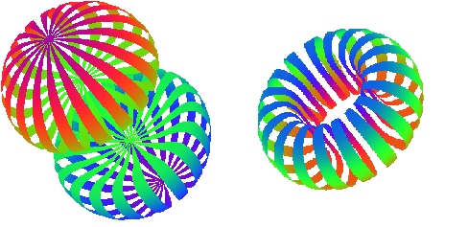
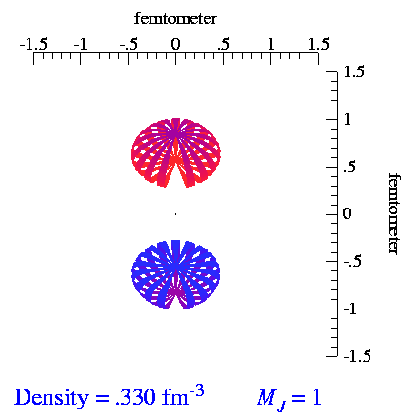
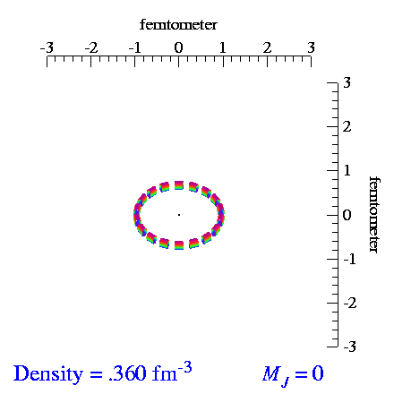
Tensor Polarization
For tensor polarization, need spin-1 particles
Spin-1
System
Spin-½
System
m = +1
m = +½
m = 0
Tensor polarization fills
the m = 0 state
m = -½
m = -1
Animations by S.C. Pieper, et al, http://www.phy.anl.gov/theory/movie-run.html
J. Forest, et al, Phys. Rev. C 54, 646 (1996)

Slide 5
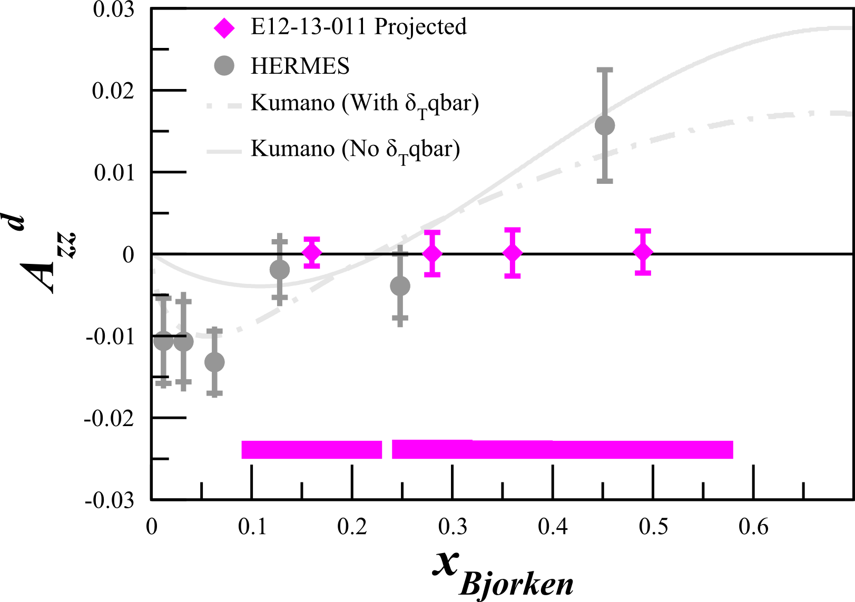
Tensor Asymmetry $A_{zz}$
In DIS, same asymmetry used to extract $b_{1}$
$$σ_{D}=σ_{D}^{u}\left[1−P_{z}P_{B}A_{∥}+\frac{1}{2}P_{zz}A_{zz}\right]$$
0 for unpolarized beam
$$σ_{D}=σ_{D}^{u}\left[1+\frac{1}{2}P_{zz}A_{zz}\right]$$
$$A_{zz}=\frac{2}{P_{zz}}\left[\frac{σ_{D}}{σ_{D}^{u}}−1\right]$$
In elastic, $A_{zz}∝T_{20}$
$$A_{zz}=\frac{2}{{f_{dil}P}_{zz}}\left[\frac{N_{pol}}{N_{unpol}}−1\right]$$
In quasi-elastic, no current or planned $A_{zz}$ measurements before LOI submitted to PAC42

Slide 6
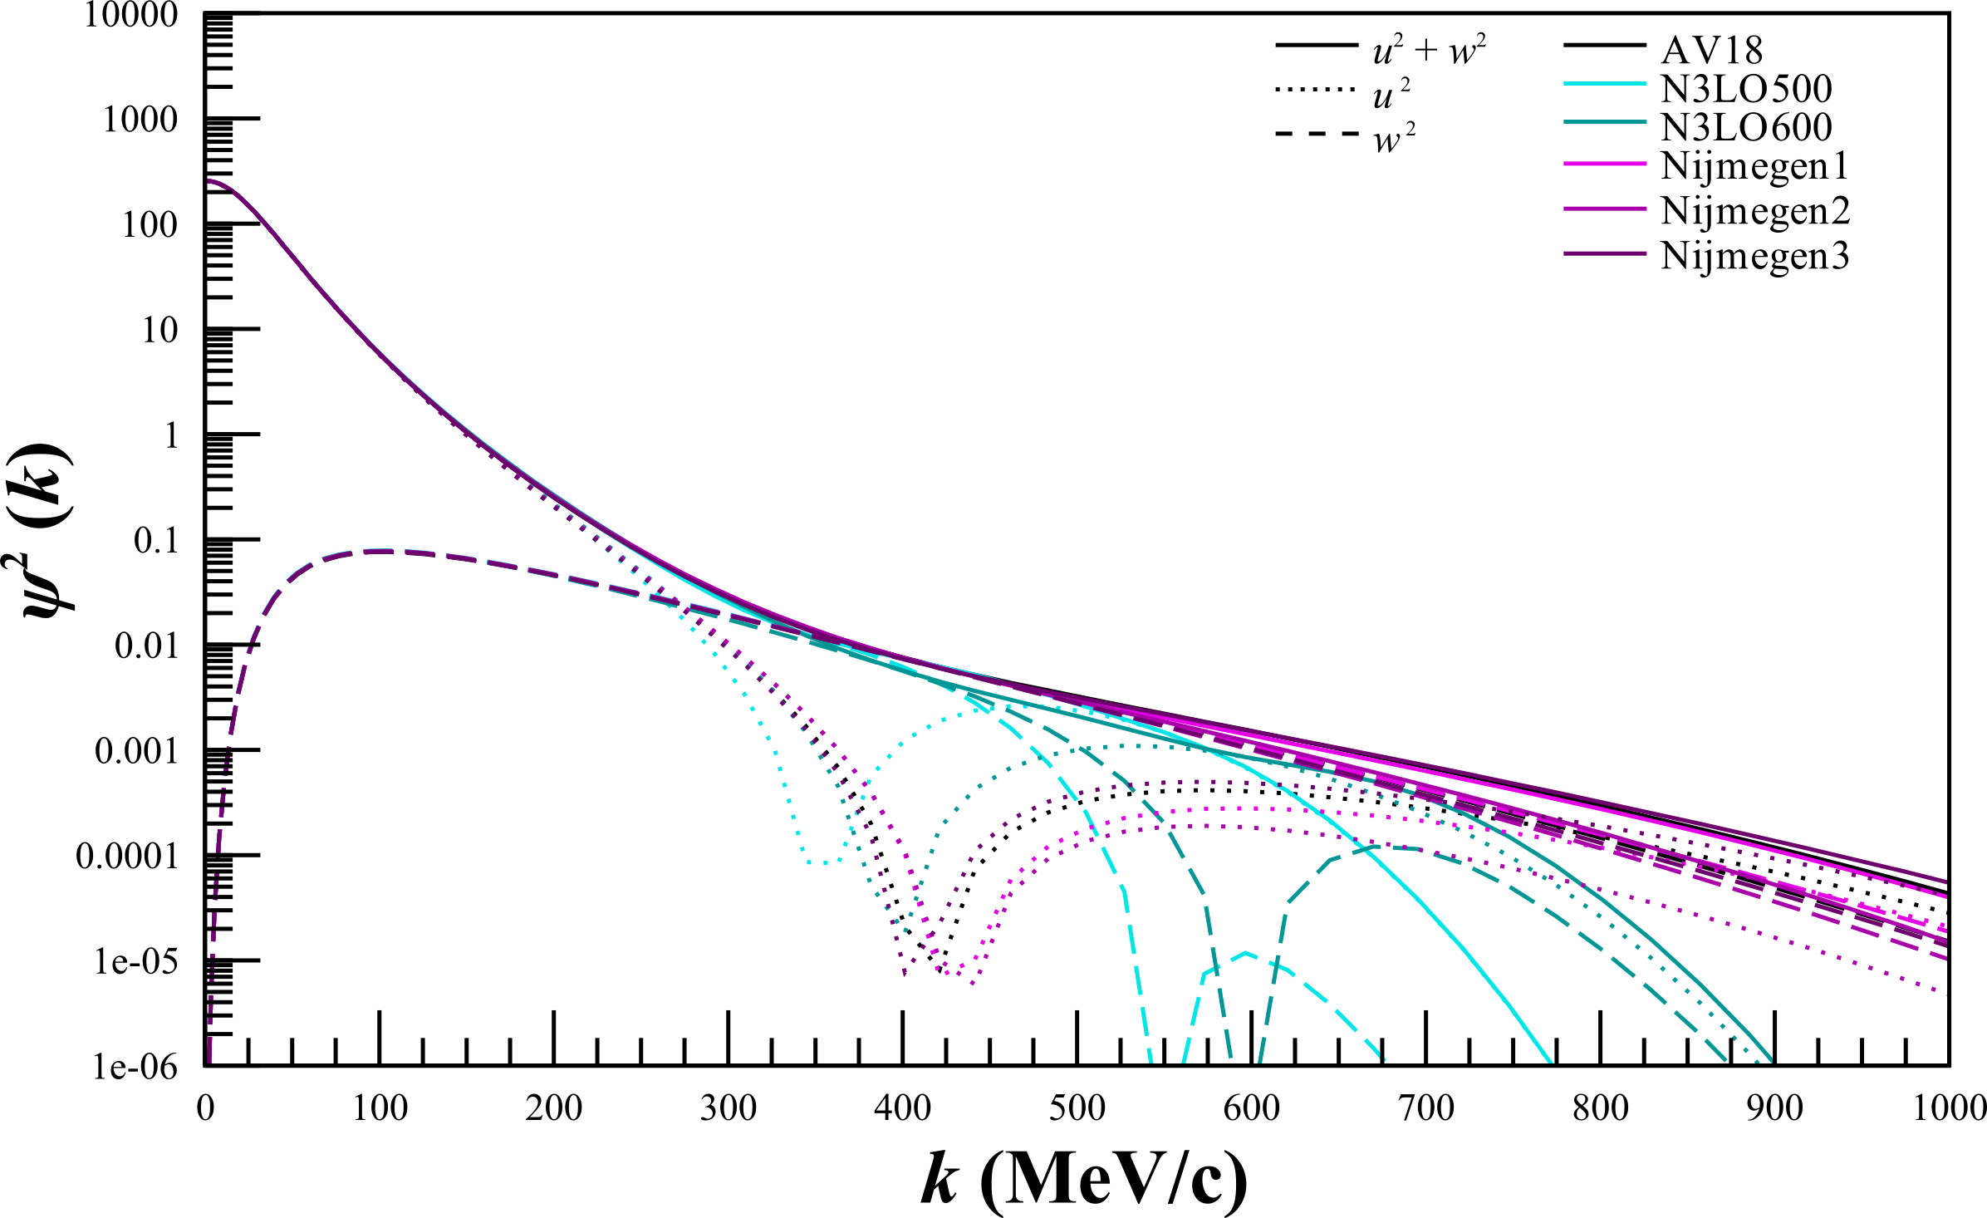
Deuteron Wave Function
D-state dominance an on-going issue in understanding the deuteron wave function
In the high-momentum region ($k>300 MeV$), tensor correlations dominate
Size of D-state dominance differs between on NN potentials

Slide 7
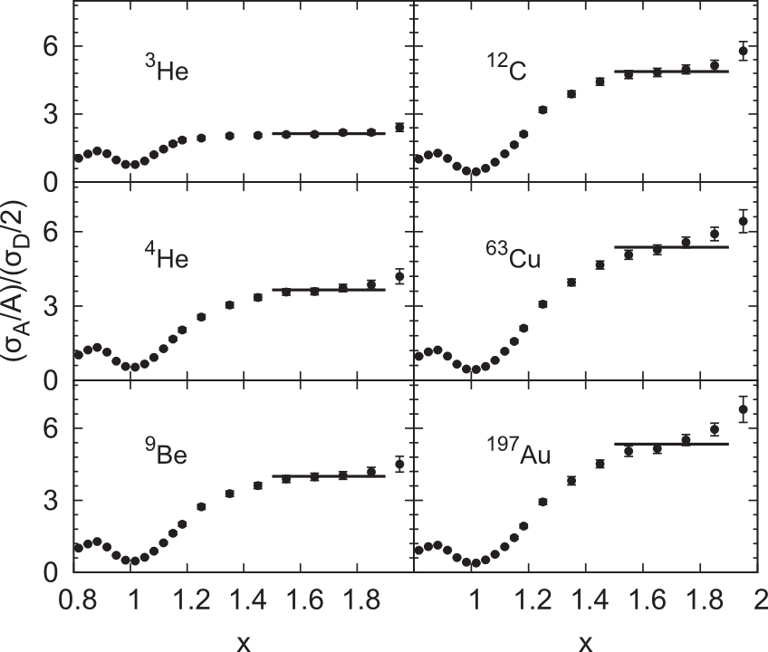
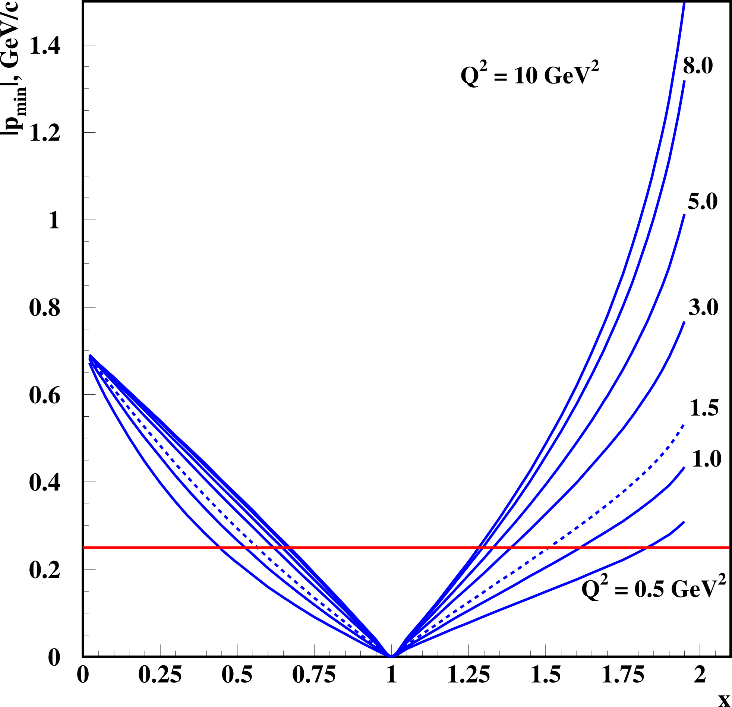
Connection to Short Range Correlations
Short range correlations caused by tensor force – why not probe it through tensor polarization?
N. Fomin et al., Phys. Rev. Lett. 108 (2012) 092505
L.L. Frankfurt et al., Int. J. Mod. Phys. A23 (2008) 2991-3055

Slide 8
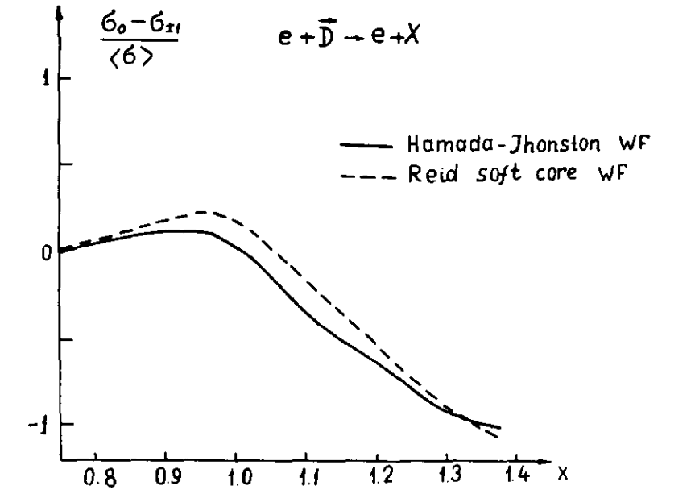
Frankfurt and Strikman Light Cone Calculations
$A_{zz}=\left(3\frac{\frac{1}{2}k_{⊥}^{2}−k_{z}^{2}}{k^{2}}\right)\frac{\frac{1}{2}w^{2}\left(k\right)−u\left(k\right)w(k)\sqrt{2}}{u^{2}\left(k\right)+w^{2}(k)}$
$u(k)$ is the momentum-dependent S state
$w(k)$ is the momentum-dependent D state
Recent preliminary study indicates dependence on choice of NN potential
M. Strikman and S. Liuti involved in further investigation
L.L. Frankfurt, M.I. Strikman, Phys. Rept. 76 (1981) 215

Slide 9
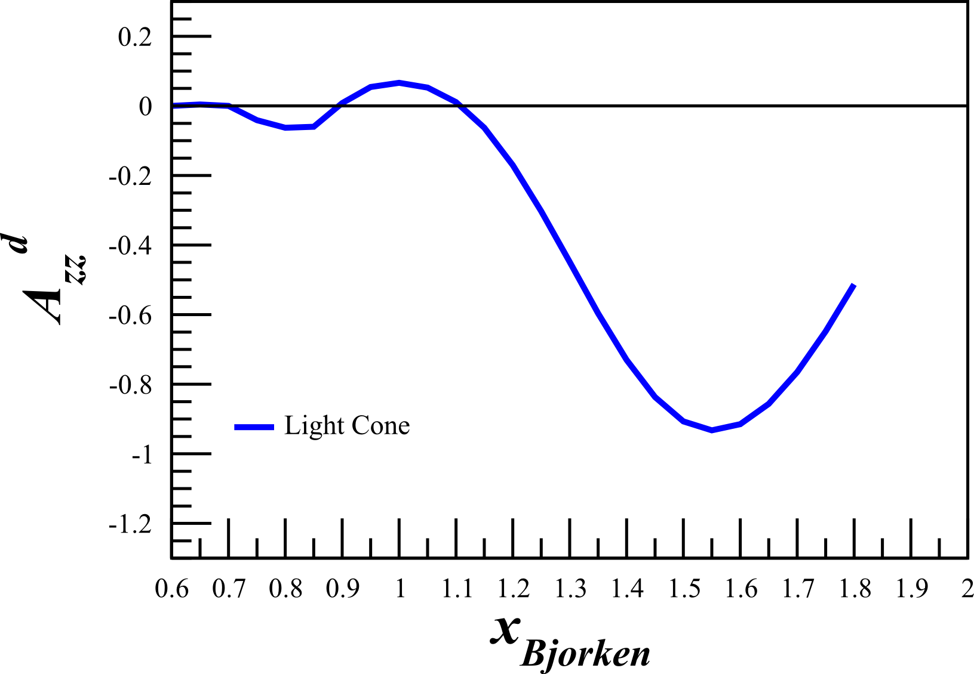
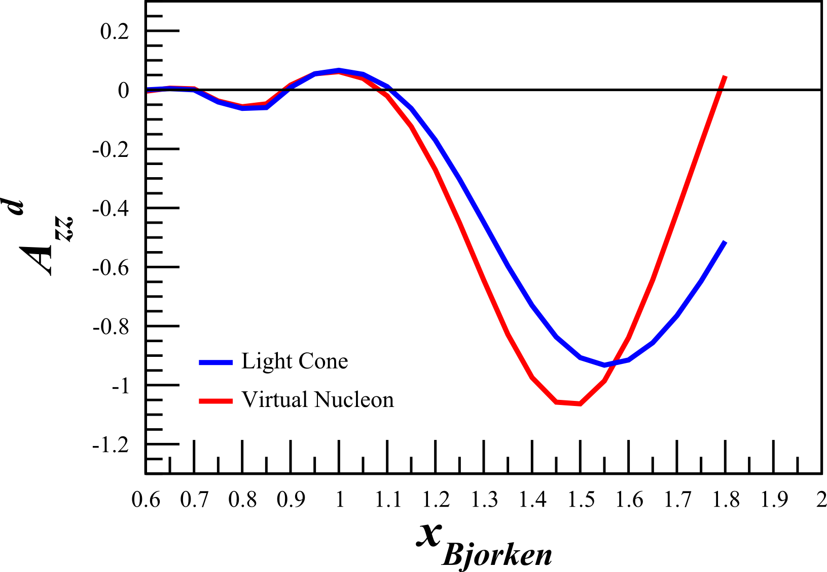
Sargsian Light Cone and Virtual Nucleon Calculations
At large $Q^{2}>1 {GeV}^{2}$, $A_{zz}$ can probe relativistic effects in the deuteron
$A_{zz}$ calculated using two very different methods
Light Cone
Calculations along the light-cone front
Similar to Frankfurt and Strikman
Virtual Nucleon
Coordinates in the lab frame
Treats the interacting nucleon as virtual
Satisfies covariant equation of NN system with spectator being on-shell
M. Sargsian, Private Communication

Slide 10
Interest from Theorists
M. Strikman and M. Sargsian have already been involved in providing $A_{zz}$ calculations
“This is an important measurement. Accessing the large x region will provide insights on the partonic structure of the D-wave dominated deuteron tensor structure function, $b_{1}$. This process should be calculated more thoroughly.” – S. Liuti
“This measurement was a highlighted need early at Jlab. A new measurement at higher $Q^{2}$ would be very interesting. In principle such could test my model. I could calculate the influence of my 6-quark configurations on elastic scattering.” – G. Miller
“I hope to do some calculations soon and could easily do them for the kinematics in your proposal.” – W. Cosyn
W. Van Orden has agreed to look into tensor polarization observables at low $Q^{2}$ using a variety of NN potentials

Slide 11
Spokespeople:
E. Long, K. Slifer, P. Solvignon
University of New Hampshire
D. Day, D. Keller
University of Virginia
D. Higinbotham
Jefferson Lab

Slide 12
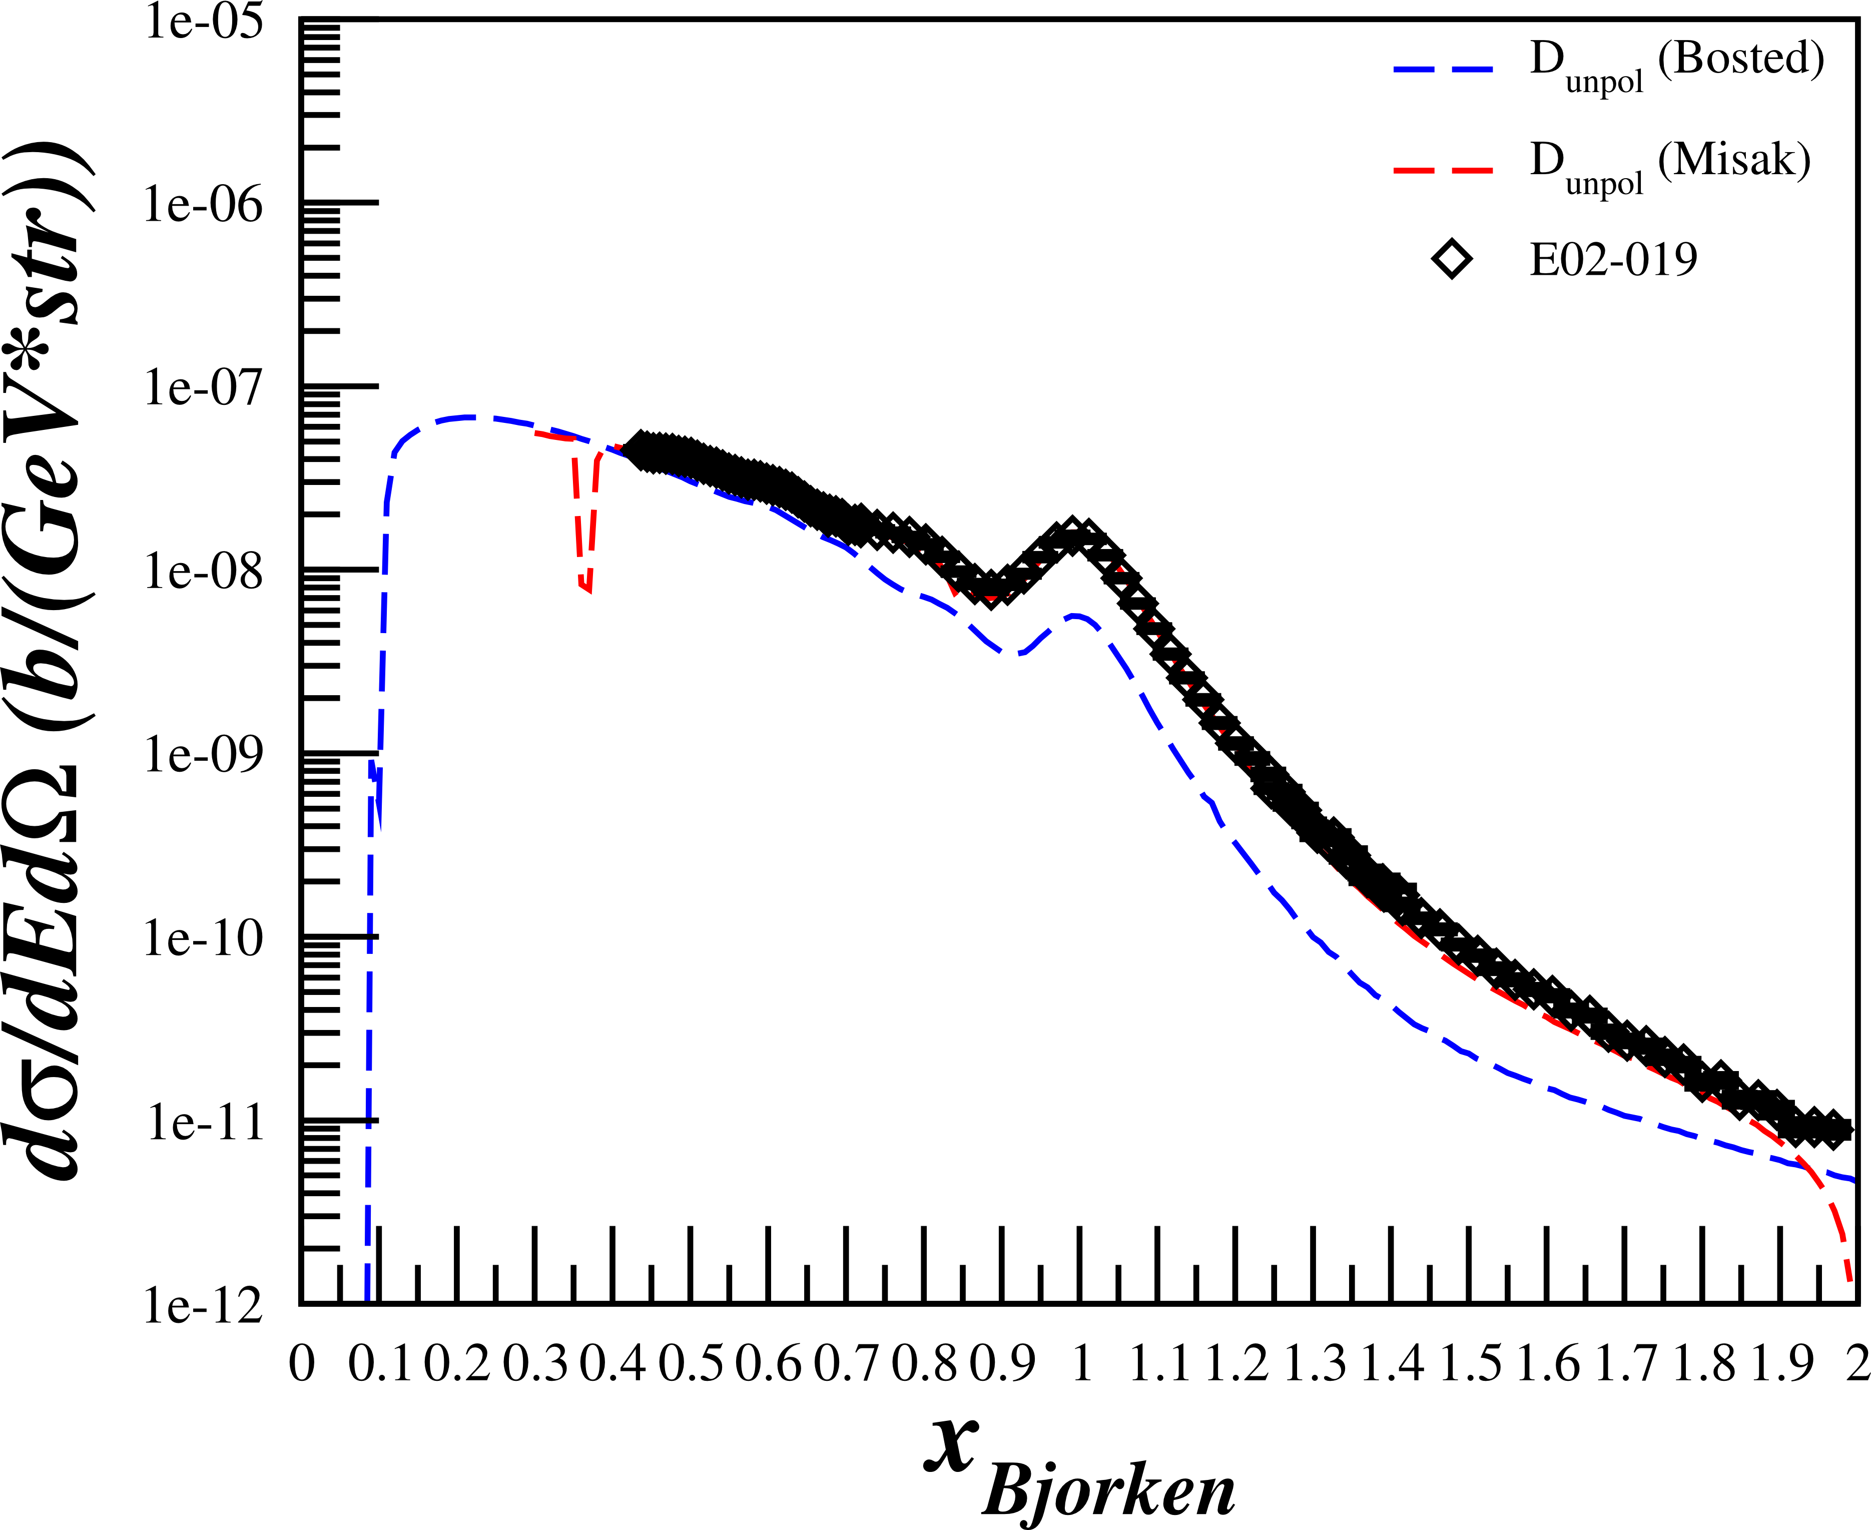
Rates for D(e,e’)X
Assumptions:
$$P_{zz}=30\%$$
$$p_{f}=65\%$$
$$z_{tgt}=3 cm$$
P.E. Bosted, V. Mamyan, arXiv:1203.2262
M. Sargsian, Private Communication
N. Fomin, et al., Phys. Rev. Lett. 108 (2012) 092502
N. Fomin, et al., Phys. Rev. Lett. 105 (2010) 212502
$R_{Pol}=𝒜\left[ℒ_{He}σ_{He}^{u}+ℒ_{N}σ_{N}^{u}+ℒ_{D}σ_{D}^{u}\left(1+\frac{1}{2}P_{zz}A_{zz}\right)\right]$
$R_{Unpol}=𝒜\left[ℒ_{He}σ_{He}^{u}+ℒ_{N}σ_{N}^{u}+ℒ_{D}σ_{D}^{u}\right]$
$N=Rt$
$A_{zz}=\frac{2}{f_{dil}P_{zz}}\left(\frac{N_{Pol}}{N_{Unpol}}−1\right)$
$δA_{zz}^{stat}=\frac{2}{f_{dil}P_{zz}}\sqrt{{\left(\frac{1}{N_{Unpol}}\sqrt{N_{Pol}}\right)}^{2}+{\left(\frac{N_{Pol}}{N_{Unpol}^{2}}\sqrt{N_{Unpol}}\right)}^{2}}$
Used combination of P. Bosted and M. Sargsian code to calculate unpolarized cross sections
Compared with data similar to Azz range
$E_{0}=5.766 GeV$
$E′=4.8 GeV$
$θ_{e′}={18.0}^{∘}$
E. Long, Technical Note, JLAB-TN-13-029

Slide 13
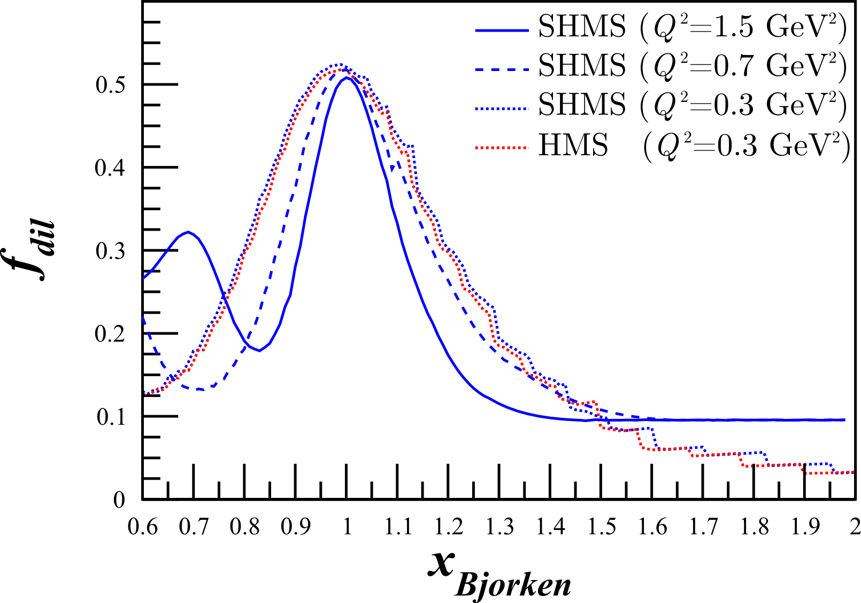
Dilution Factor
“…the background from interaction with nuclei increases as $α(x)$ increases. For example, for a D¹²C target the ratio of the cross sections $σ_{A}$ for A=¹²C and A=D is of the order of 40 for $x\sim 1.3$ and increases with $x$.” - L.L. Frankfurt, M.I. Strikman, Phys. Rept. 160 (1988) 235
$f_{dil}=\frac{ℒ_{D}σ_{D}}{ℒ_{N}σ_{N}+ℒ_{He}σ_{He}+ℒ_{D}σ_{D}+\sum{ℒ_{A}σ_{A}}}$
With the 12 GeV upgrade and the new SHMS, this measurement becomes possible even with the low dilution factor at high $x$

Slide 14
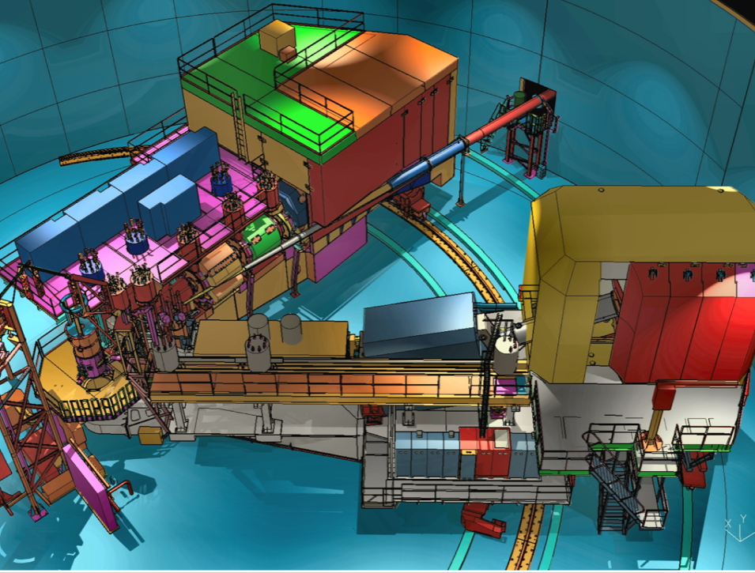
Experimental Set-Up
Hall C
Identical equipment as $b_{1}$ (E12-13-011)
SHMS
SHMS
Slow
Raster
Faraday Cup
Lumi
Unpolarized
Beam
Fast
Raster
Polarized
Target
HMS

Slide 15
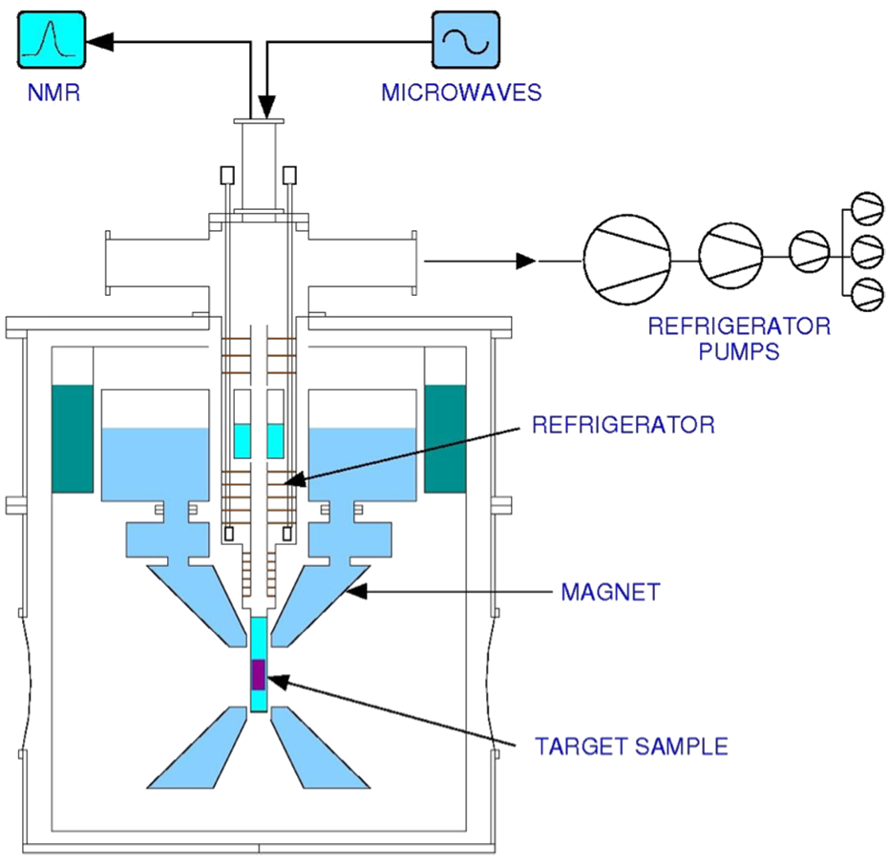
DNP Target
Identical target as $b_{1}$ (E12-13-011)
JLab/UVa DNP target using modified Hall B magnet
Dynamic Nuclear Polarization of ND₃
$P_{zz} \sim 30\%$
5 Tesla at 1 K
3cm Target Length
$p_{f} \sim 0.65$
Figure courtesy of C. Keith

Slide 16
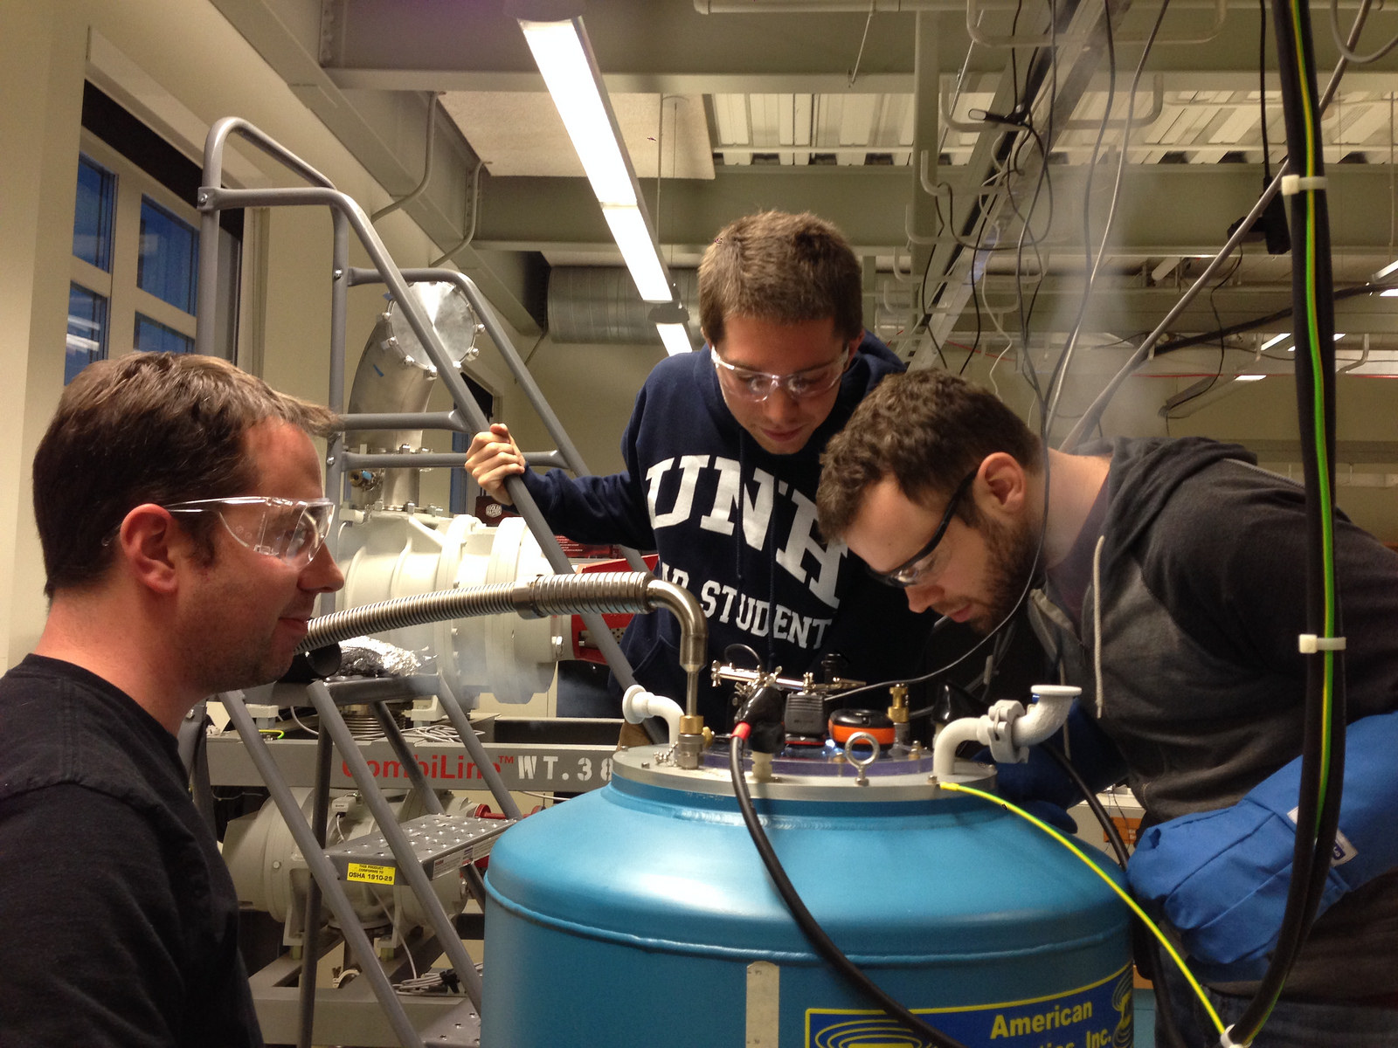
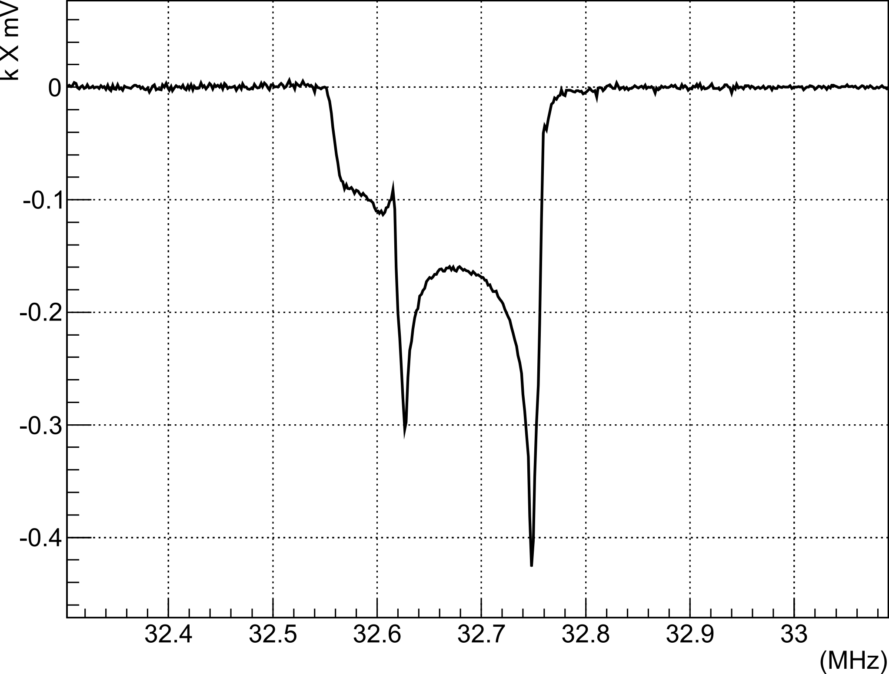
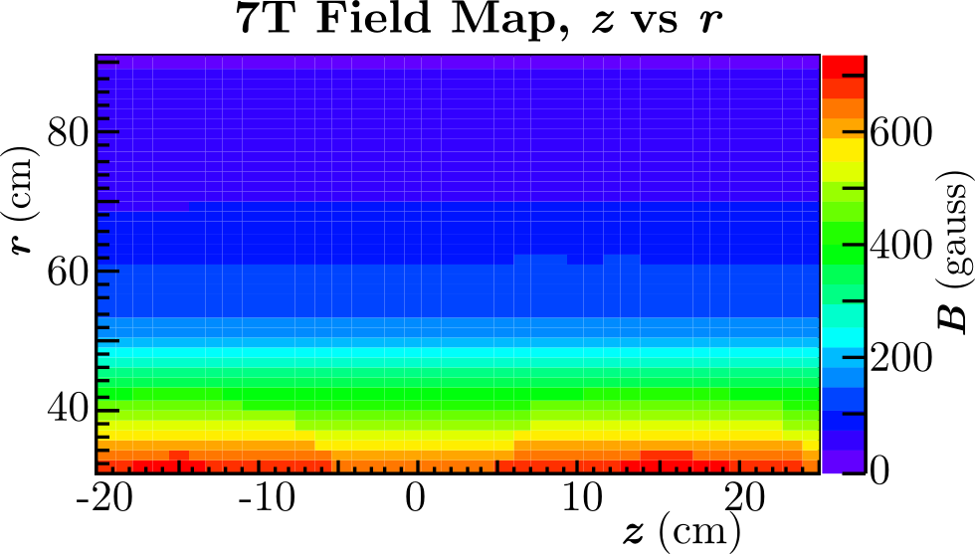
Target Development in Progress
UVa Target Lab has successfully polarized deuterated butanol in April
UNH Target Lab is ramping up, first cool-down in January, successfully reached 7T
Courtesy of D. Keller

Slide 17
Experimental Details
D(e,e’)X with 90nA beam current
Same equipment as C1-approved $b_{1}$ (E12-13-011) experiment

Slide 18
Kinematics

Slide 19
Systematics Estimate

Slide 20
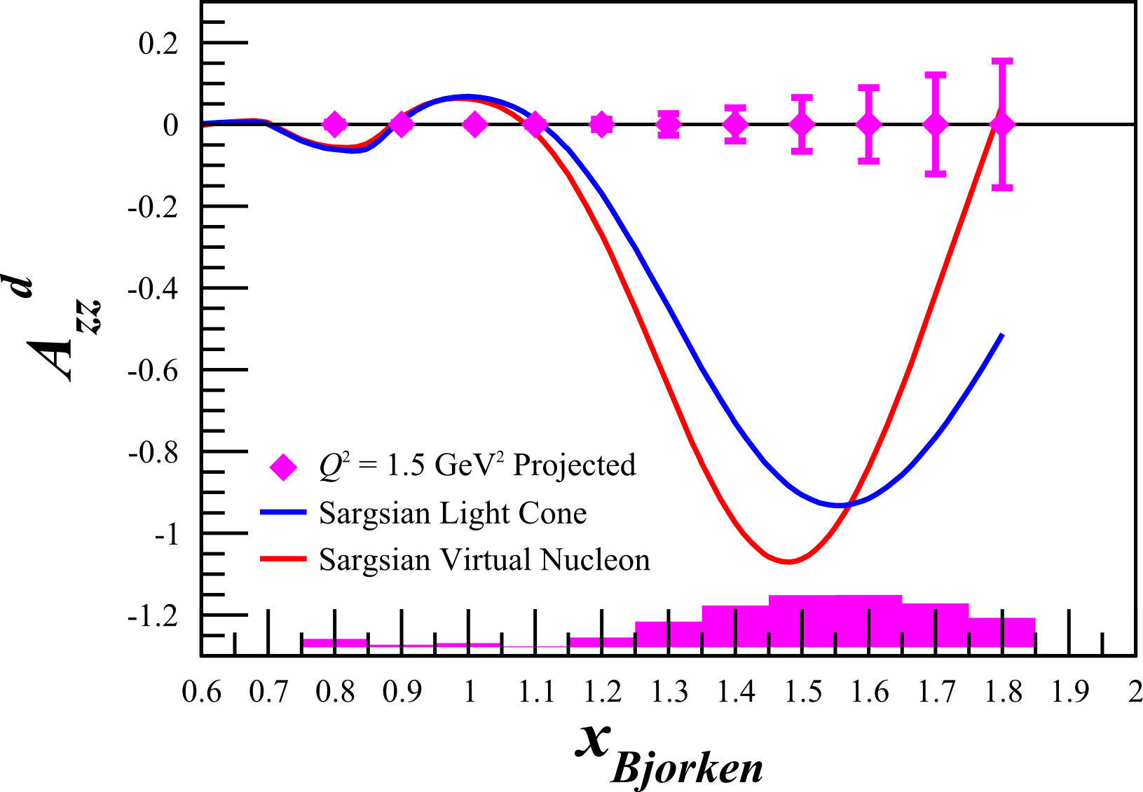
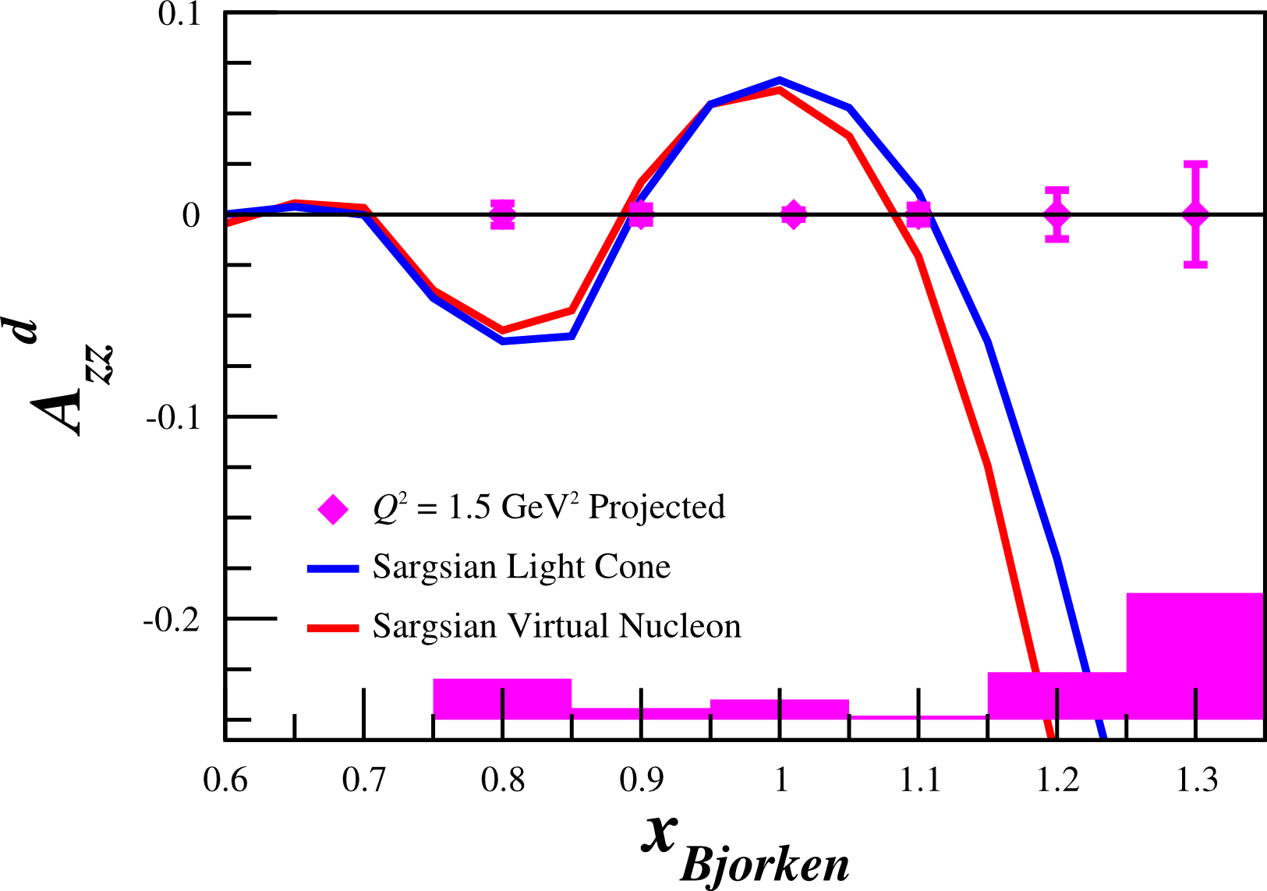
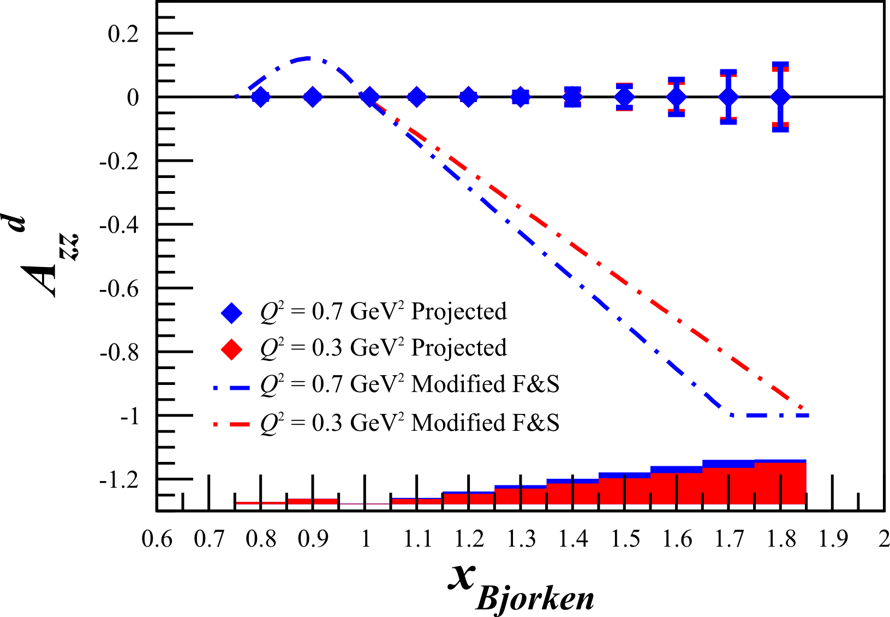
Potential First Quasi-Elastic $A_{zz}$ Measurements

Slide 21
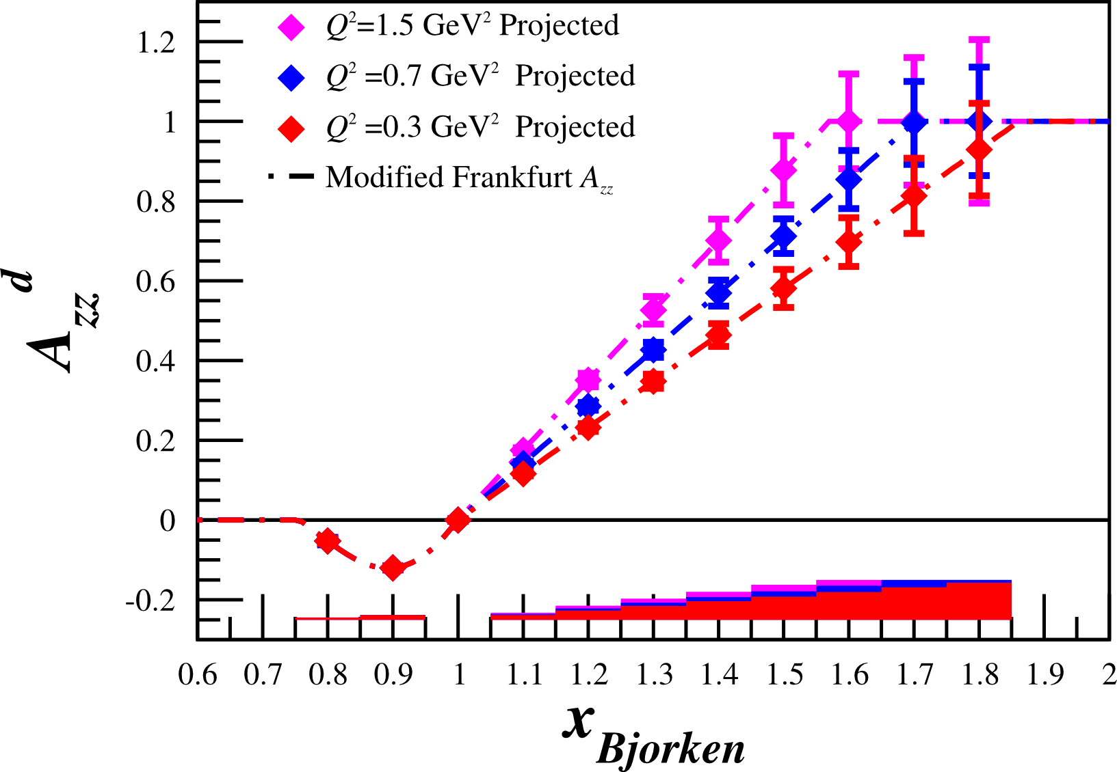
Challenges
Large dilution
D(e,e’p) reduces the dilution factor, but also reduces the acceptance
Tensor polarization of 30% not yet achieved, but development is in progress
Can run at lower tensor polarization ($P_{zz}≥20\%$), but statistics are reduced
Needs further theoretical development to fully utilize the measurements

Slide 22
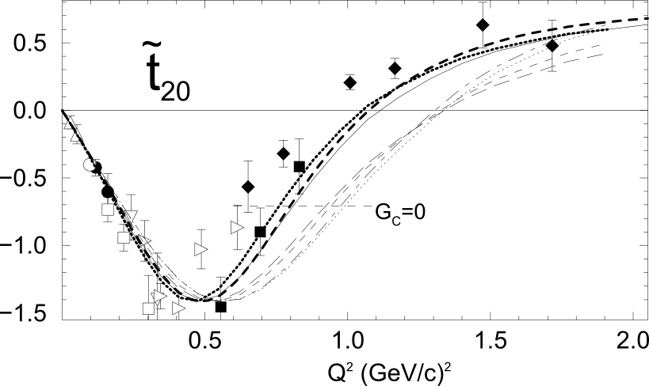
Opportunities
Very large asymmetry
Identical equipment as $b_{1}$
Less dependent on systematics than $b_{1}$
Potential to be used as commissioning to get a better handle on the $b_{1}$ systematics
Direct access to the tensor component of the deuteron, which is necessary to understand SRC
Potential for parasitic $t_{20}$ measurement (needs development)

Slide 23
Tensor Asymmetry $A_{zz}$ (T$A_{zz}$)
Direct access to the tensor contributions to deuteron WF
Probes deuteron relativistic effects, NN potentials, tensor contributions
Potentially probes 6-quark configurations, $t_{20}$(needs development)
Fills gap of tensor polarized scattering measurements
Identical equipment as $b_{1}$
30 PAC days measurement
Open for collaboration

Slide 24
Thank you

Slide 26
Backup Slides

Slide 27
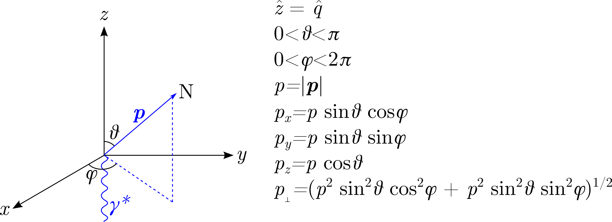
Light Cone Kinematics
$k_{⊥}=p_{⊥}$
$k^{2}=\frac{m_{N}^{2}+p_{⊥}^{2}}{α(2−α)}−m_{N}^{2}$
$k_{3}=\sqrt{k^{2}−k_{⊥}^{2}}$
$α=2−\frac{ν−\sqrt{Q^{2}+\frac{Q^{4}}{2m_{N}x}+}{2m}_{N}}{{2m}_{N}}\left(1+\frac{\sqrt{W^{2}−4m_{N}^{3}}}{W}\right)$

Slide 28
Lower Tensor Polarization
Pzz = 30%

Slide 29
Lower Tensor Polarization
Pzz = 25%

Slide 30
Lower Tensor Polarization
Pzz = 20%

Slide 31
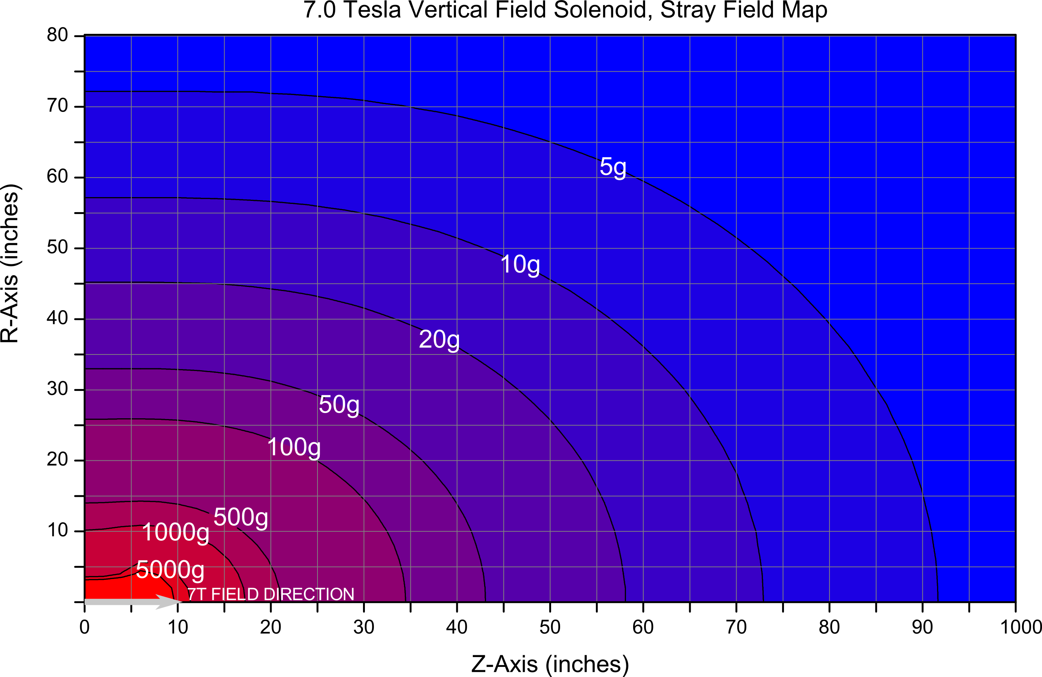
UNH Magnetic Field Map

Slide 32
UNH Magnetic Field Map

Slide 33
UNH Magnetic Field Map

Slide 34
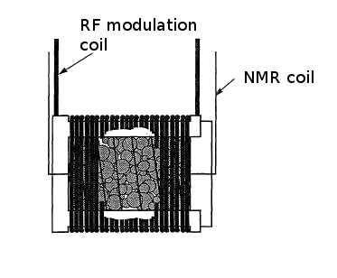
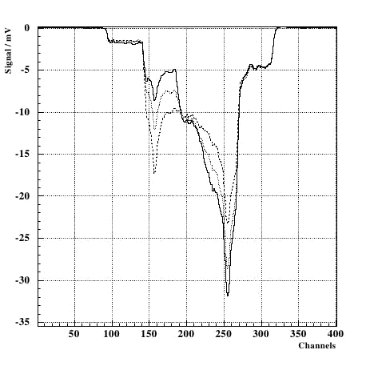
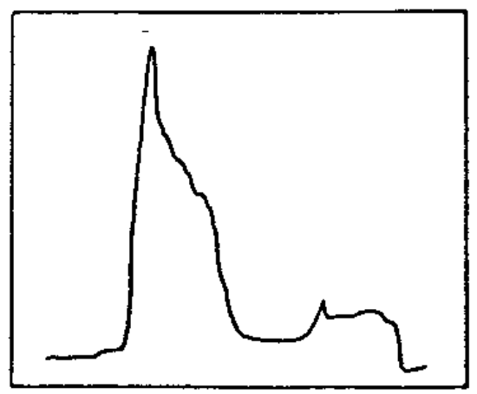
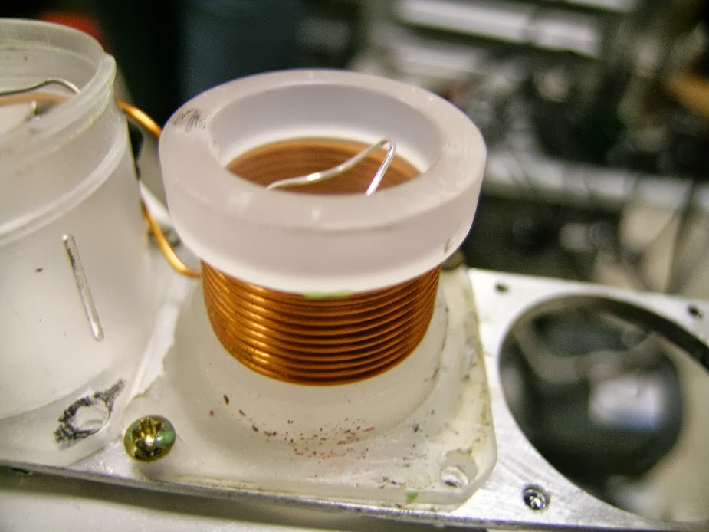
Tensor Polarization Optimization
Born: 20% at 2.5T
UVA: 30% at 5.0T

Slide 35
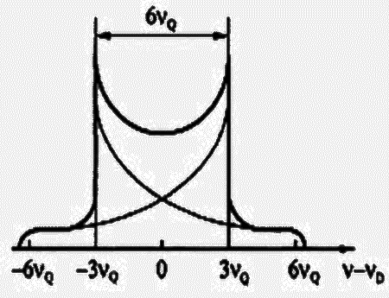
Tensor Polarization Measurement
Vector optimize with microwaves
Fit peaks with convolution
Tensor optimize with RF
Measure change in peaks using Riemann Sum segments
Ratio of instantaneous to initial NMR signal area
Percentage of initial peak shifted any time (from reduced side)
Available tensor enhancement

Slide 36
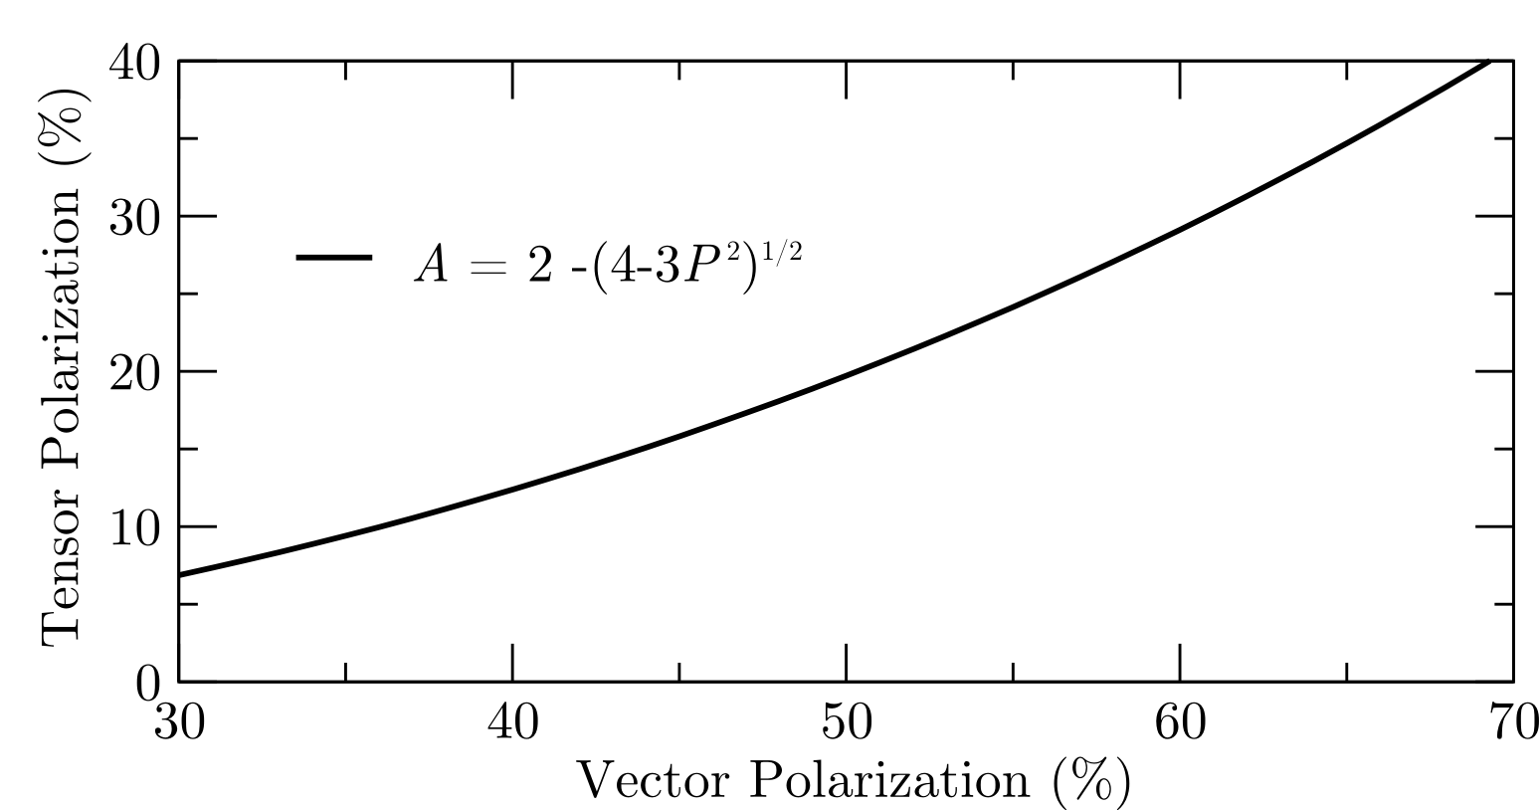
Brute Force Tensor Polarization
When vector polarizing deuterium, some amount of tensor polarization occurs
Higher vector polarization → Higher tensor polarization

Slide 37
Cross Section Calculations - Deuterium
Compared with data similar to Azz range
$E_{0}=5.766 GeV$
$E′=4.8 GeV$
$θ_{e′}={18.0}^{∘}$
N. Fomin, et al., Phys. Rev. Lett. 108 (2012) 092502
N. Fomin, et al., Phys. Rev. Lett. 105 (2010) 212502

Slide 38
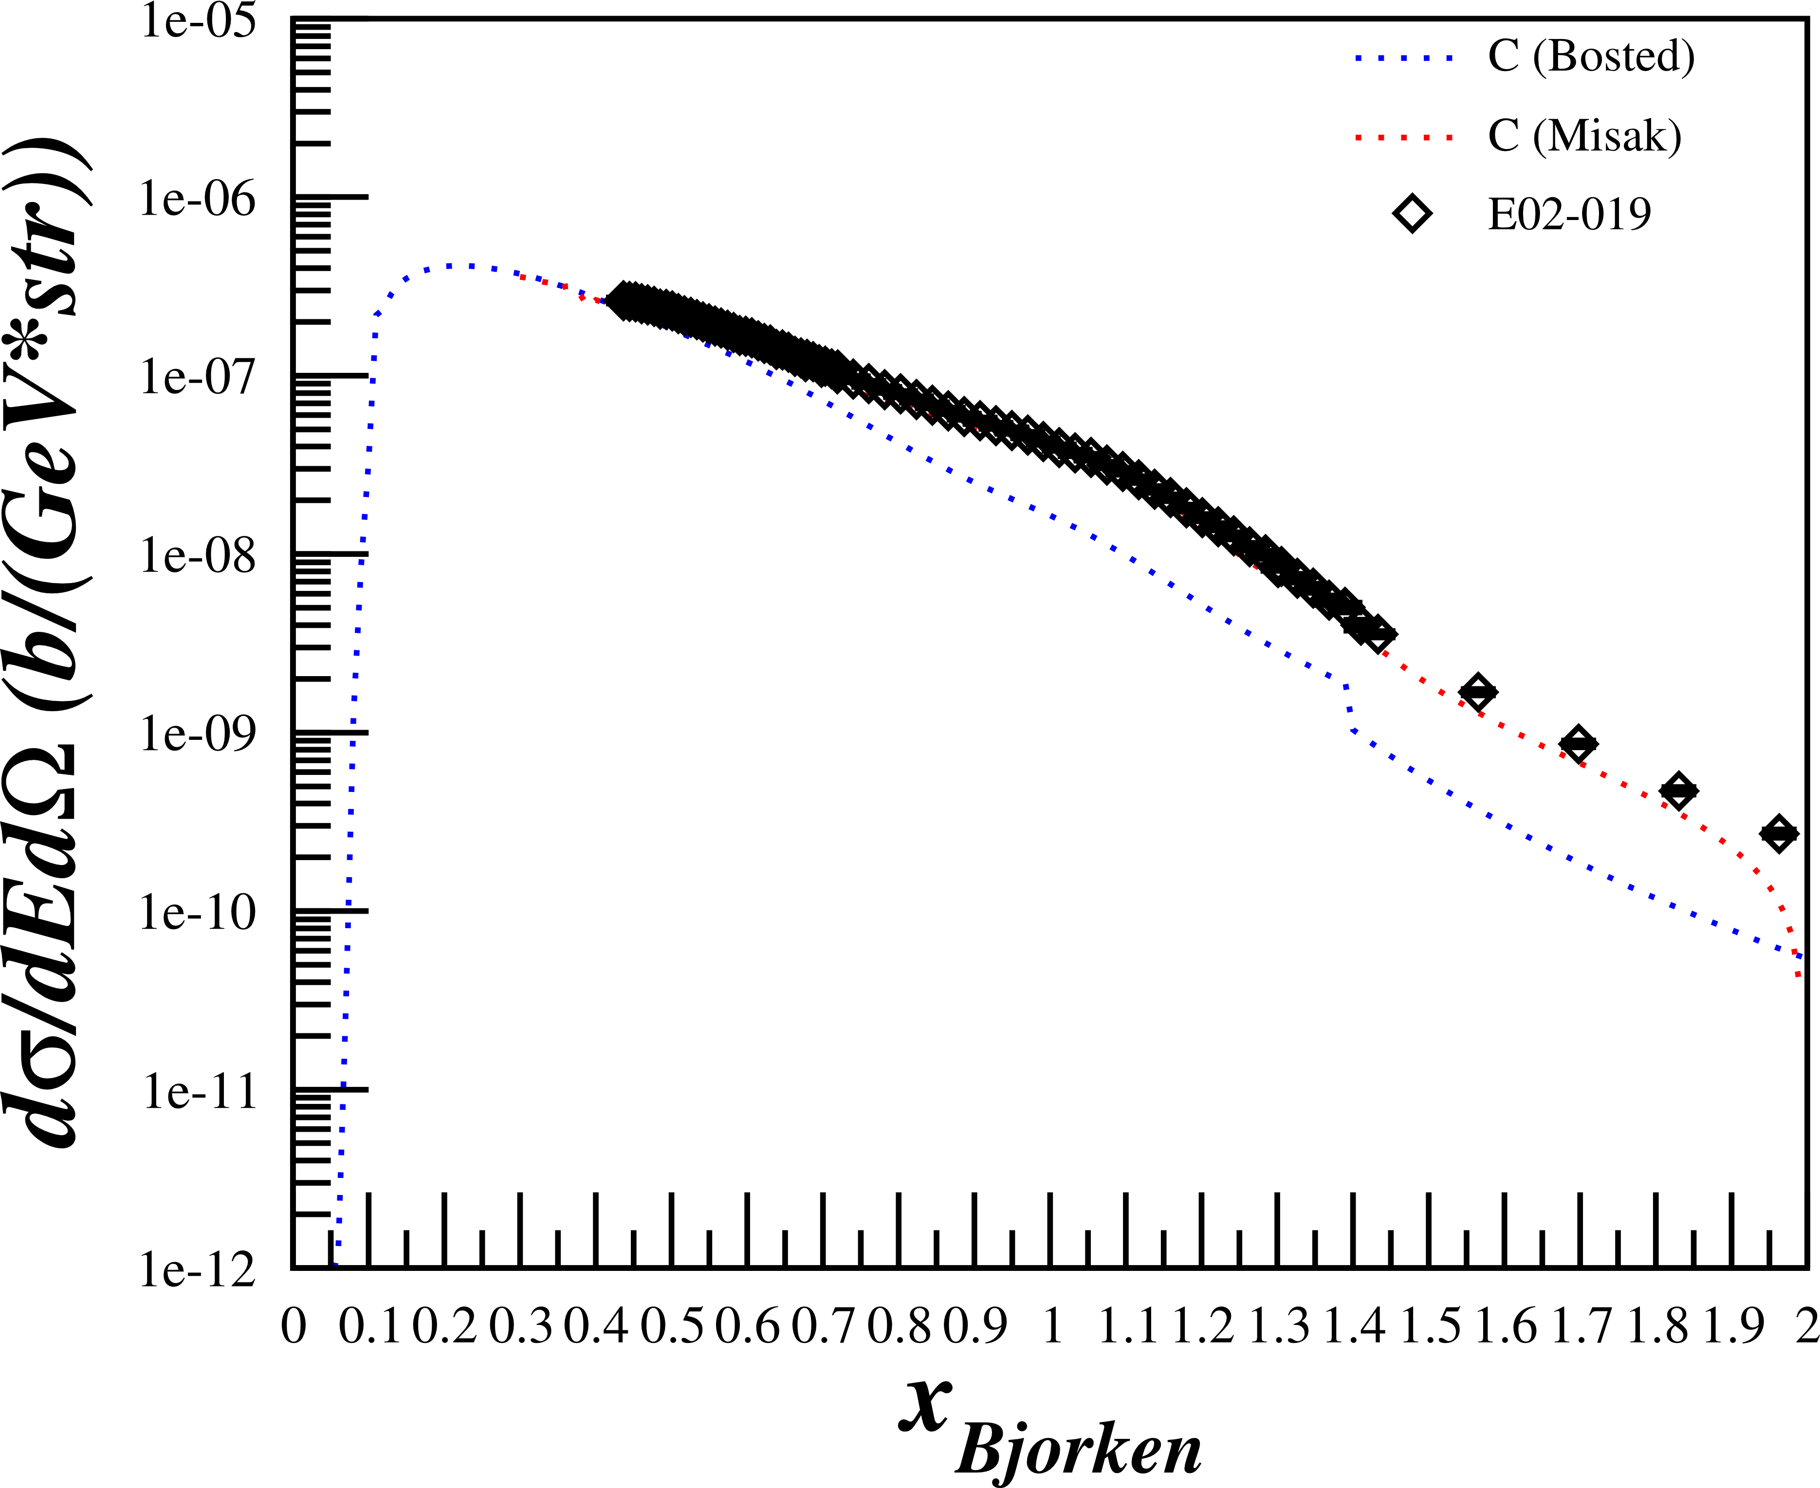
Cross Section Calculations - Carbon
Compared with data similar to Azz range
$E_{0}=5.766 GeV$
$E′=4.8 GeV$
$θ_{e′}={18.0}^{∘}$
N. Fomin, et al., Phys. Rev. Lett. 108 (2012) 092502
N. Fomin, et al., Phys. Rev. Lett. 105 (2010) 212502

Slide 39
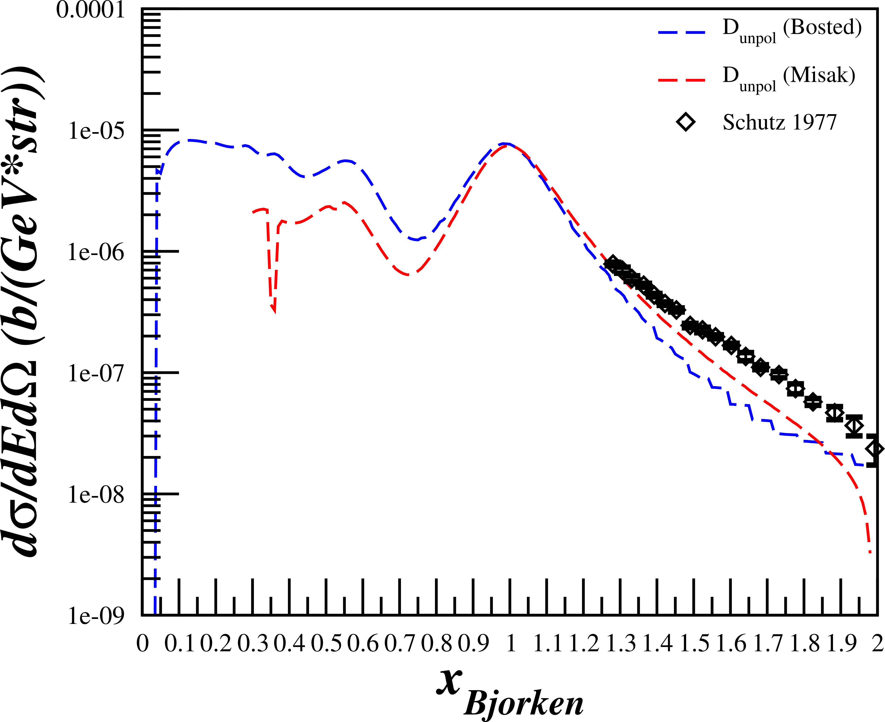
Cross Section Calculations - Deuterium
Compared with data similar to Azz range
$E_{0}=6.519 GeV$
$E′=6.23GeV$
$θ_{e′}={8.0}^{∘}$
W.P. Shutz, et al., Phys. Rev. Lett. 38, 259 (1977)

