Slide 1
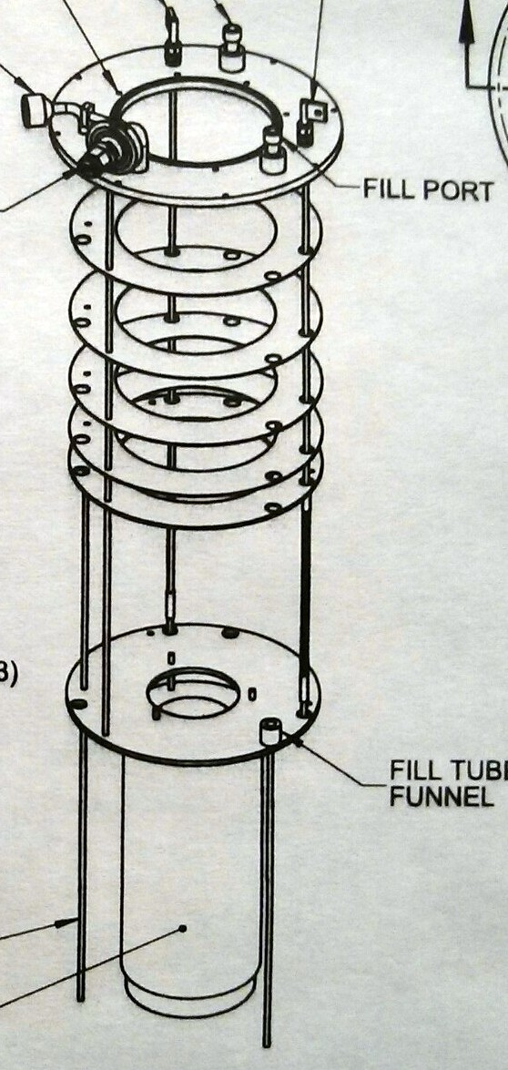
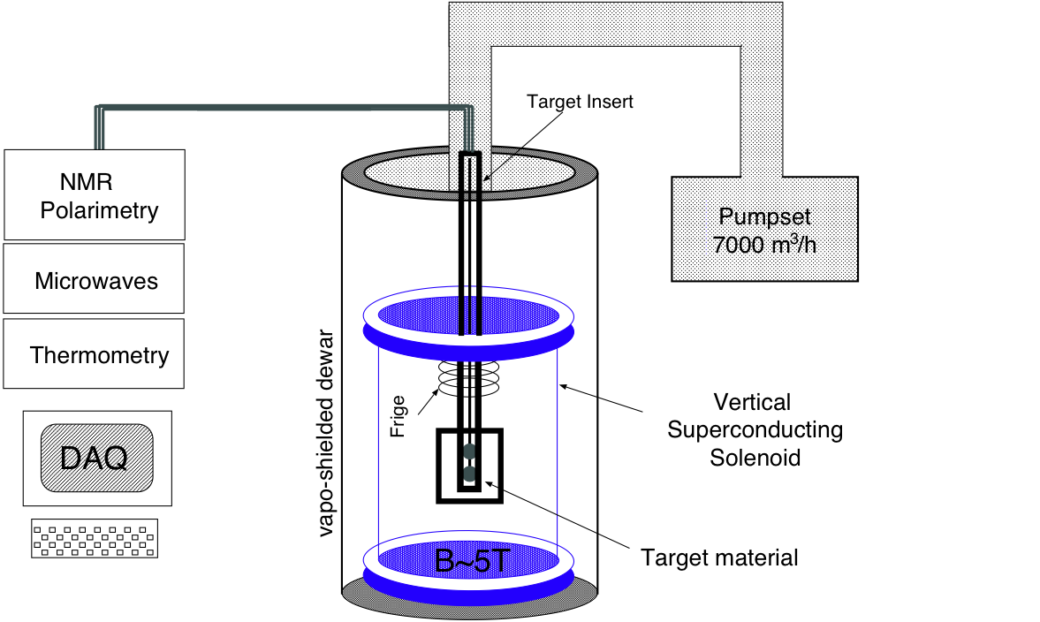
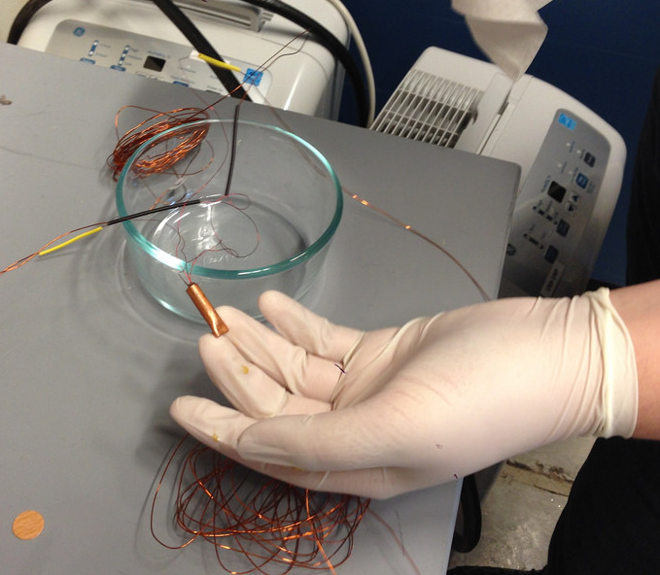
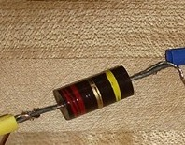
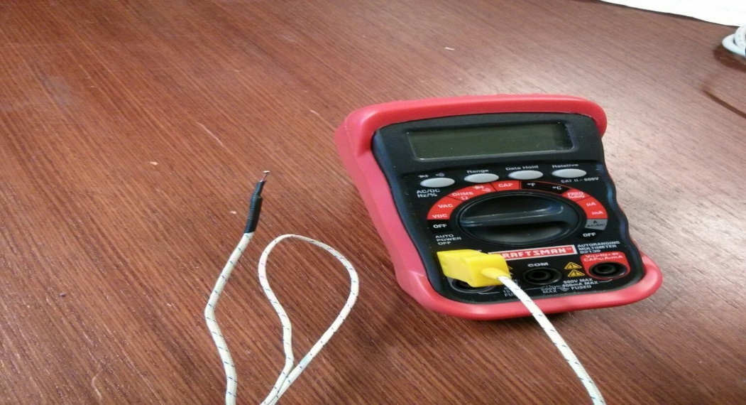
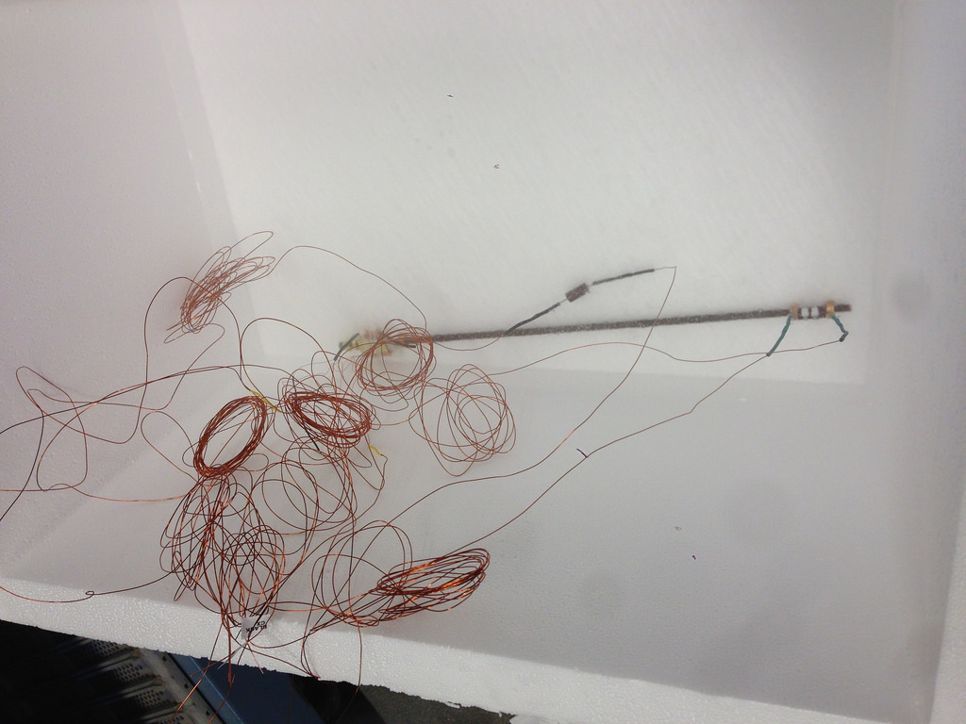
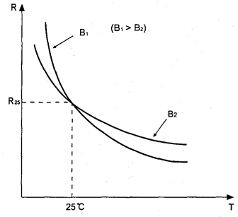
Understanding Thermometry at Low Temperature
Zain Abbas.
Advisors Prof. K. Slifer and Dr. E. Long
Department of Physics, University of New Hampshire
Abstract
Cryogenics play a vital role in building a Dynamic Nuclear Polarization (DNP) target for electron scattering experiments. The target material temperature was monitored using thermometry in order to evaluate their stability for use in the low temperature cryogenic bath of a DNP target. In this project, I investigated the resolutions and accuracies of carbon ceramic, Cernox, Allen-Bradley, and thermocouple sensors at five known temperatures.
Method
The Cernox was connected to
the Mercury ITC which is capable
of automatic data logging.
Carbon Ceramic Resistors (CCS):
The two terminals of the sensor were soldered
with magnetic wire.
The output terminals were connected to ohmmeter.
Cernox:
The two terminals of the Cernox were soldered with four magnetic copper wires. The inner two measures the voltage
and outer two provides the current.
The current and voltage was measured through ITC.
Allen Bradley Resistors:
The two terminals of Allen Bradley resistors
were soldered with magnetic copper wire.
The resistance was measured using ohmmeter.
Thermocouple (Type K):
The positive nickel-chromium and
negative nickel-aluminum were connected
to the multimeter.
All the sensors except thermocouple are Negative Temperature
Co-efficient (NTC). NTC sensors are made from pure metal oxides. They are inversely proportional to temperature changes.
Carbon Ceramic Resistors:
The temperature range is
1.5 - 300K .
Resistant to magnetic fields
Cernox:
Cernox temperature ranges
from 100 mk to 420 K.
They are high sensitive at
low temperature and
good sensitivity over a
broad range.
Thermocouple (type K):
This thermocouple is made
of nickel-chromium
and nickel-aluminum.
The temperature
range is 73.15 K to 1533 K.
They have good
corrosion resistance.
Ω
Background
The UNH Nuclear Physics Group is building a dynamic nuclear polarization (DNP) target to spin-polarize protons in solid NH3 at cryogenic temperatures. DNP is capable of producing nearly 100% proton polarization, but its accuracy is dependent on that of the temperature. The temperature of the DNP, shown below, is measured near the 5T magnet where the NH3 will be located.
At thermal equilibrium the spin polarization of protons in NH3 have a known dependence on temperature and magnetic field:
$P_{TE}=tanh⁡\left(\frac{μB}{kT}\right)$
To keep the uncertainty of the polarization under 1%, we can solve for the required uncertainty in the thermometry.
$$δP= \sqrt{{\left(\frac{δP}{δT}. δT\right)}^{2}}$$
$δP= \sqrt{{\left(\frac{−μB{sech}^{2}\left(\frac{Bμ}{kT}\right)}{kT^{2}}δT\right)}^{2}}$
where $δP=0.01$, $μ=−9.2x{10}^{−24}$J/K, k = 1.38x${10}^{−23}$J/K, T = 1K, B = 5T. Solving for $δT$gives us $δT=0.62K$. It shows that uncertainty in temperature must be less than 0.62K to achieve less than 1% relative uncertainty in polarization.
ITC
AB1
Cernox
& CCS
Allen Bradley:
They are also known as
carbon resistors.
There temperature
ranges is below 1K-100K.
Insensitive to
nuclear radiations.
AB2
Magnet
Ω
V
Conclusions and future plans:
This project will establish an accurate thermometry system to be used in the polarized target lab. The calibration data indicates that CCS and Cernox perform with sufficient accuracy and precision in LHe in given temperatures, however AB responds poorly in LHe and does not match our calibration curve, thus we can’t use it. For future measurements all of the thermometry data will go through the Mercury ITC and will be operated by Labview.
All the sensors were placed in liquid nitrogen, liquid helium,
room temperature and ice water.
Resolution and Accuracy of Cryogenic temperature measurements.
The equation for determining resolution of a thermometer is
$∆T=\frac{ε_{V}}{\left(\frac{d_{V}}{dT}\right)},$
Where $\left(\frac{d_{V}}{dT}\right)$ is the sensitivity of the thermometer, $∆T$ is the temperature resolution of a thermometer and $ε_{V}$ is the measurement system resolution. Similarly, the relative system resolution is described by:
$∆T$ = $\frac{ε_{V}\text{/}\text{V}}{\left(\frac{T}{V}\right)\left(\frac{d_{V}}{dT}\right)}=\frac{ε_{rel}}{S},$
Where $ε_{rel}\text{is} \text{the} \text{relative} \text{measurement} \text{system} \text{resolution}\text{, }\text{which} \text{consists} \text{of} \text{measurement} \text{system}\text{,}{ ε}_{V}\text{, }\text{divided} \text{by} \text{the} \text{voltage} \text{measured}\text{. }\text{The} \text{denominator} \text{consists} \text{of} \text{S}\text{ =}$ $\left(\frac{T}{V}\right)\left(\frac{d_{V}}{dT}\right)$ which is known as the specific sensitivity of the thermometer at a temperature T.
NTC (Negative Temperature Co-efficient):
Allen Bradley, Cernox and CCS are the resistors that obey the NTC principle.
NTC temperature sensors are made from pure metal oxides. They are inversely proportional to temperature changes. Therefore, even small increase in temperature causes the NTC resistance to decrease significantly.
The R/T curve shows the relationship between the zero power resistance of thermistor and its temperature. The B value is the constant coefficient for a particular thermistor which is calculated using the zero power resistance at 25 deg. C (298.15K) and at 50 deg C (323.15K).

