Slide 1
The Deuteron Polarized Tensor Structure Function b₁
PAC 40 Defense
PR12-13-011 Spokespeople
J.-P. Chen, N. Kalantarians, D. Keller, E. Long,
O. A. Rondon, K. Slifer, P. Solvignon

Slide 2
b₁ Collaboration
K. Allada, A. Camsonne, J.-P. Chen, A. Deur, D. Gaskell, M. Jones, C. Keith, J. Piece, P. Solvignon, S. Wood, J. Zhang Jefferson Lab | O. Rondon Aramayo, D. Crabb, D. B. Day, C. Hanretty, D. Keller, R. Lindgren, S. Liuti, B. Norum, Zhihong Ye, X. Zheng University of Virginia
T. Badman, J. Calarco, J. Dawson, S. Phillips, E. Long, K. Slifer, R. Zielinski University of New Hampshire | W. Bertozzi, S. Gilad, J. Huang, A. Kelleher, V. Sulkosky MIT
N. Kalantarians Hampton University | G. Ron Hebrew University of Jerusalem
J. Dunne, D. Dutta Mississippi State University | K. Adhikari Old Dominion University
R. Gilman Rutgers | Seonho Choi, Hoyoung Kang, Hyekoo Kang, Yoomin Oh Seoul National University
H. P .Cheng, H. J. Lu, X. H. Yan Huangshan University | Y. X. Ye, P. J. Zhu University of Science and Technology of China
B. T. Hu, Y. Zhang Lanzhou University | Abdellah Ahmidouch North Carolina A&T State University
Caroline Riedl DESY

Slide 3
Deuteron
n
p
Spin-1 System
Simple testing ground for nuclear and particle physics
Reasonably “easy” to polarize

Slide 4
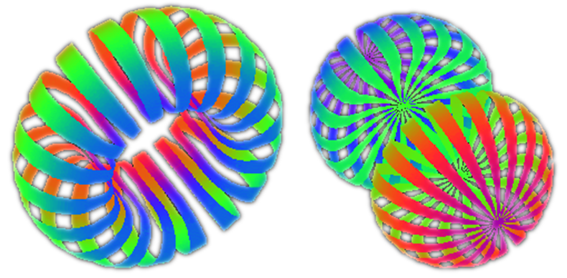
Deuteron
n
p
Spin-1 System
Simple testing ground for nuclear and particle physics
Reasonably “easy” to polarize
Spatial distribution depends on the spin state
m=0 m=±1

Slide 5
Spin-1 System
Spin-1 in B-field leads to three Zeeman sublevels
-1
0
m=+1
+1
m=0
m=-1
z
Vector Polarization P_{z}: (n⁺ - n⁻) (-1 < P_{z} < +1)
Tensor Polarization P_{zz}: (n⁺ - n⁰) – (n⁰-n⁻) (-2 < P_{zz} < +1)
Normalization
(n⁺ + n⁻ + n⁰) = 1

Slide 6
Inclusive Scattering from Deuteron
Construct the most general Tensor W consistent with Lorentz and gauge invariance
e'
e
γ∗
W
Frankfurt and Strickman (1983)
Hoodbhoy, Jaffe, Manohar (1989)
D

Slide 7
Inclusive Scattering from Deuteron
Construct the most general Tensor W consistent with Lorentz and gauge invariance
e'
e
γ∗
W
Frankfurt and Strickman (1983)
Hoodbhoy, Jaffe, Manohar (1989)
D
Unpolarized Scattering

Slide 8
Inclusive Scattering from Deuteron
Construct the most general Tensor W consistent with Lorentz and gauge invariance
e'
e
γ∗
W
Frankfurt and Strickman (1983)
Hoodbhoy, Jaffe, Manohar (1989)
D
Doubly-Polarized
Scattering from
Vector Polarized
Target

Slide 9
Inclusive Scattering from Deuteron
Construct the most general Tensor W consistent with Lorentz and gauge invariance
e'
e
γ∗
W
Frankfurt and Strickman (1983)
Hoodbhoy, Jaffe, Manohar (1989)
D
Unpolarized Beam &
Tensor Polarized
Target

Slide 10
Inclusive Scattering from Deuteron
Construct the most general Tensor W consistent with Lorentz and gauge invariance
e'
e
γ∗
W
Frankfurt and Strickman (1983)
Hoodbhoy, Jaffe, Manohar (1989)
D
b₂ = xb₁

Slide 11
b₁ Structure Function
Focus on b₁ in this experiment:
  Leading Twist
  Simplest to access experimentally
  Probe the tensor polarization of the sea quarks
  Signature of “exotic” effects in nuclei
    i.e. deviation of deuteron from simple system of two bound nucleons

Slide 12
b₁ Structure Function

Slide 13
b₁ Structure Function
q⁰: Probability to scatter from a quark (any flavor) carrying momentum fraction x while the deuteron is in state m=0
q¹: Probability to scatter from a quark (any flavor) carrying momentum fraction x while the deuteron is in state |m|=1
-

Slide 14
b₁ Structure Function
q⁰: Probability to scatter from a quark (any flavor) carrying momentum fraction x while the deuteron is in state m=0
q¹: Probability to scatter from a quark (any flavor) carrying momentum fraction x while the deuteron is in state |m|=1
-
Nice mix of nuclear and quark physics
Measured in DIS (so probing quarks), but depends solely on the deuteron spin state
Investigate nuclear effects at the level of partons!

Slide 15
b₁ Structure Function
b1 vanishes in the absence of nuclear effects
Even accounting for D-state admixture, b1 is expected to be vanishingly small
i.e. if...
Deuteron
=
n
+
p
Proton Neutron in relative S-state
Khan & Hoodbhoy, PRC 44 ,1219 (1991) : b₁ ≈ O(10⁻⁴)
Relativistic convolution model with binding
Umnikov, PLB 391, 177 (1997) : b₁ ≈ O(10⁻³)
Relativistic convolution with Bethe-Salpeter formalism

Slide 16
It is a unique opportunity at JLab to develop this new field of spin physics.
S. Kumano (KEK)
I’m glad to hear that b1 is not forgotten in all the excitement about other spin dependent effects.
Robert Jaffe (MIT)
I am particularly interested in signatures of novel QCD effects in the deuteron. The tensor charge could be sensitive to hidden color (non-nucleonic) degrees of freedom at large x. It is also interesting that antishadowing in DIS in nuclei is not universal but depends on the quark flavor and spin. One can use counting rules from PQCD to predict the x → 1 dependence of the tensor structure function.
Stanley Brodsky (SLAC)
I am certainly interested in the experimental development to find the novel QCD phenomena from the hidden color component of deuteron.
Chueng-Ryong Ji (NCSU)
Surely this is of real interest the spin community!
Leonard Gamberg (Penn State Berks)
I find the proposal well written, well justified, sound, and exciting.
Alessandro Bacchetta (Universita di Pavia)
It is certainly an interesting quantity, precisely because it vanishes in the independent nucleon picture of the deuteron.
Elliot Leader (Imperial College of London)

Slide 17
World Data

Slide 18
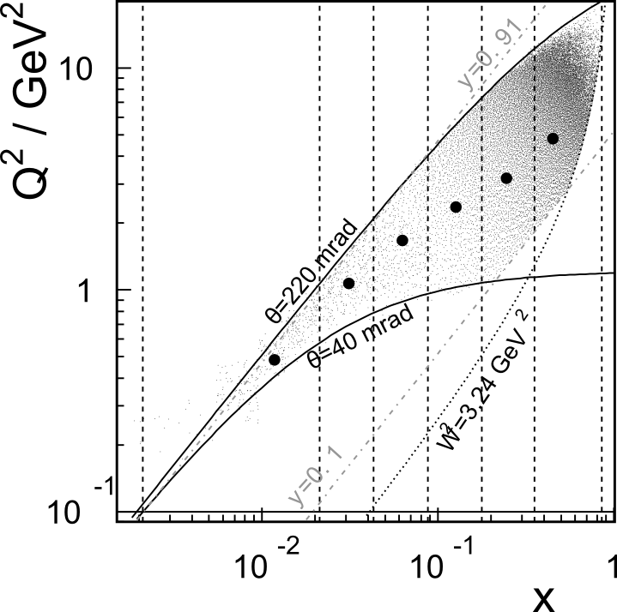
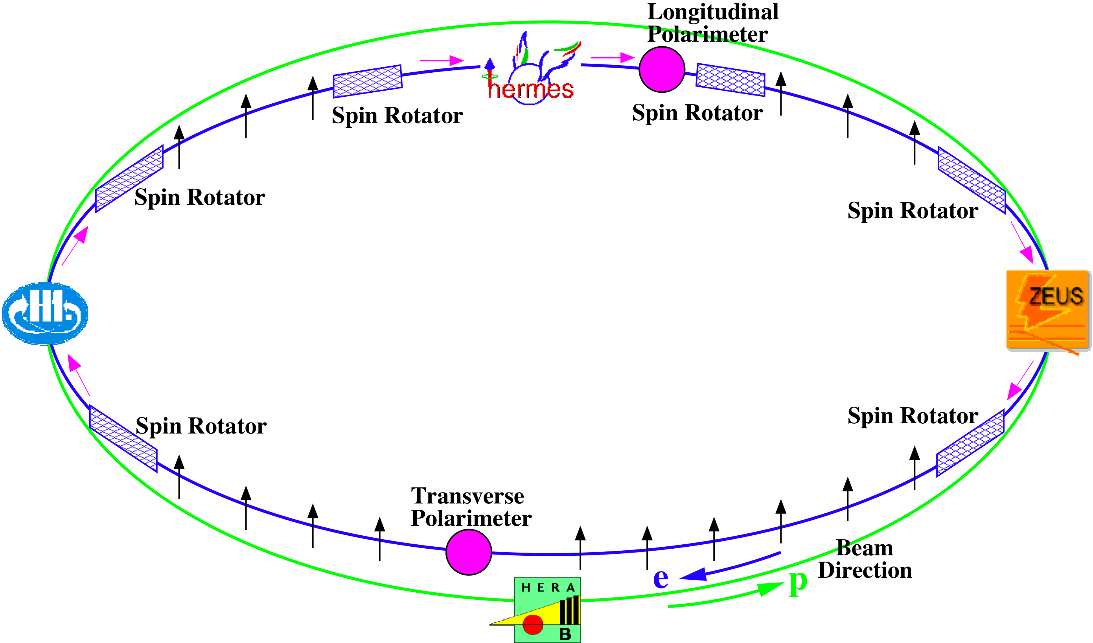
First Data from HERMES
27.6 GeV Positrons
Internal Gas Target
  ~Pure tensor polarization
  with little vector component
0.01 < <x> < 0.45
0.5 < <Q²> < 5 GeV²

Slide 19
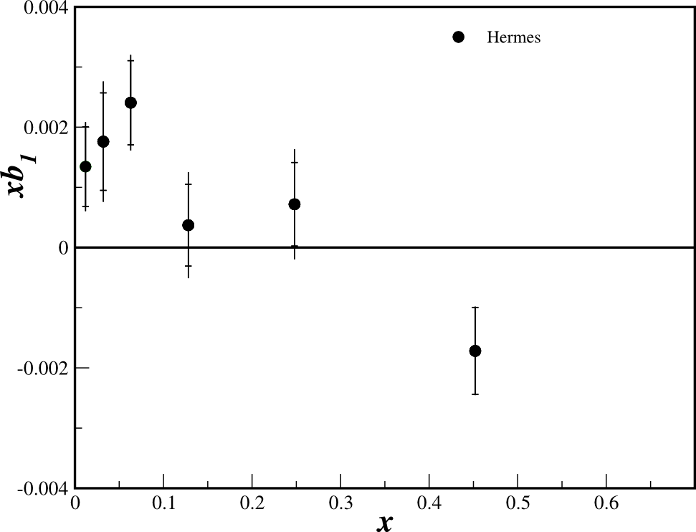
First Data from HERMES
PRL 95, 242001 (2005)

Slide 20
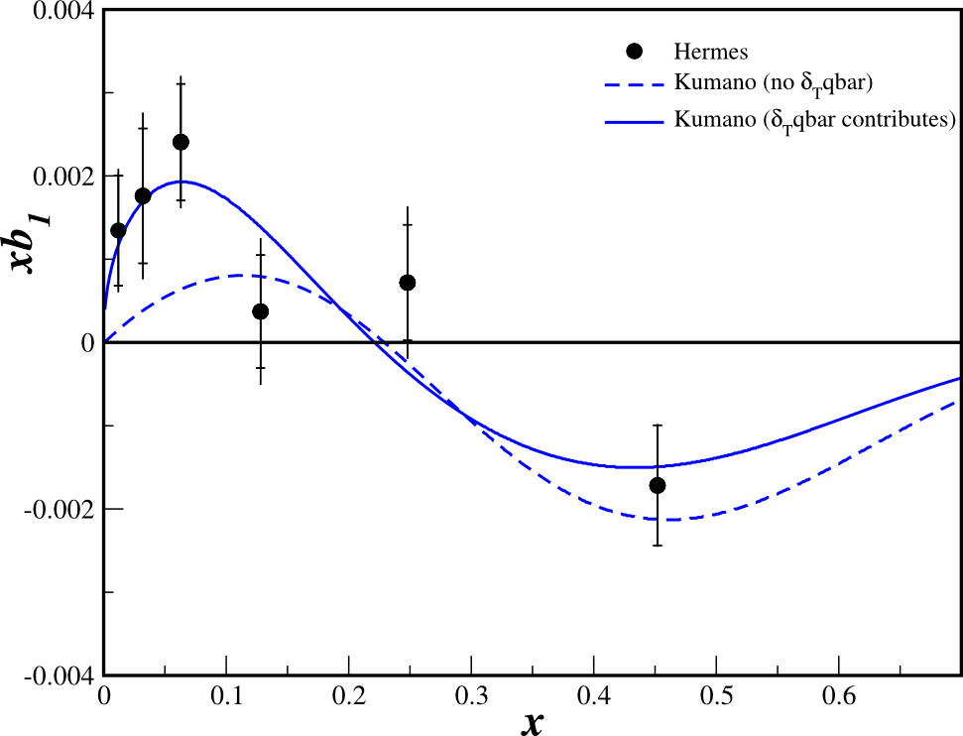
First Data from HERMES
Kumano fit to the data
Requires tensor-polarized sea for best fit

Slide 21
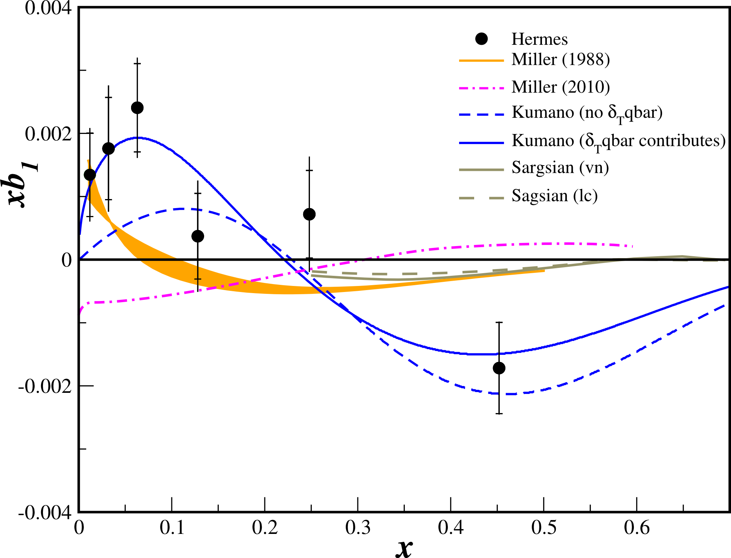
First Data from HERMES
All conventional models predict small or vanishing values of b₁ in contrast with the HERMES data

Slide 22
First Data from HERMES
All conventional models predict small or vanishing values of b₁ in contrast with the HERMES data
Any measurement of a b₁<0 indicates exotic physics

Slide 23
Close-Kumano Sum Rule
Satisfied for an unpolarized sea
Deviations from zero:
  Good signature of exotic effects in the deuteron wave function
  Khan & Hoodbhoy, PRC 44, 1219 (1991)
    Relativistic convolution model with binding: -6.7 × 10⁻⁴
HERMES Result
            2.2σ difference from zero

Slide 24
Jefferson Lab
Experimental Set-up

Slide 25
JLab
Unpolarized Beam
  Polarized beam will be spin-averaged to isolate b₁
UVa/JLab Polarized Target
  Longitudinal field

Slide 26
JLab
Unpolarized Beam
  Polarized beam will be spin-averaged to isolate b₁
UVa/JLab Polarized Target
  Longitudinal field

Slide 27
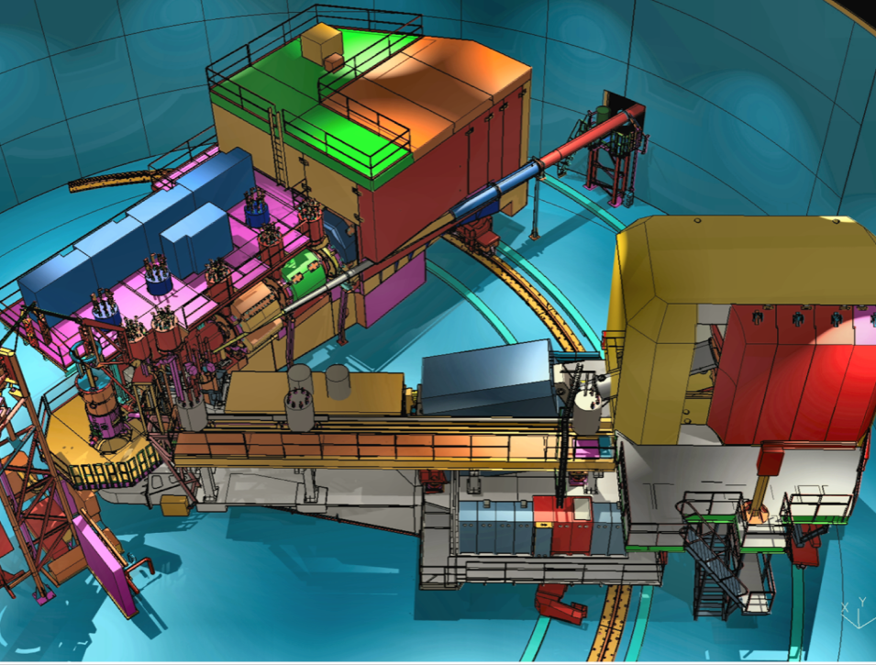
Hall C Configuration

Slide 28
Hall C Beamline
SHMS
Slow
Raster
Faraday
Cup
Lumi
Fast
Raster
Polarized
Target
HMS

Slide 29
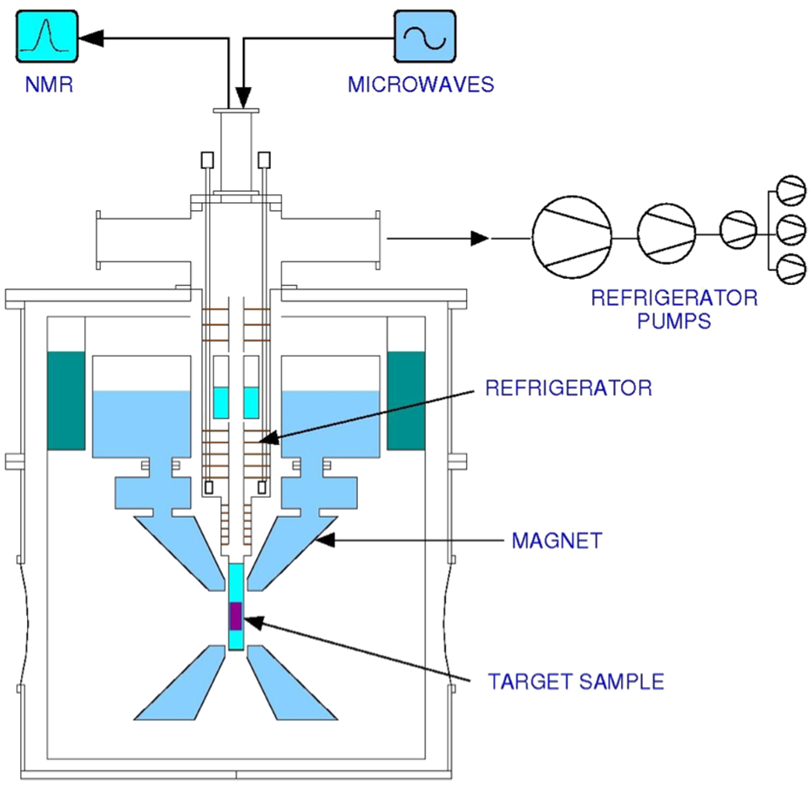
Polarized Target
Dynamic Nuclear Polarization of ND₃
5 Tesla at 1 K
SLAC, G_{E}^{n} (1&2), RSS, SANE, g2p
3cm Target Length
p_{f} ~ 0.65
f_{dil} ~ 0.27
Development of a highly-polarized (30%+) tensor deuteron target has far-reaching effects
Figure courtesy of C. Keith

Slide 30
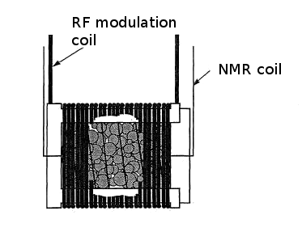
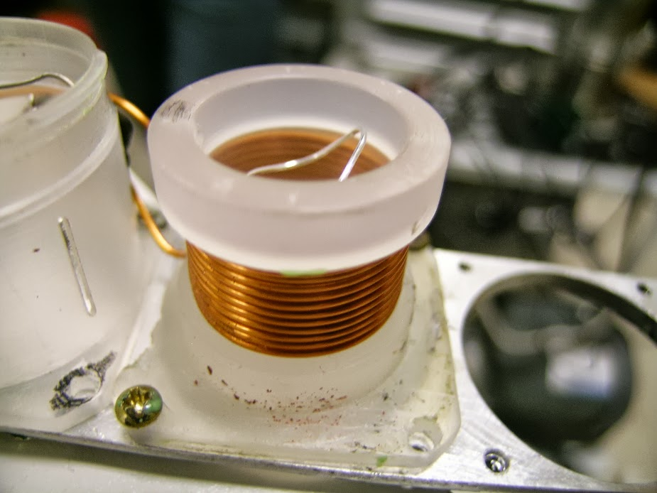
Polarized Target

Slide 31
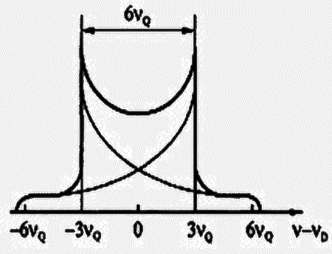
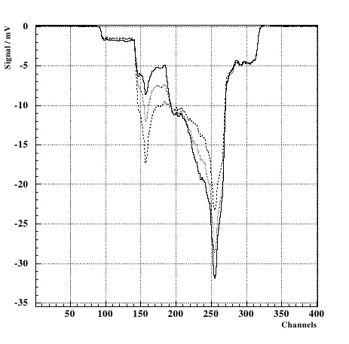
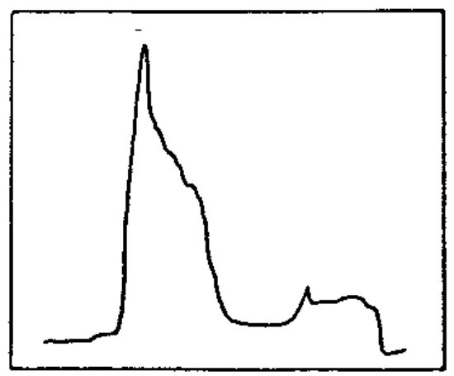
Tensor Polarization Optimization
UVA: 30% at 5.0T
Born: 20% at 2.5T

Slide 32
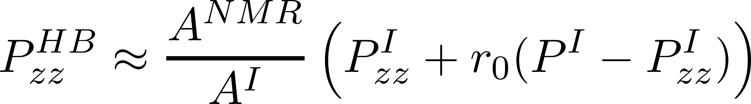
Tensor Polarization Measurement
Vector optimize with microwaves
Fit peaks with convolution
Tensor optimize with RF
Measure change in peaks using Riemann Sum segments
Ratio of instantaneous
to initial NMR signal area
Percentage of initial peak
shifted any time
(from reduced side)
Available tensor
enhancement

Slide 33
Polarization Cycle
Each day will consist of 10 hours of polarized beam, depolarization using destructive NMR and DPR, and 10 hours of unpolarized beam with 4 hours spent switching between states
Each pol/unpol cycle is an independent measurement
  Any issues from annealing, bead dropping, or luminosity drift will be isolated to a single cycle and not effect the rest of the data
For the lowest SHMS setting, the time spent in each state will be halved

Slide 34
Polarization Cycle
Unpolarized
Polarized
Unpolarized
Each day will consist of 10 hours of polarized beam, depolarization using destructive NMR and DPR, and 10 hours of unpolarized beam with 4 hours spent switching between states
Each pol/unpol cycle is an independent measurement
  Any issues from annealing, bead dropping, or luminosity drift will be isolated to a single cycle and not effect the rest of the data
For the lowest SHMS setting, the time spent in each state will be halved

Slide 35
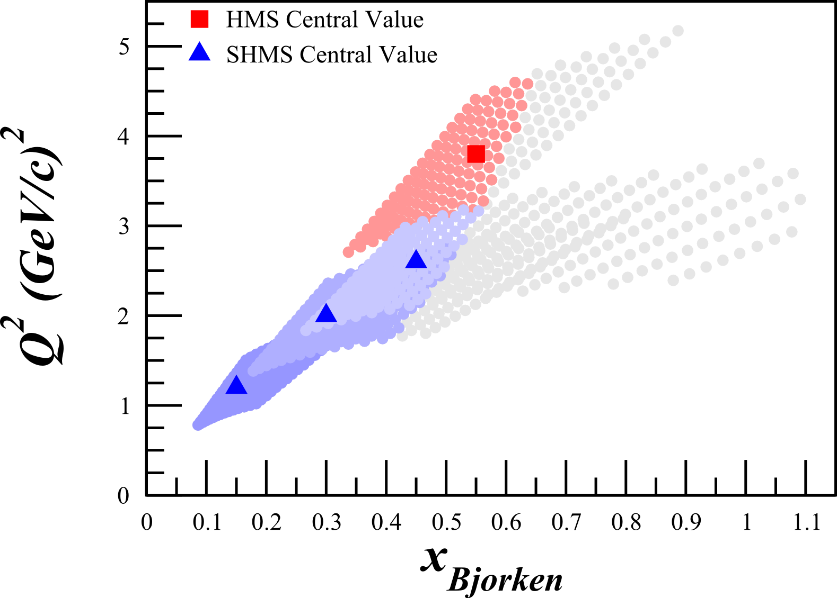
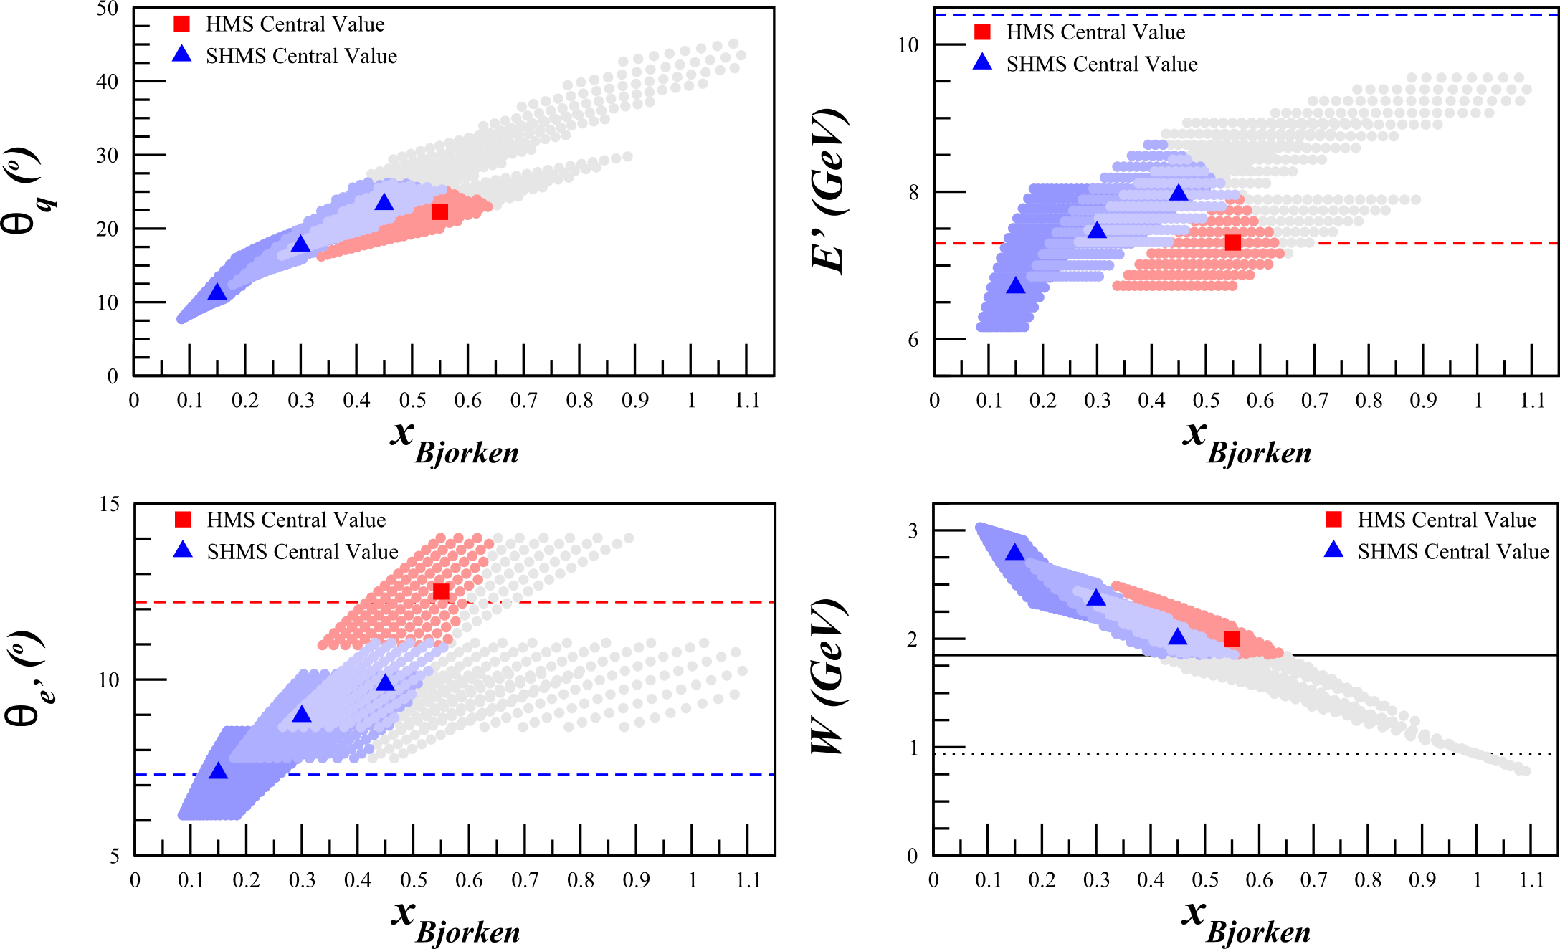
Kinematics
I_{beam} = 115 nA

Slide 36
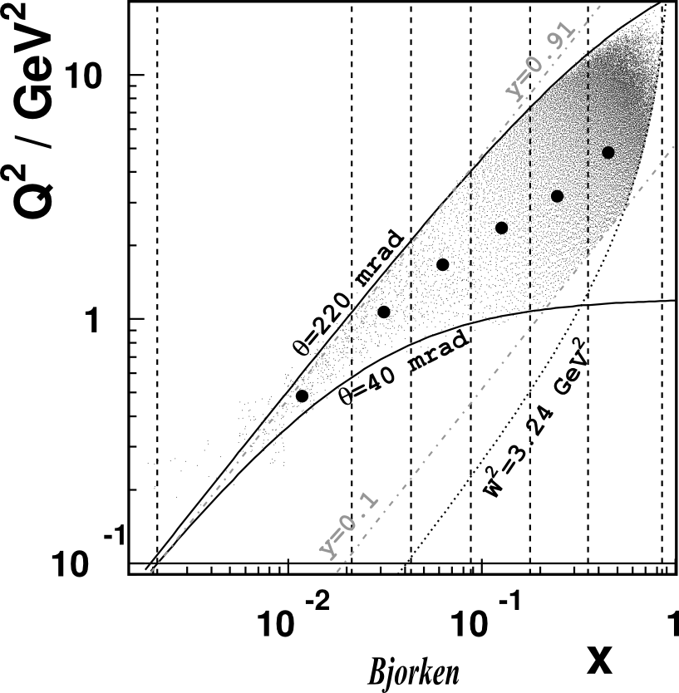
HERMES Kinematics
Logarithmic Scale
Q² (GeV/c)²
x

Slide 37
HERMES Kinematics
Approximate
0.09 < x < 0.18
0.8 < Q² < 7
Q² (GeV/c)²
x

Slide 38
HERMES Kinematics
Approximate
0.09 < x < 0.18
0.8 < Q² < 7
0.18 < x < 0.35
1 < Q² < 9
Q² (GeV/c)²
x

Slide 39
HERMES Kinematics
Approximate
0.09 < x < 0.18
0.8 < Q² < 7
0.18 < x < 0.35
1 < Q² < 9
0.35 < x < 0.85
2 < Q² < 18
Q² (GeV/c)²
x

Slide 40
HERMES Kinematics
Approximate
0.09 < x < 0.18
0.8 < Q² < 7
0.18 < x < 0.35
1 < Q² < 9
0.35 < x < 0.85
2 < Q² < 18
This experiment
Q² (GeV/c)²
x

Slide 41
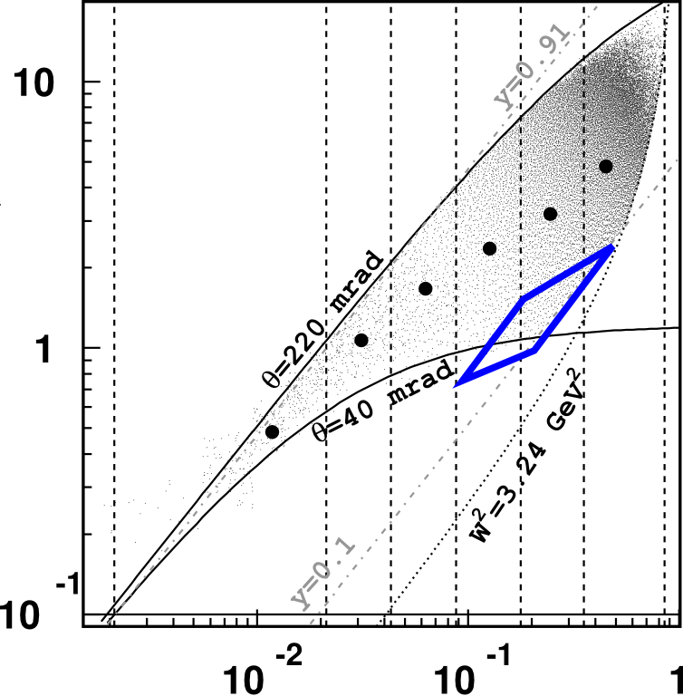
HERMES Kinematics
Approximate
0.09 < x < 0.18
0.8 < Q² < 7
0.18 < x < 0.35
1 < Q² < 9
0.35 < x < 0.85
2 < Q² < 18
This experiment
Q² (GeV/c)²
x

Slide 42
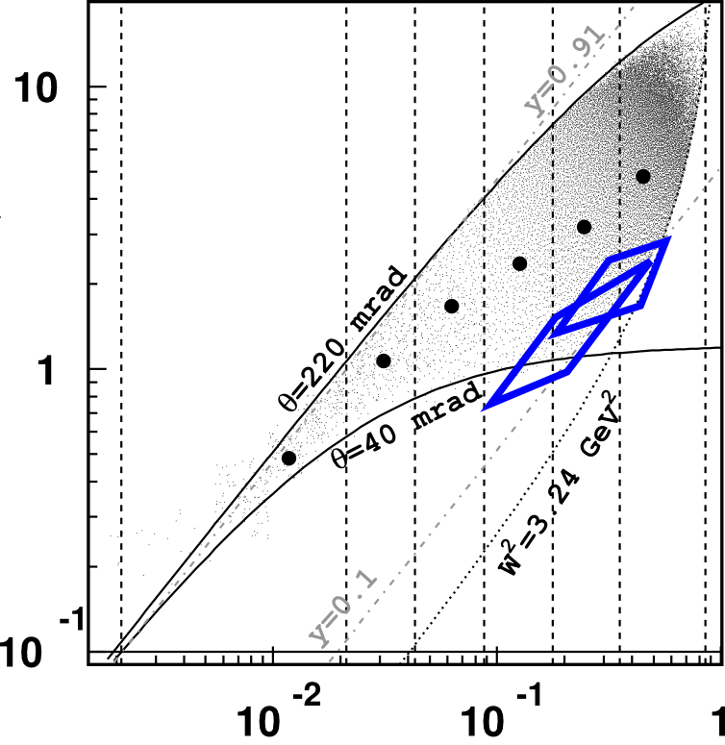
HERMES Kinematics
Approximate
0.09 < x < 0.18
0.8 < Q² < 7
0.18 < x < 0.35
1 < Q² < 9
0.35 < x < 0.85
2 < Q² < 18
This experiment
Q² (GeV/c)²
x

Slide 43
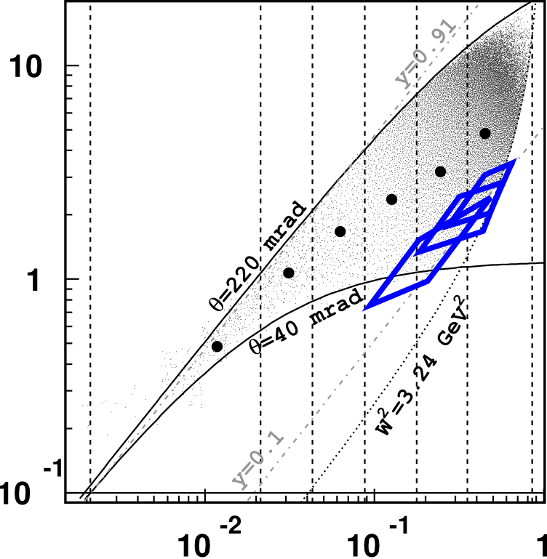
HERMES Kinematics
Approximate
0.09 < x < 0.18
0.8 < Q² < 7
0.18 < x < 0.35
1 < Q² < 9
0.35 < x < 0.85
2 < Q² < 18
This experiment
Q² (GeV/c)²
x

Slide 44
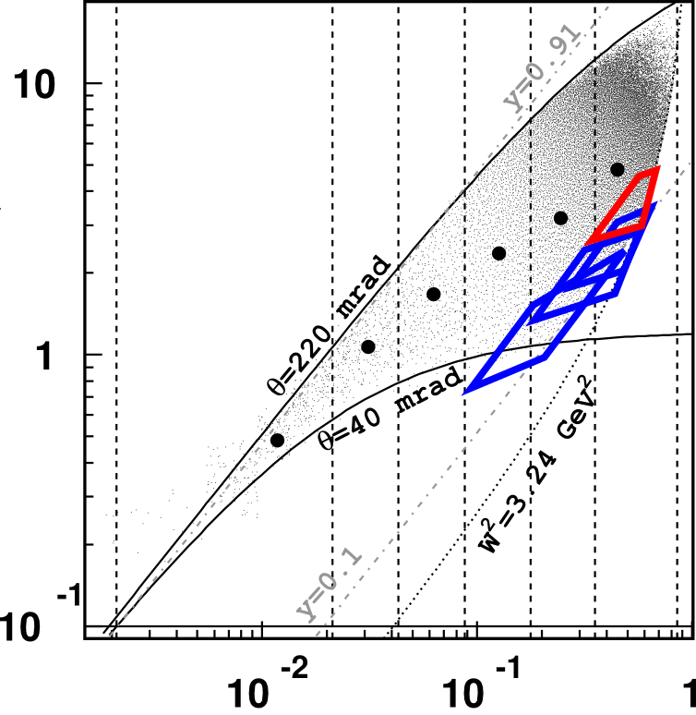
HERMES Kinematics
Approximate
0.09 < x < 0.18
0.8 < Q² < 7
0.18 < x < 0.35
1 < Q² < 9
0.35 < x < 0.85
2 < Q² < 18
This experiment
Q² (GeV/c)²
x

Slide 45
HERMES Kinematics
Approximate
0.09 < x < 0.18
0.8 < Q² < 7
0.18 < x < 0.35
1 < Q² < 9
0.35 < x < 0.85
2 < Q² < 18
This experiment
0.09 < x < 0.23
0.75 < Q² < 1.1
Q² (GeV/c)²
x

Slide 46
HERMES Kinematics
Approximate
0.09 < x < 0.18
0.8 < Q² < 7
0.18 < x < 0.35
1 < Q² < 9
0.35 < x < 0.85
2 < Q² < 18
This experiment
0.09 < x < 0.23
0.75 < Q² < 1.1
0.23 < x < 0.32
1.1 < Q² < 2.6
Q² (GeV/c)²
x

Slide 47
HERMES Kinematics
Approximate
0.09 < x < 0.18
0.8 < Q² < 7
0.18 < x < 0.35
1 < Q² < 9
0.35 < x < 0.85
2 < Q² < 18
This experiment
0.09 < x < 0.23
0.75 < Q² < 1.1
0.23 < x < 0.32
1.1 < Q² < 2.6
0.32 < x < 0.40
2.6 < Q² < 3.1
Q² (GeV/c)²
x

Slide 48
HERMES Kinematics
Approximate
0.09 < x < 0.18
0.8 < Q² < 7
0.18 < x < 0.35
1 < Q² < 9
0.35 < x < 0.85
2 < Q² < 18
This experiment
0.09 < x < 0.23
0.75 < Q² < 1.1
0.23 < x < 0.32
1.1 < Q² < 2.6
0.32 < x < 0.40
2.6 < Q² < 3.1
0.40 < x < 0.58
3.1 < Q² < 4.3
Q² (GeV/c)²
x

Slide 49
Addressing Systematics
Charge drift
  < 2 x 10⁻⁴, mitigated by thermal isolation of BCMs and addition of new low-power Faraday Cup (comparable to E06-010 and E08-027
Beam drift
  < 6 x 10⁻⁴/cycle, mitigated by taking multiple cycles
Trigger and tracking drift
  < 2.2 x 10⁻⁴, similar to Transversity in Hall A
Target dilution and length
  ~ 1 x 10⁻⁴,
Luminosity
  ~ 1 x 10⁻⁴, monitored with the Hall C Lumi
Unpolarized measurement with polarized beam
  ~ 2.2 x 10⁻⁵, using parity feedback

Slide 50
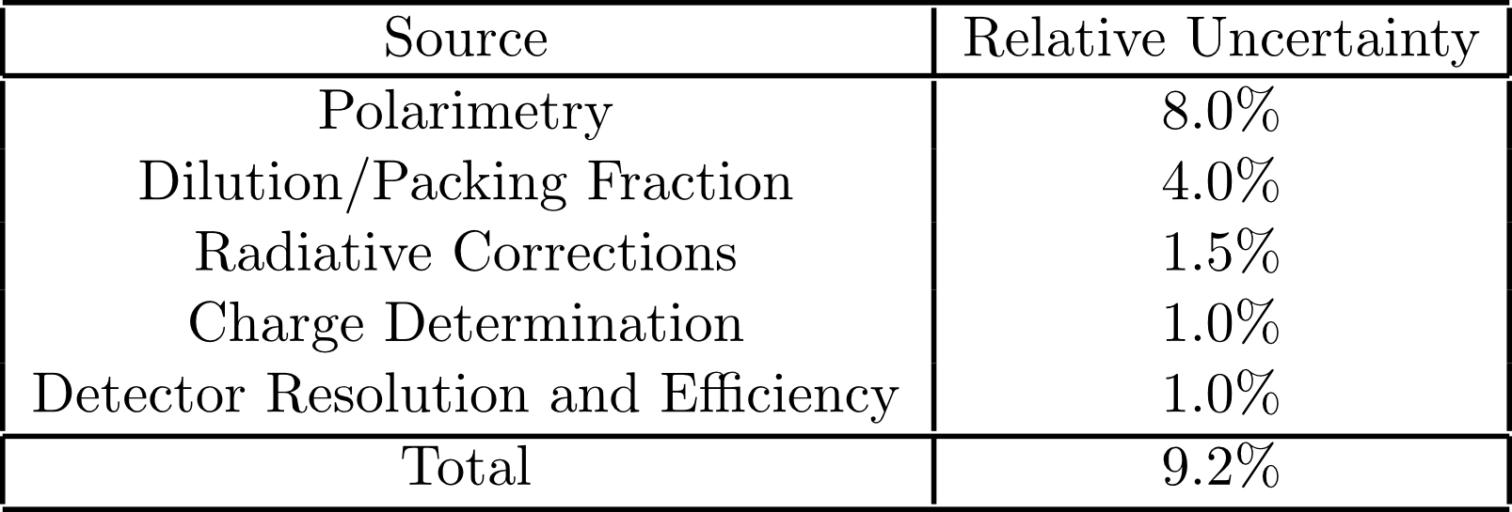
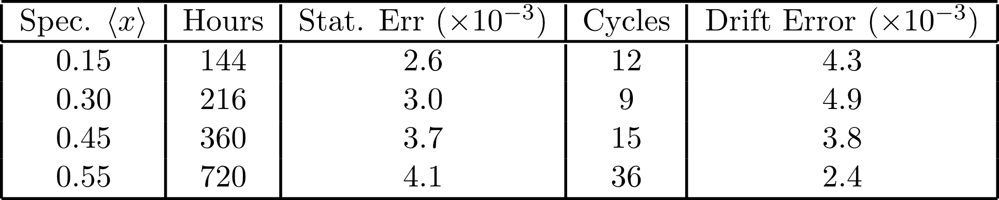
Systematic Contributions

Slide 51
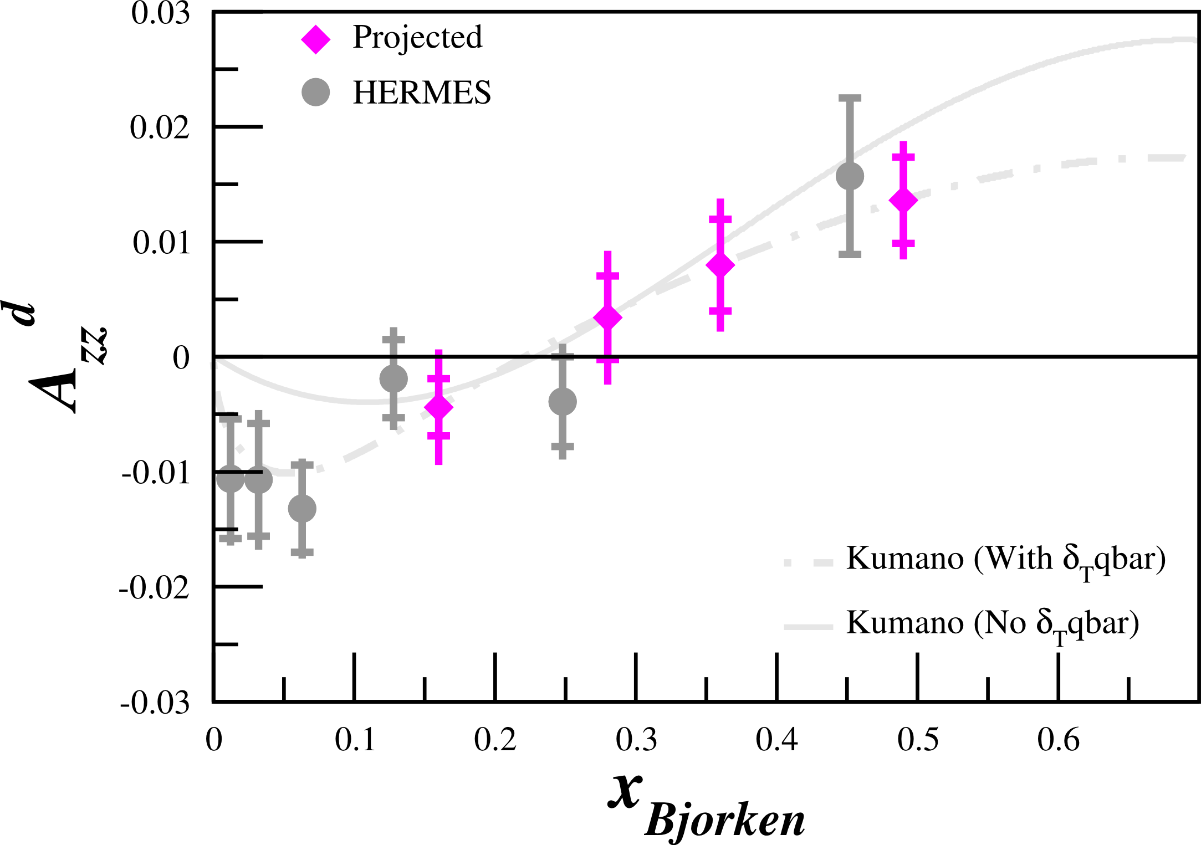
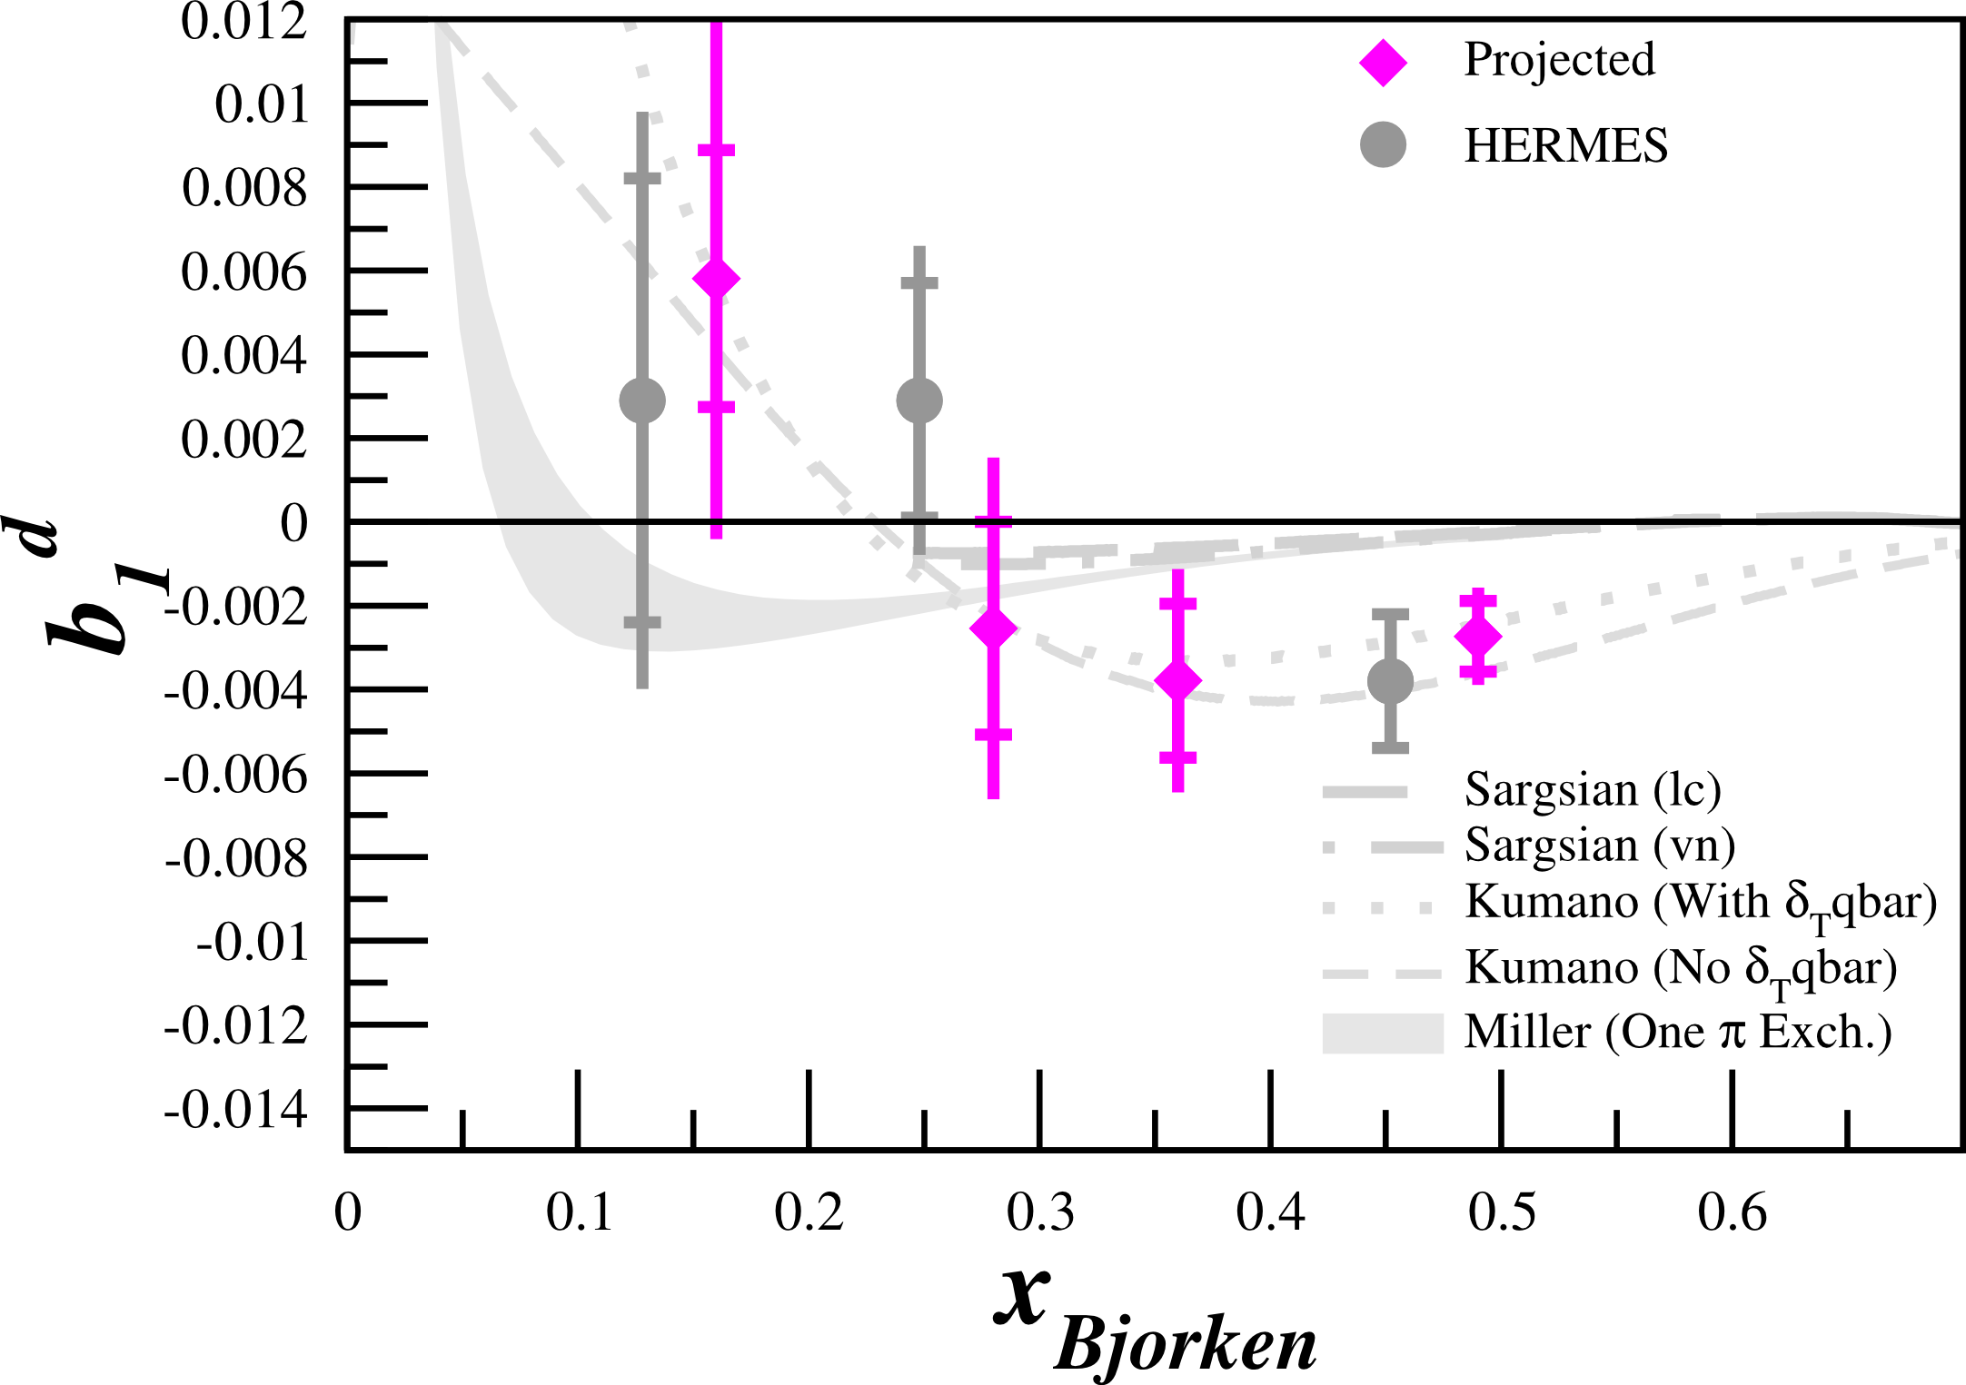
Projected Results
Assuming P_{zz}=20%

Slide 52
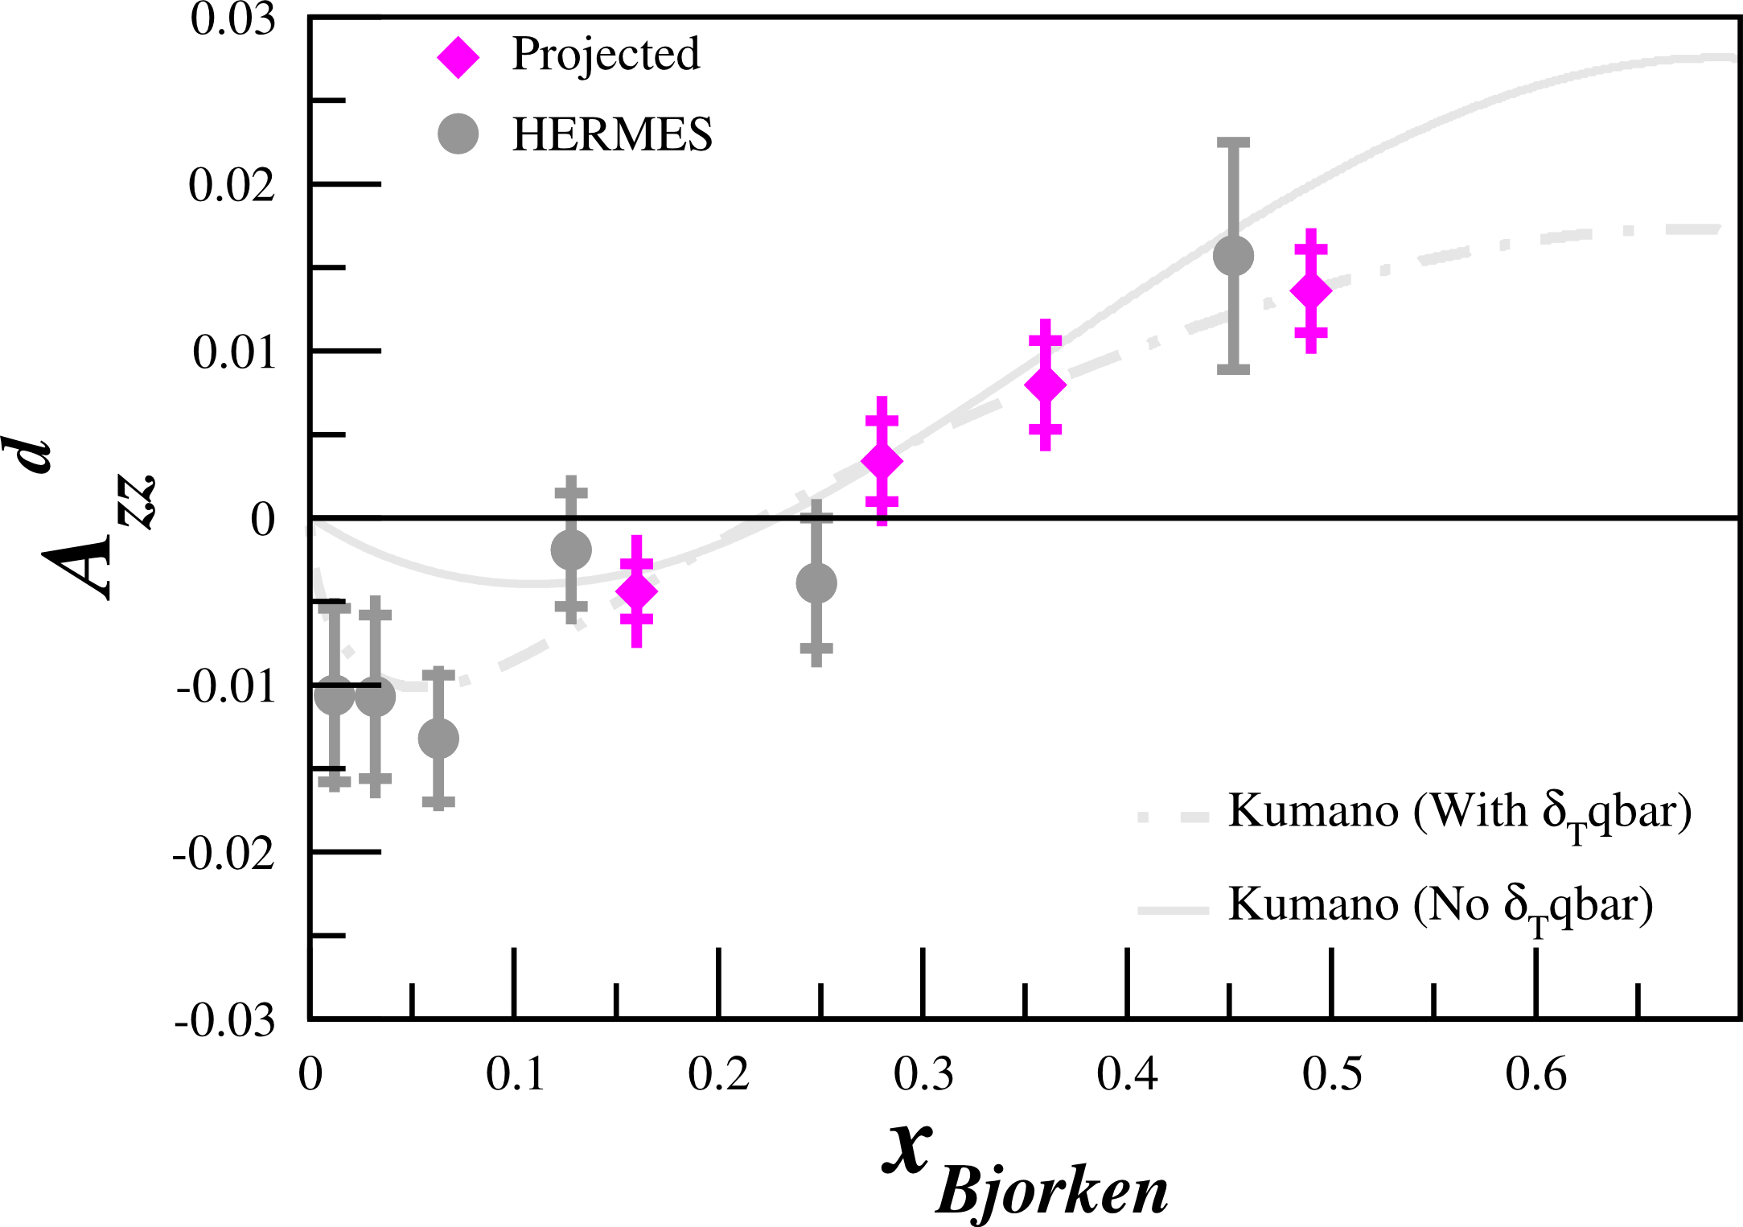
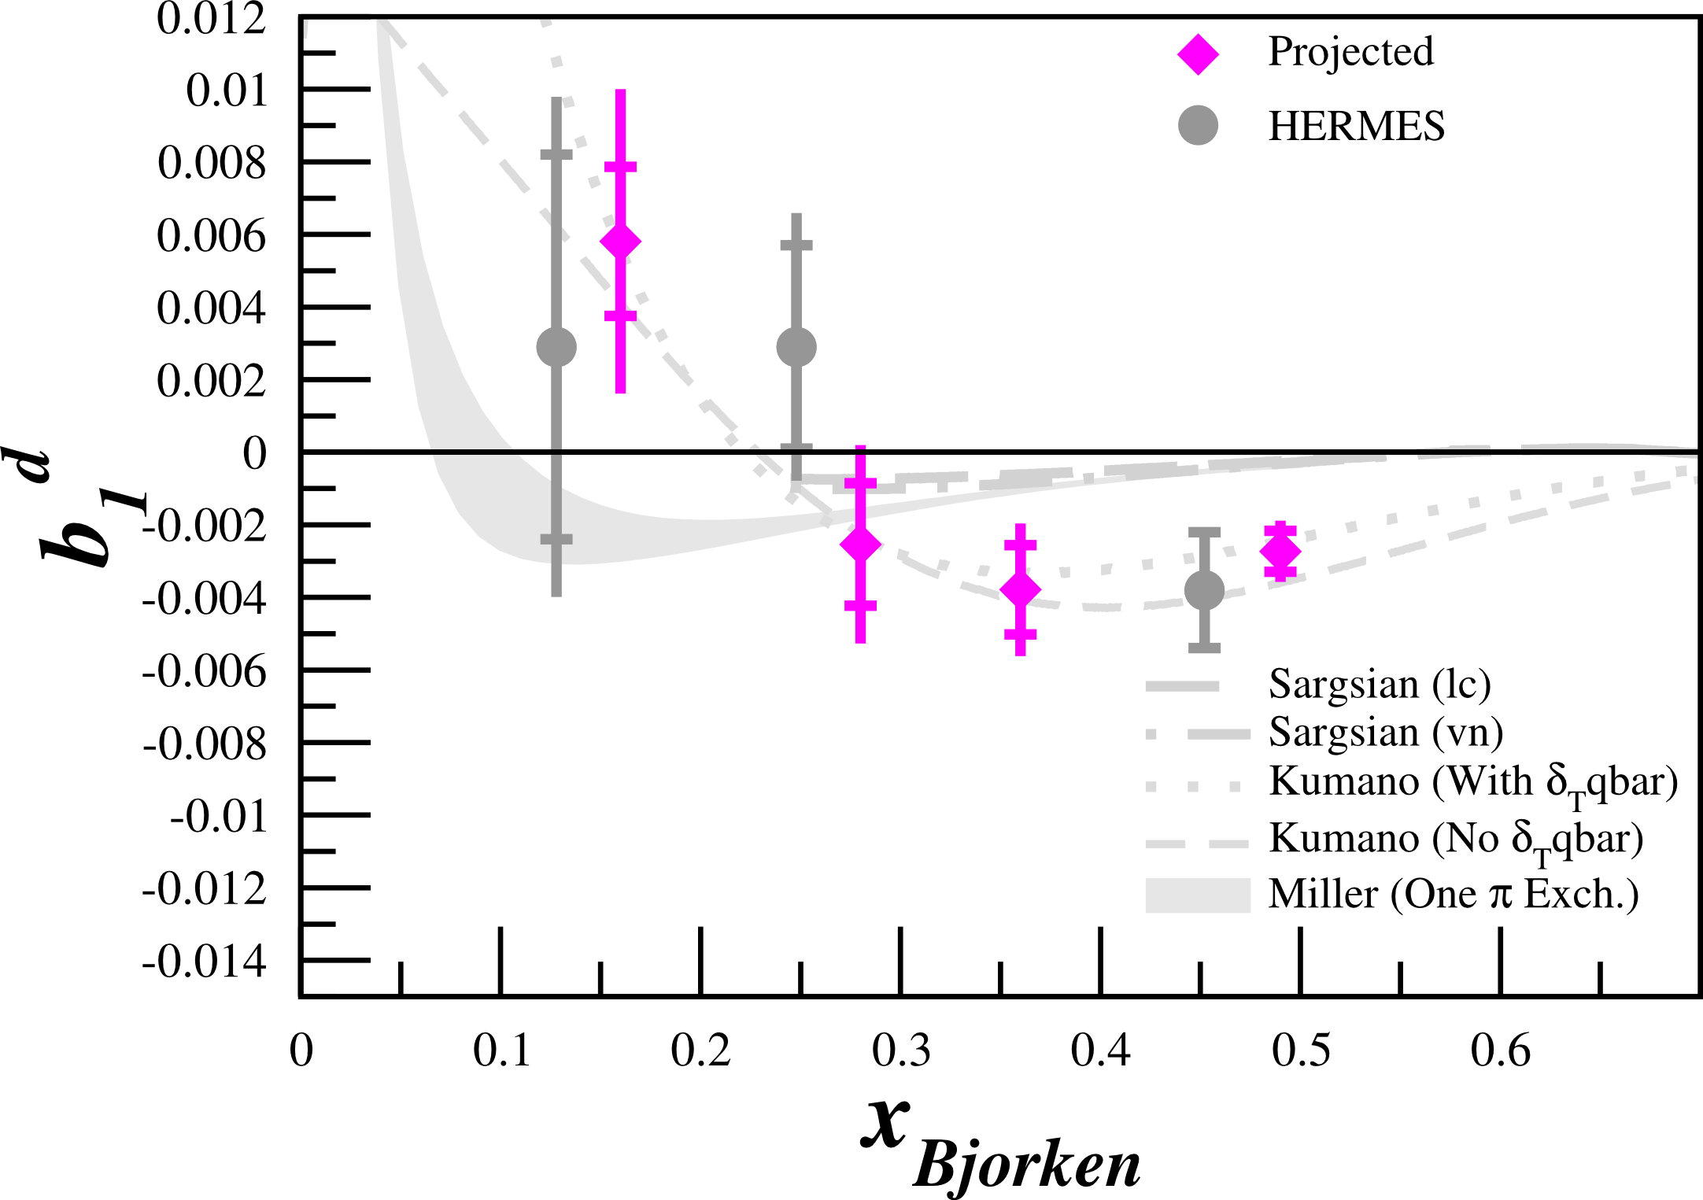
Projected Results
Assuming P_{zz}=30%

Slide 53
Summary
All conventional models predict b₁~0 at moderate x
Large, non-zero values of b₁ in this region would serve as clean signatures of exotic effects in nuclei
First data showed intriguing behavior, but are only ~2σ from zero
HMS/SHMS from Hall C

Slide 54
Summary
All conventional models predict b₁~0 at moderate x
Large, non-zero values of b₁ in this region would serve as clean signatures of exotic effects in nuclei
First data showed intriguing behavior, but are only ~2σ from zero
HMS/SHMS from Hall C
Novel type of experiment at Jefferson Lab
With 30 days of beam-time we can perform a very precise measurement of b₁ for 0.1 < x < 0.6 with much smaller kinematic binning than HERMES
  2.7σ for P_{zz}=20%, 3.6σ for P_{zz}=30% at x=0.49

Slide 56
Back-Ups

Slide 57
Kinematics

Slide 58
Close-Kumano Sum Rule Calculations
Integrating model calculations in the x range we will measure
Miller (0.15 < x < 0.5)
  -0.0001
Sargsian (0.245 < x < 0.5)
  -0.0002

Slide 59
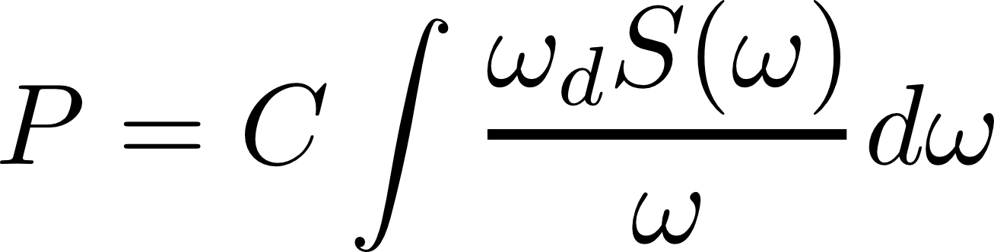
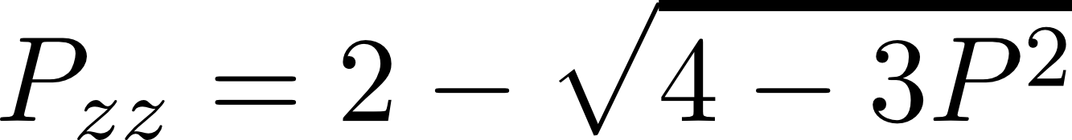
Polarization Without Hole-Burning
UVA has achieved vector polarization > 50%
Polarization measured using line shape fitting
  Vector polarization from NMR signal
  Determine tensor polarization from vector polarization
With development, we expect to achieve P_{zz} ~ 20%

Slide 60
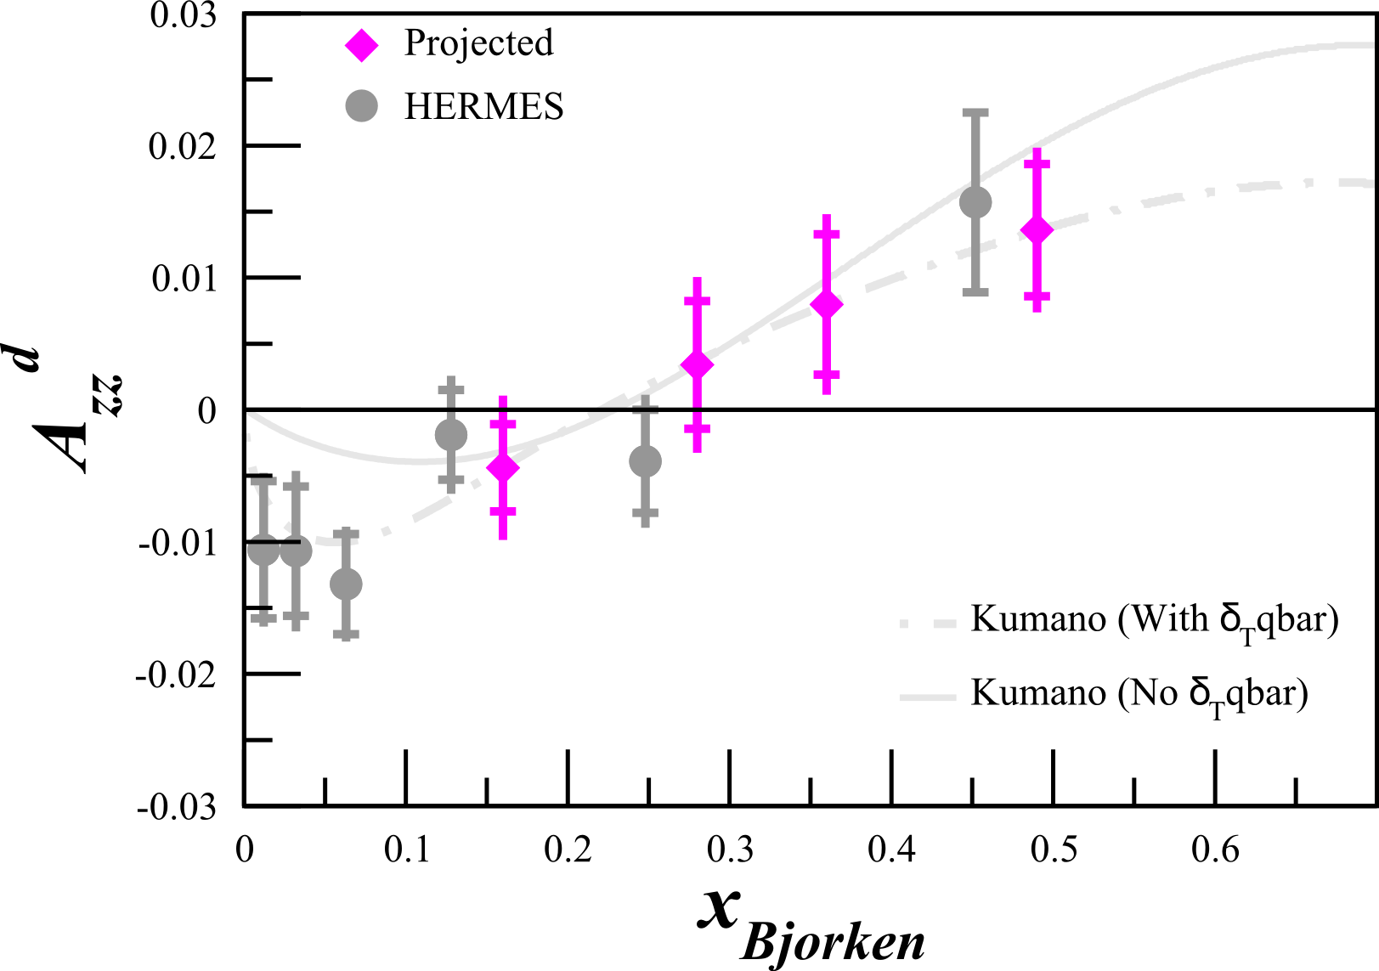
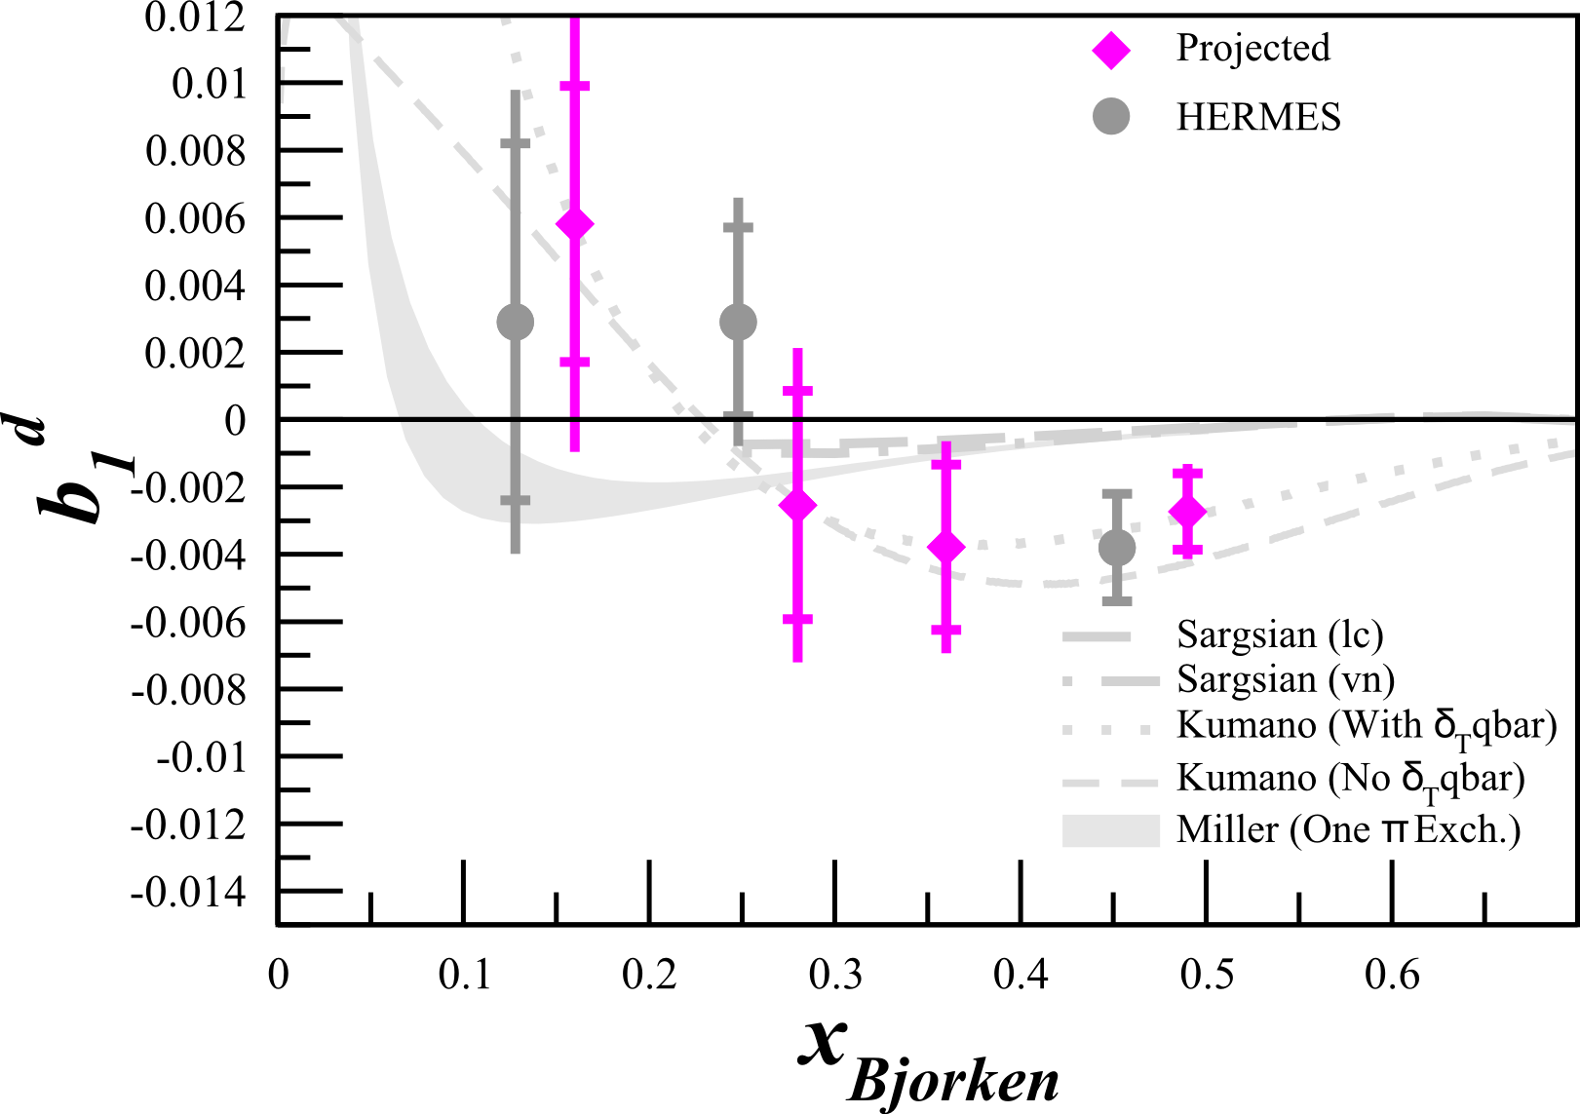
Projected Results
Assuming P_{zz}=15%

Slide 61
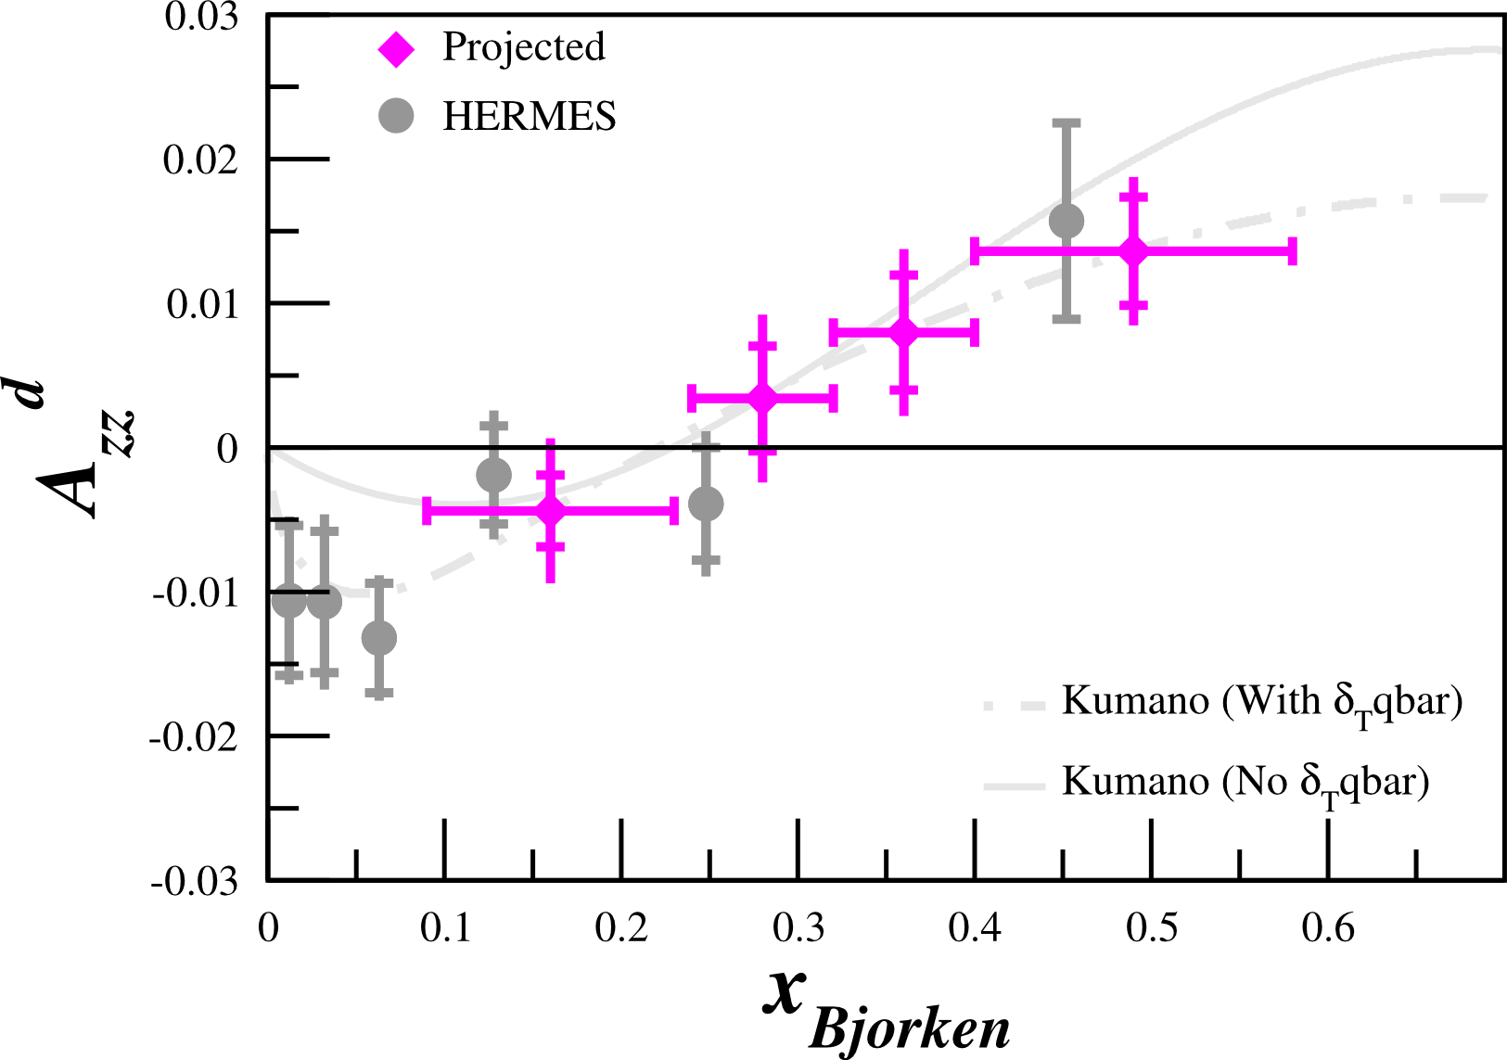
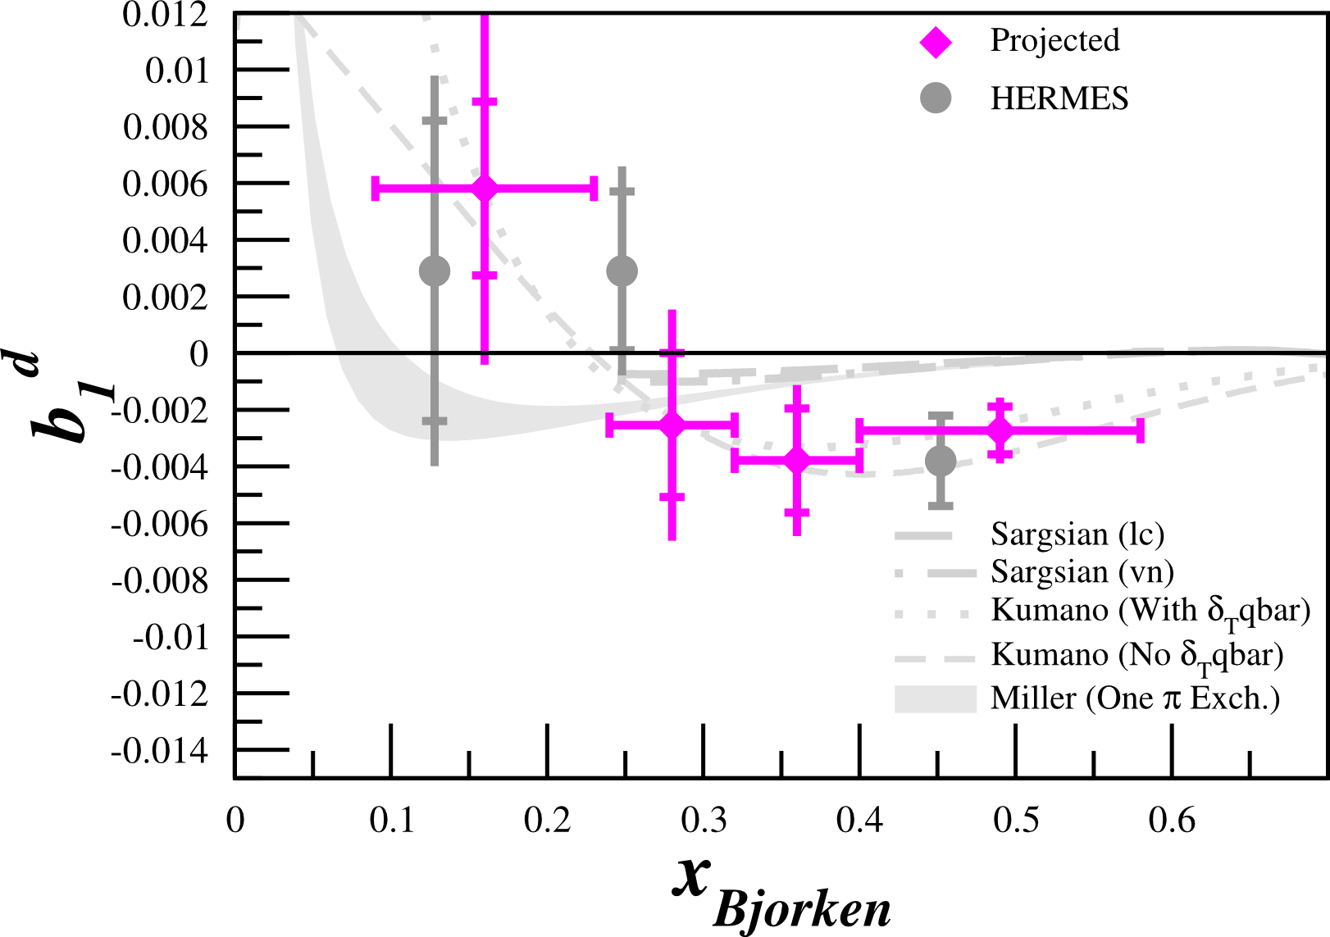
Projected Results
Assuming P_{zz}=20%

Slide 62
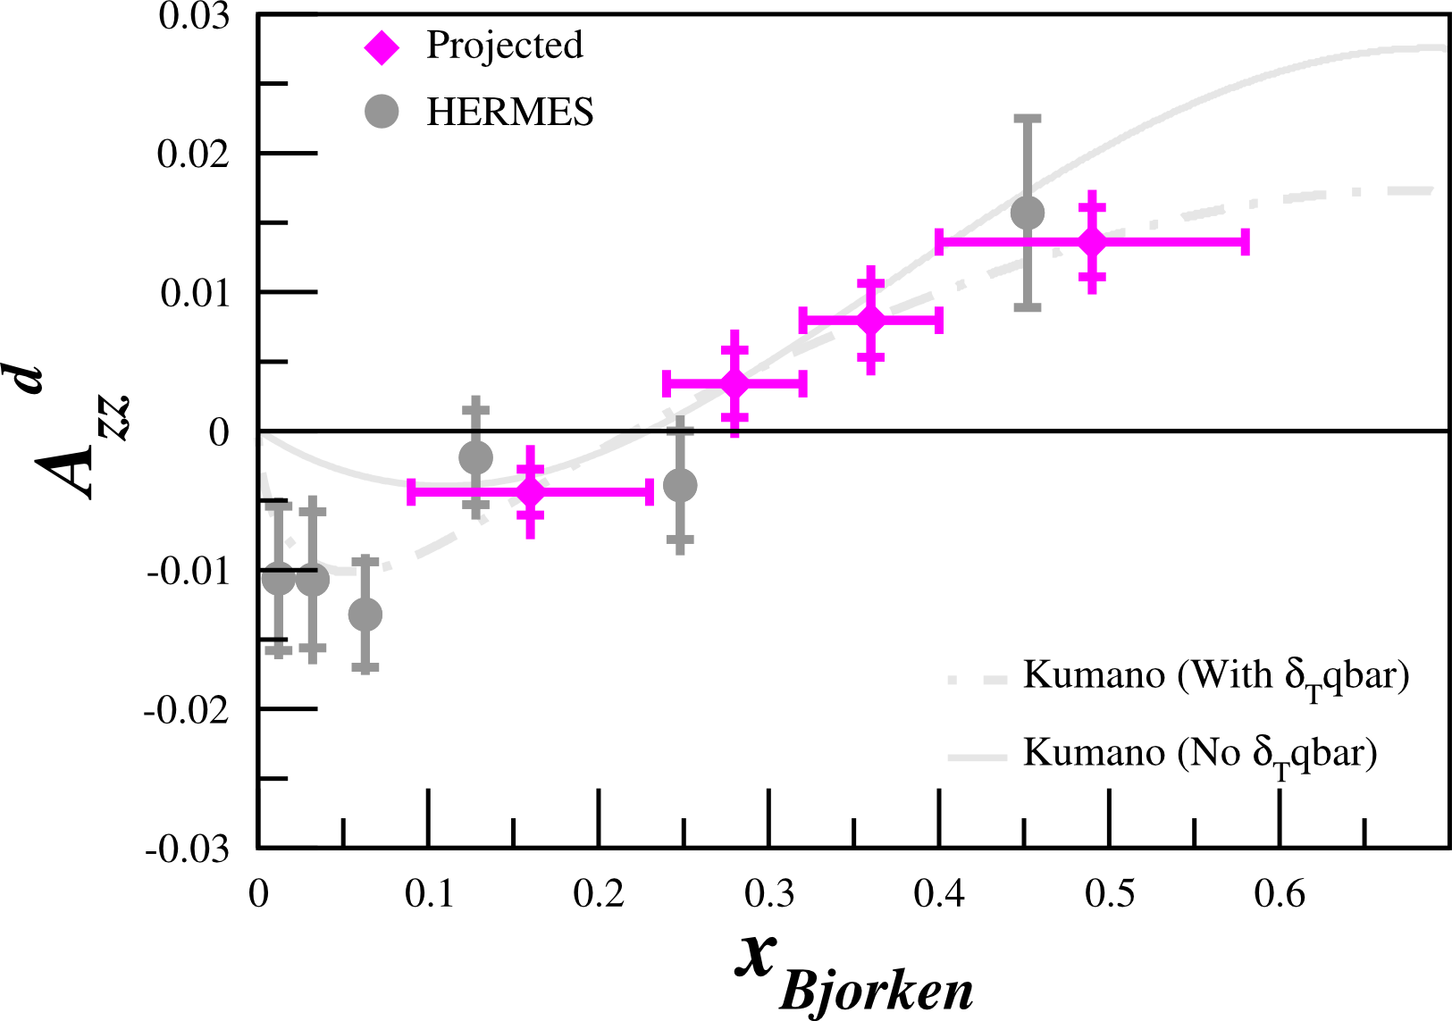
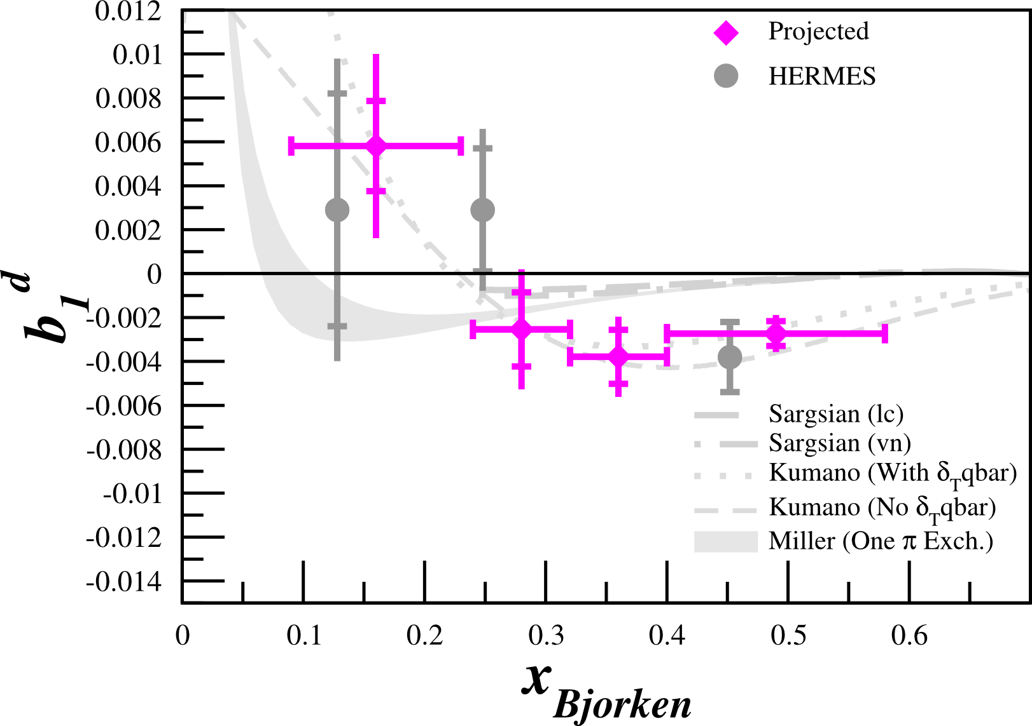
Projected Results
Assuming P_{zz}=30%

