Slide 1
The Deuteron Polarized ensor Structure Function b₁ PAC 38 Defense
PR12-11-110 Spokespeople
Jian-Ping Chen, Narbe Kalantarians
Oscar Rondon, Patricia Solvignon, Karl Slifer

Slide 2
b₁ Collaboration
W. Bertozzi, S. Gilad, J. Huang,
A. Kelleher, V. Sulkosky
Massachusetts Institute of Technology
Ronald Gilman
Rutgers, The State University of New Jersey
Seonho Choi, Hoyoung Kang,
Hyekoo Kang, Yoomin Oh
Seoul National University
H.P. Cheng, H.J. Lu, X.H. Yan
Huangshan University
Y. X. Ye, P. J. Zhu
University of Science and Technology of China
B. T. Hu, Y. Zhang
Lanzhou University
Abdellah Ahmidouch
North Carolina A & T State University
Caroline Riedl
DESY
J.-P. Chen, P. Solvignon, K. Allada, A. Camsonne, A. Deur, D. Gaskell, M. Jones,
C. Keith, J. Pierce, S. Wood, J. Zhang
Jefferson Lab
N. Kalantarians, O. Rondon, D. Crabb, D. Day, H. Baghdasaryan, C. Hanretty R. Lindgren, B. Norum, Zhihong Ye, X. Zheng
University of Virginia
K. Slifer, A. Atkins, T. Badman, J. Calarco,
J. Dawson, J. Maxwell, S. Phillips, R. Zielinski
University of New Hampshire
James Dunne, Dipankar Dutta
Mississippi State University
Guy Ron
Hebrew University of Jerusalem
Krishna Adhikari
Old Dominion University

Slide 3
Deuteron
n
p
Spin-1 system
Simple testing ground for nuclear physics
Reasonably “easy” to polarize

Slide 4
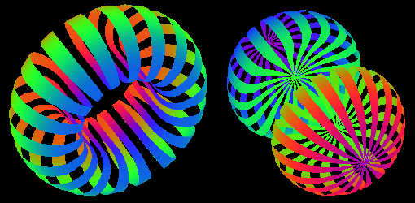
Deuteron
n
p
Spin-1 system
Simple testing ground for nuclear physics
Reasonably “easy” to polarize
Spatial distribution depends on the spin state
M = 0
M = ±1

Slide 5
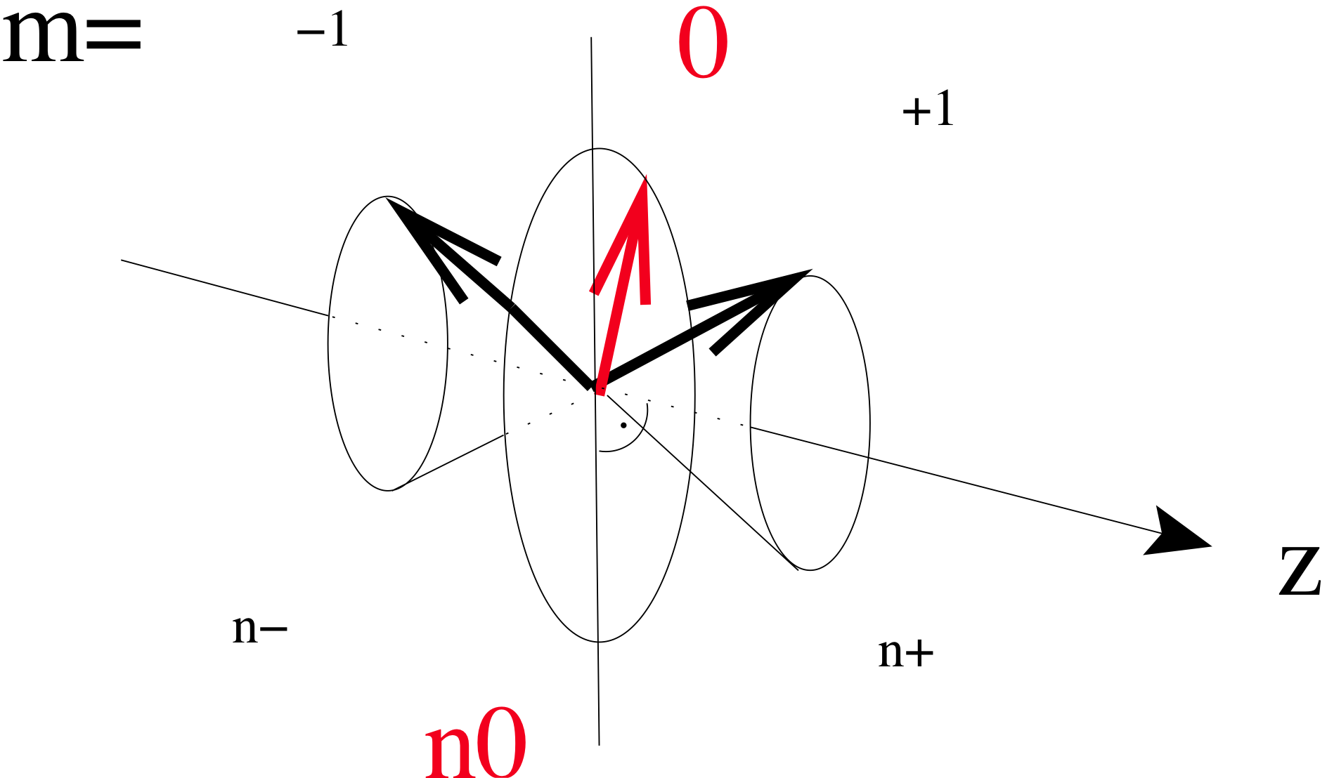
Spin-1 System
Spin-1 in B-field leads to 3 Zeeman sublevels
0
m=+1
m=0
m=-1
Vector Polarization
P_{z} : (n⁺ - n⁻)
(-1 <P_{z} < +1)
and
Tensor polarization
P_{zz} : (n⁺ - n⁰) – (n⁰ – n⁻)
(-2 < P_{zz} < +1)
Normalization
(n⁺ + n⁻ + n⁰) = 1

Slide 6
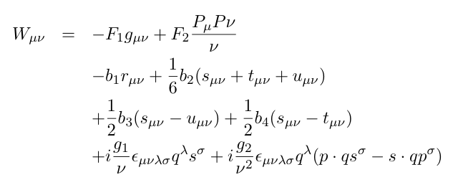
Inclusive Scattering from Deuteron
e
e’
γ∗
Construct the most general
Tensor W consistent with
Lorentz and gauge invariance
W
D
Frankfurt & Strikman (1983)
Hoodbhoy, Jaffe, Manohar (1989)
Unpolarized Scattering

Slide 7
Inclusive Scattering from Deuteron
e
e’
γ∗
W
D
Doubly Polarized Scattering

Slide 8
Inclusive Scattering from Deuteron
e
e’
γ∗
W
D
Unpolarized beam
&
Polarized Target

Slide 9
b₁ Structure Function
Focus on b₁ in this experiment:
Leading twist
Simplest to access experimentally.
Probe the tensor polarization of the sea quarks.
Signature of “exotic” effects in nuclei.
i.e. deviation of proton from simple system of two bound nucleons.

Slide 10
b₁ Structure Function

Slide 11
Inclusive Scattering
b₁ Structure Function
q⁰ : Probability to scatter from a quark (any flavor) carrying momentum fraction x while
the Deuteron is in state m=0
q¹ : Probability to scatter from a quark (any flavor) carrying momentum fraction x while
the Deuteron is in state |m| = 1

Slide 12
b₁ Structure Function
q⁰ : Probability to scatter from a quark (any flavor) carrying momentum fraction x while
the Deuteron is in state m=0
q¹ : Probability to scatter from a quark (any flavor) carrying momentum fraction x while
the Deuteron is in state |m| = 1

Slide 13
b₁ Structure Function
q⁰ : Probability to scatter from a quark (any flavor) carrying momentum fraction x while
the Deuteron is in state m=0
q¹ : Probability to scatter from a quark (any flavor) carrying momentum fraction x while
the Deuteron is in state |m| = 1
Nice mix of nuclear and quark physics
measured in DIS (so probing quarks), but depends solely on the deuteron spin state
Investigate nuclear effects at the level of partons!

Slide 14
b₁ Structure Function
Hoodbhoy, Jaffe and Manohar (1989)
b₁ vanishes in the absence of nuclear effects
i.e. if...
deuteron
=
n
+
p
Proton Neutron in relative S-state
Even accounting for D-State admixture b₁ expected to be vanishingly small
Khan & Hoodbhoy, PRC 44 ,1219 (1991) : b₁ ≈ O(10⁻⁴)
Relativistic convolution model with binding
Umnikov, PLB 391, 177 (1997) : b₁ ≈ O(10⁻³)
Relativistic convolution with Bethe-Salpeter formalism

Slide 15
It is a unique opportunity at JLab to develop this new field of spin physics.
S. Kumano (KEK)
I’m glad to hear that b1 is not forgotten in all the excitement about other spin dependent effects.
Robert Jaffe (MIT)
I am particularly interested in signatures of novel QCD effects in the deuteron. The tensor charge could be sensitive to hidden color (non-nucleonic) degrees of freedom at large x. It is also interest- ing that antishadowing in DIS in nuclei is not universal but depends on the quark flavor and spin. One can use counting rules from PQCD to predict the x → 1 dependence of the tensor structure function.
Stanley Brodsky (SLAC)
I am certainly interested in the experimental development to find the novel QCD phenomena from the hidden color component of deuteron.
Chueng-Ryong Ji (NCSU)
Surely this is of real interest the spin community!
Leonard Gamberg (Penn State Berks)
I find the proposal well written, well justified, sound, and exciting.
Alessandro Bacchetta (Universita di Pavia)
It is certainly an interesting quantity, precisely because it vanishes in the independent nucleon picture of the deuteron.
Elliot Leader (Imperial College of London)

Slide 16
world data

Slide 17
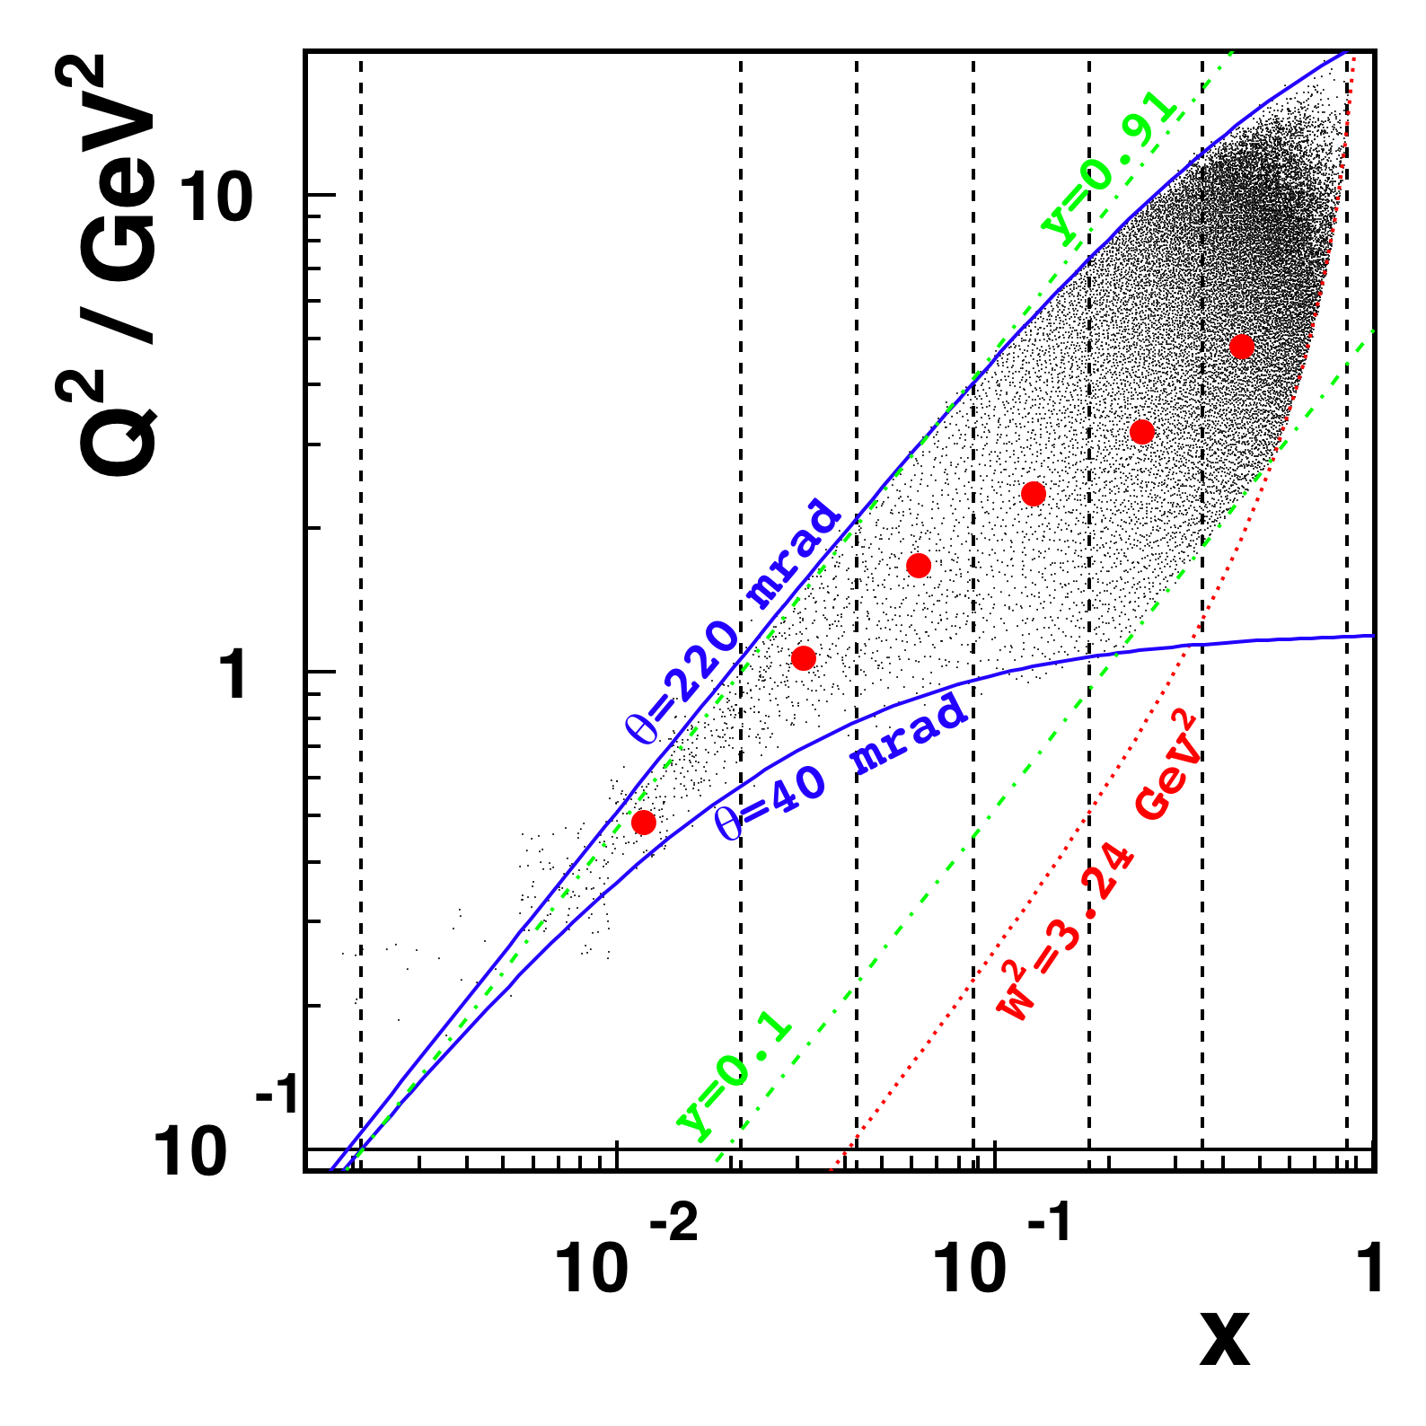
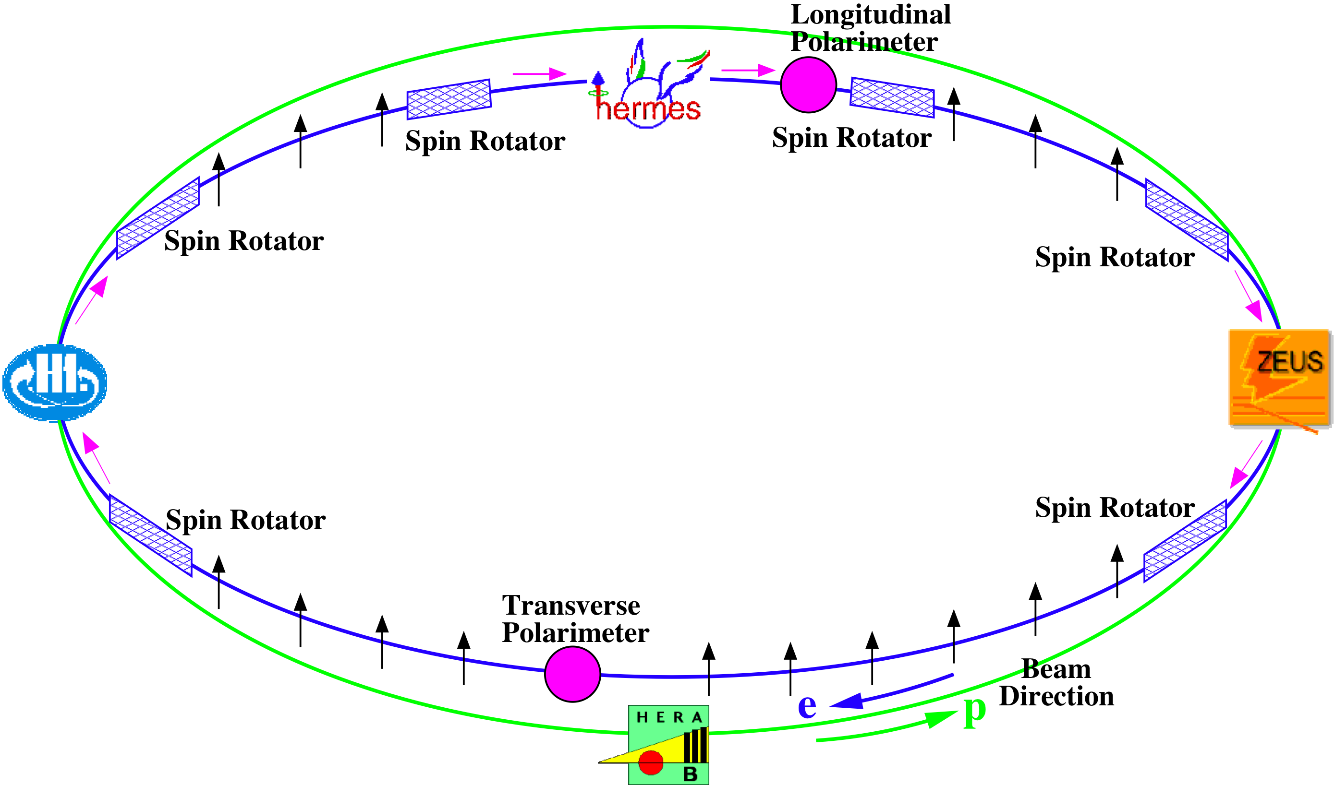
First Data from HERMES
27.6 GeV positrons
Internal gas target
~Pure tensor polarization
with little vector component
0.01 < <x> < 0.45
0.5 < <Q²> < 5 GeV²

Slide 18
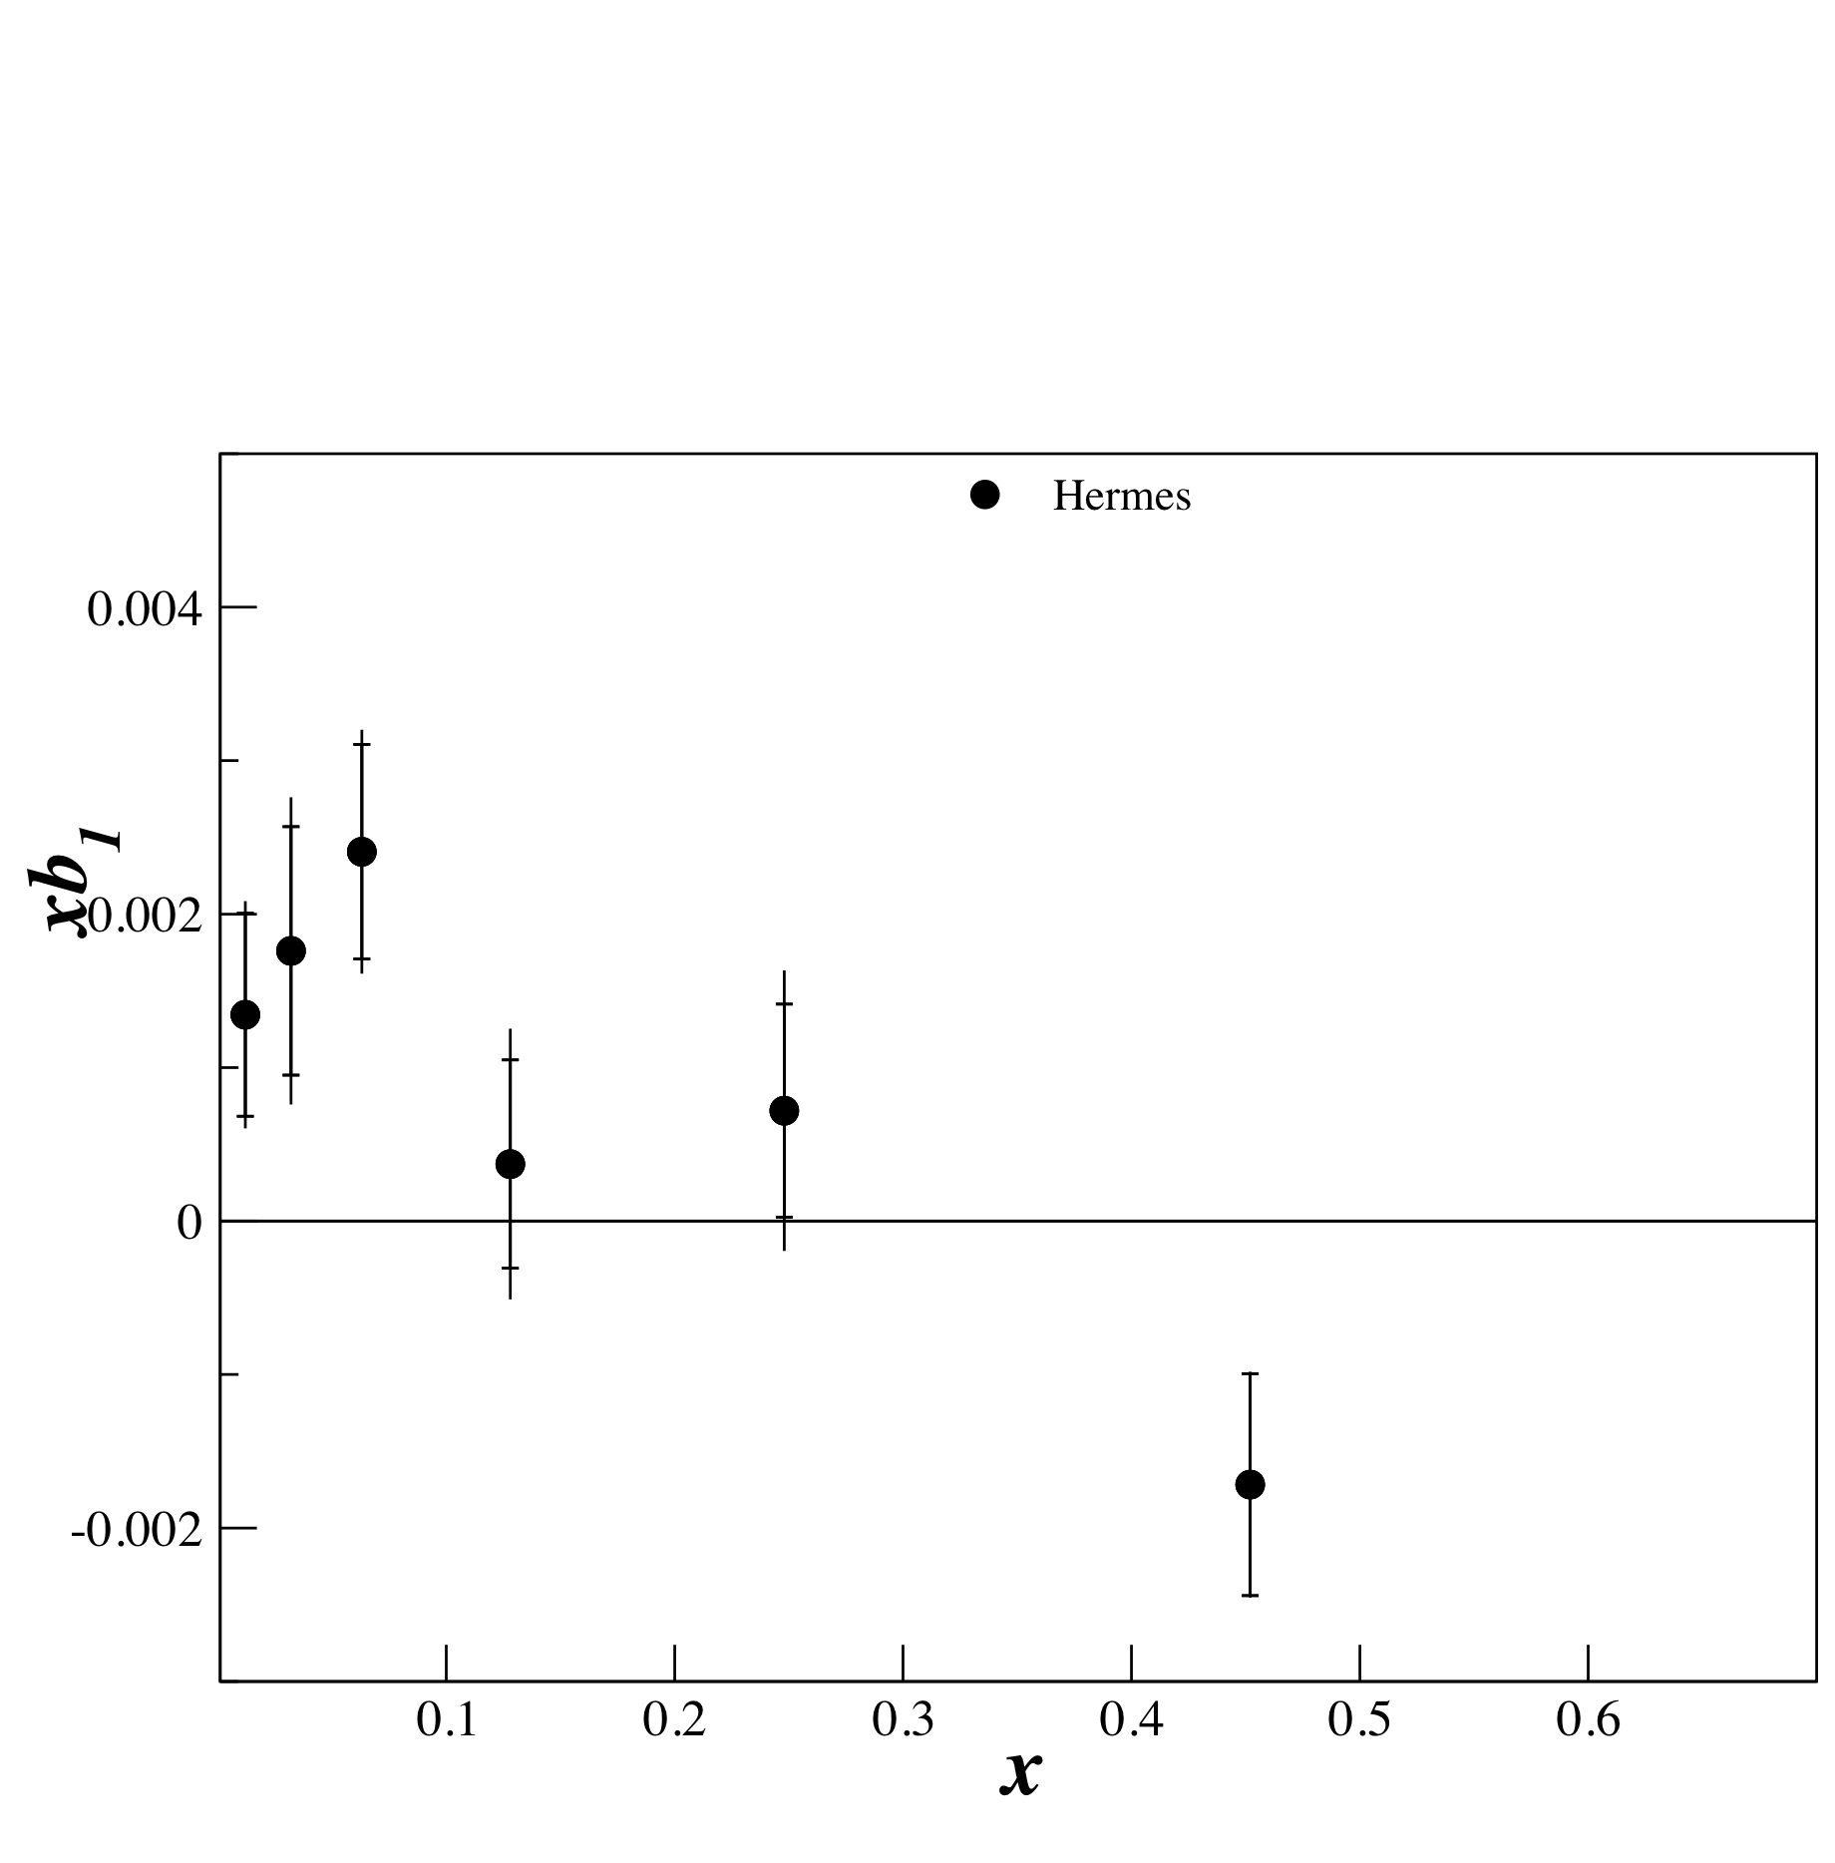
First Data from HERMES
PRL 95, 242001 (2005)

Slide 19
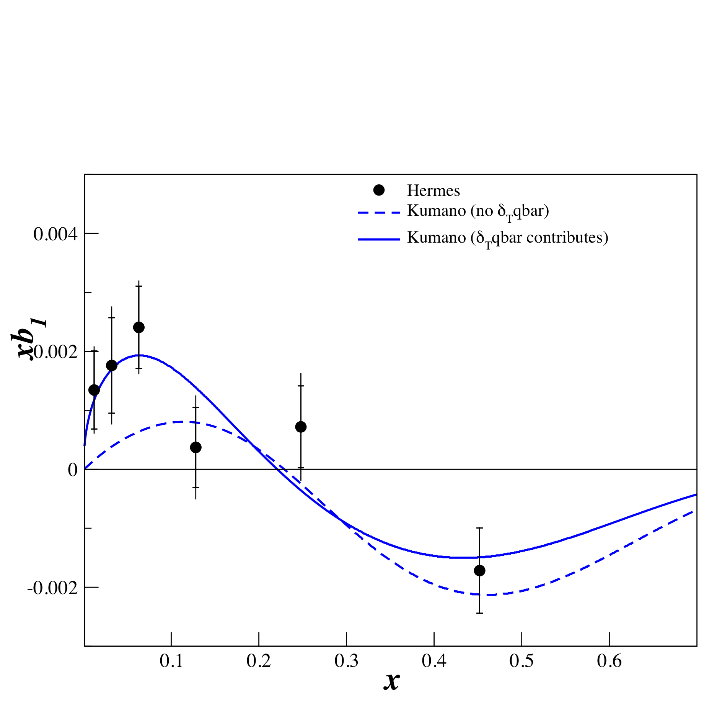
Model Predictions
Kumano Fit to the Data
Requires tensor polarized sea for
best fit.

Slide 20
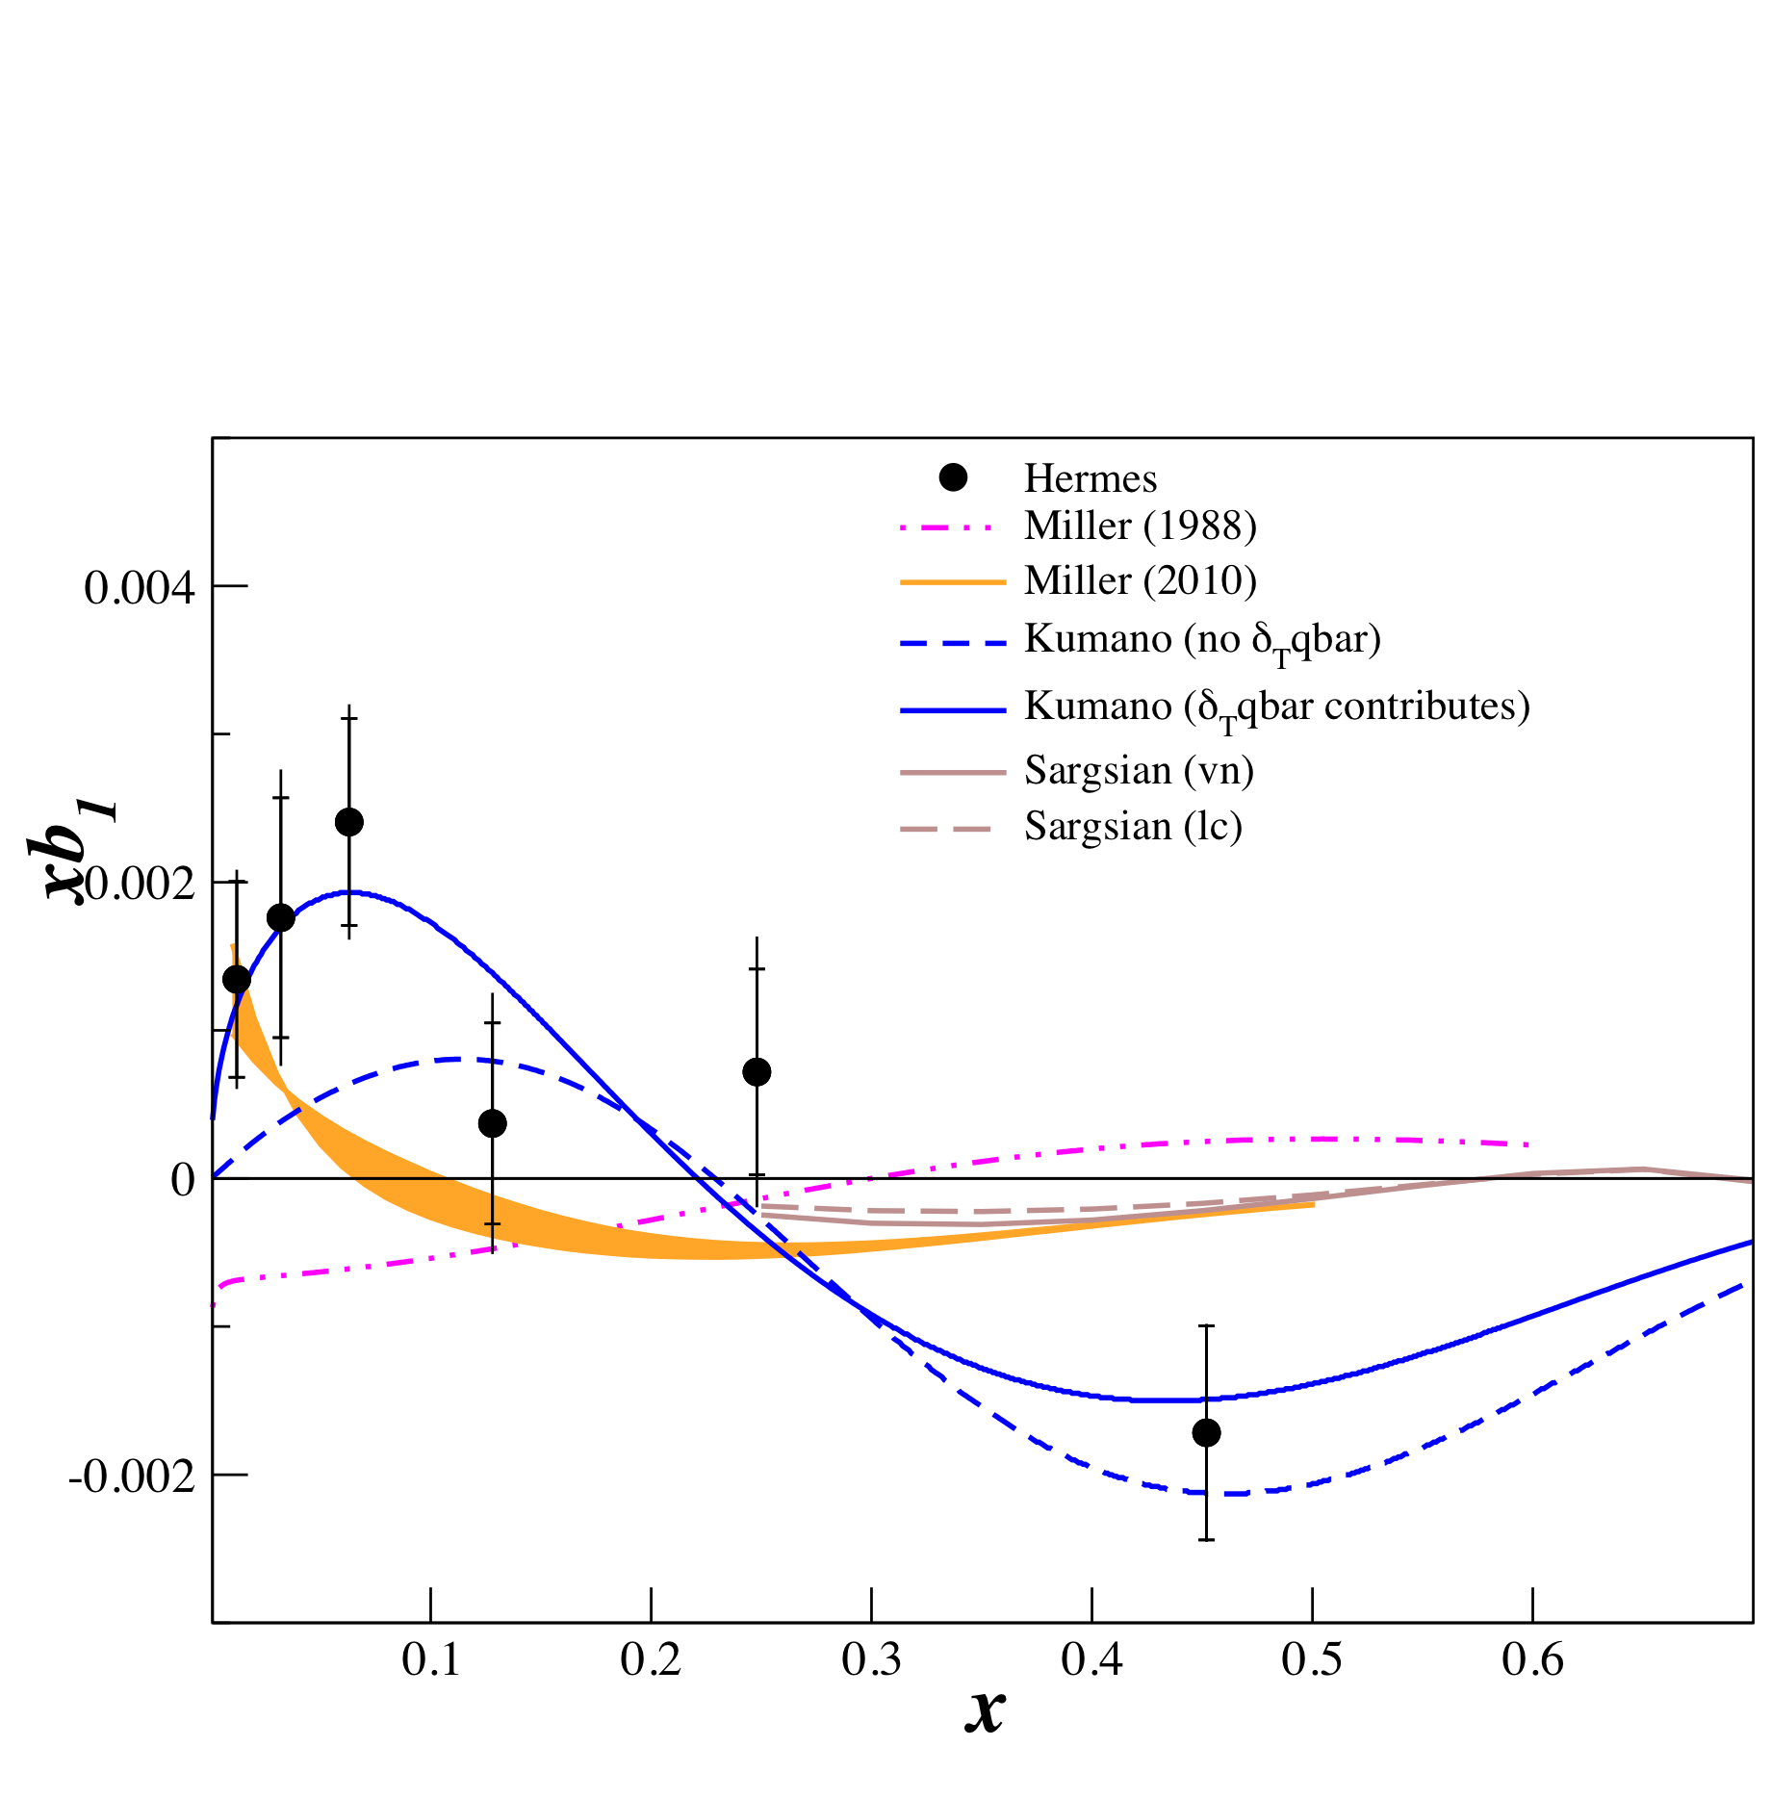
Model Predictions
All Conventional Models predict small or
vanishing values of b1 in contrast to
the HERMES data

Slide 21
Close-Kumano Sum Rule
Satisfied for an unpolarized sea.
Deviations from zero : good signature of exotic effects
in the Deuteron Wave Function.
Khan & Hoodbhoy, PRC 44 ,1219 (1991) :
Relativistic convolution model with binding : -6.7E10⁻⁴
Hermes result
2
2.2 σ difference from zero

Slide 22
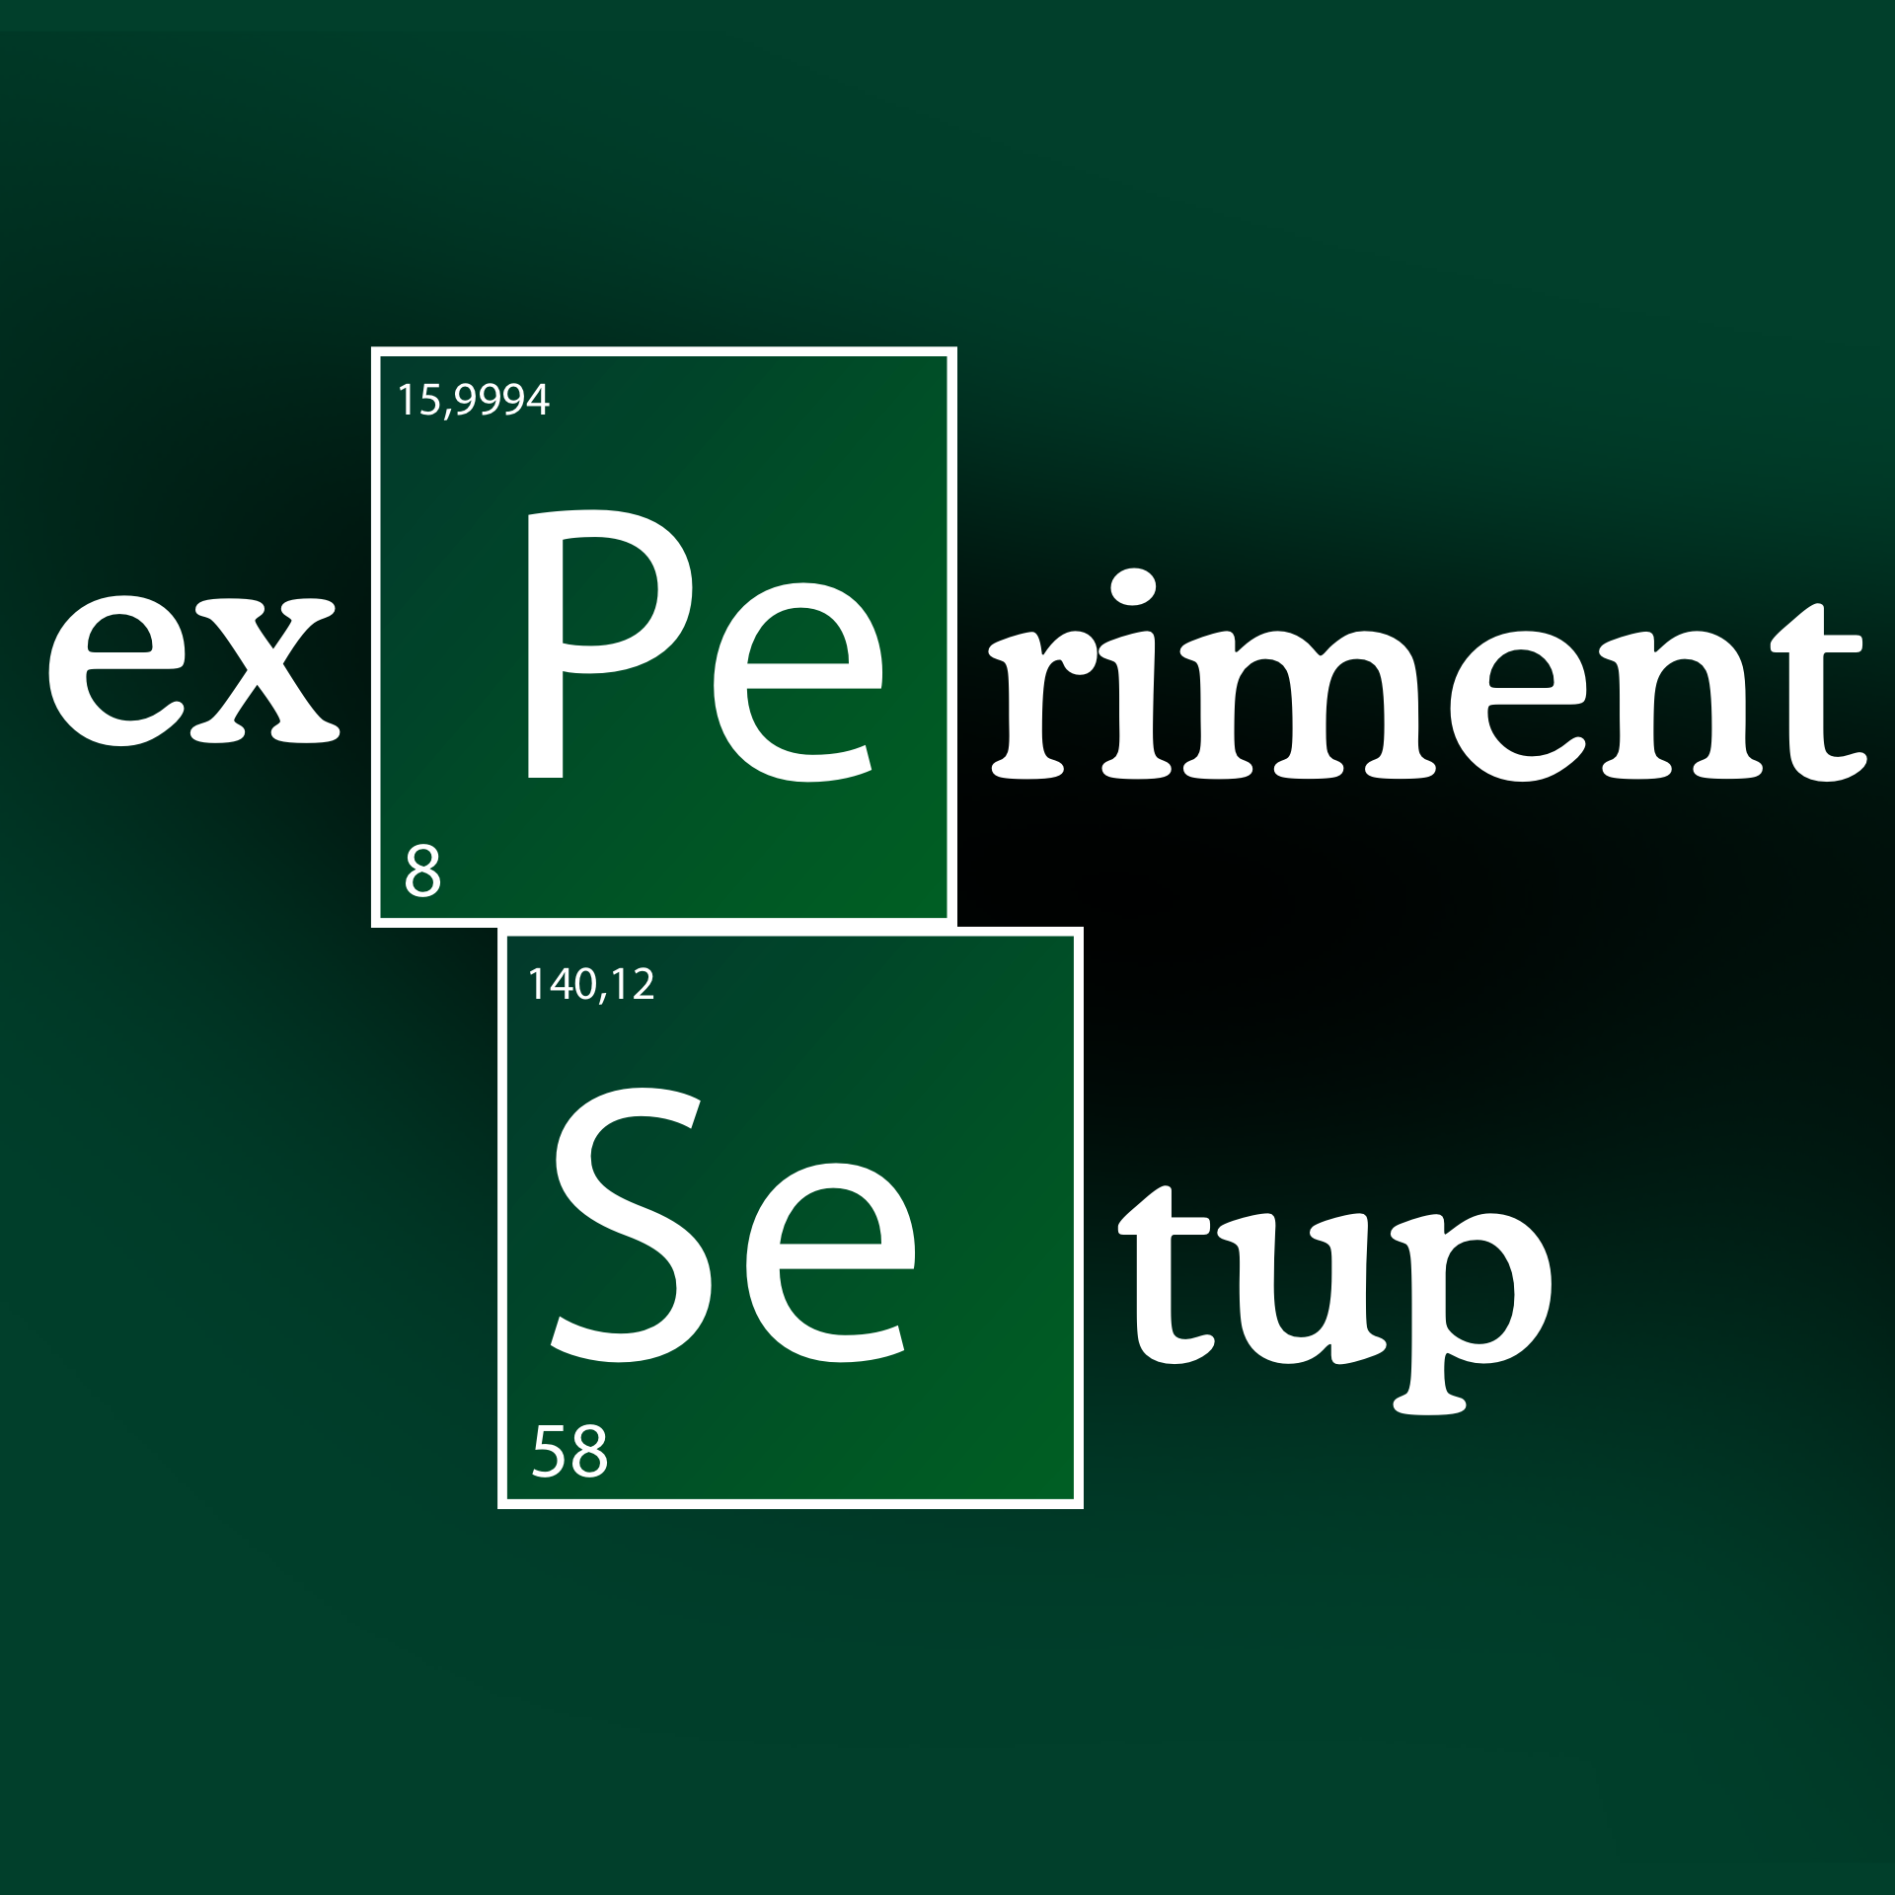

Slide 23
JLab
Unpolarized Beam: polarized beam ok. isolate b₁ by spin averaging. (get g₁ &g₂ for free).
UVa/JLab Polarized Target : Longitudinal and Transverse magnetic field.
Vector polarization determined by standard NMR, then simple relation for tensor pol:
Crabb et al. had some limited success in enhancing the tensor polarization in past

Slide 24
JLab
Unpolarized Beam: polarized beam ok. isolate b₁ by spin averaging. (get g₁ &g₂ for free).
UVa/JLab Polarized Target : Longitudinal and Transverse magnetic field.
Vector polarization determined by standard NMR, then simple relation for tensor pol:
Hoodbhoy, Jaffe and Manohar, Nucl. Phys. B312, 571 (1989)
Difference of polarized cross sections
Crabb et al. had some limited success in enhancing the tensor polarization in past
Tensor Polarization
while in para config
Tensor Polarization
while in perp config

Slide 25
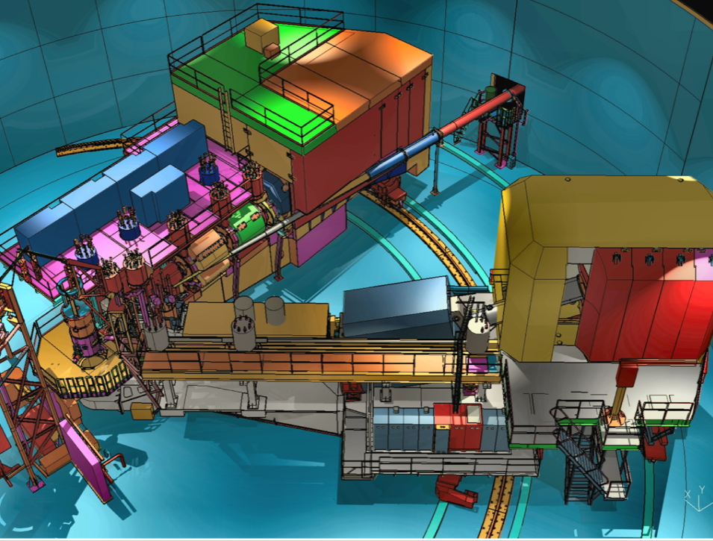
Hall C Configuration

Slide 26
Hall C Beamline
SHMS @8.9º
Slow
Raster
FZ2 on
Movable stand
Poltarg
FZ1
Helium Bag
HMS @13.4º
Similar config as in SANE but expect less deviation of the beam.
Downstream helium bag.
Chicane will be standard part of 12 GeV Beamline.

Slide 27
Kinematics
Logarithmic Scale

Slide 28
Kinematics
0.18<x<0.35
1<Q²<9
approximate

Slide 29
HERMES Kinematics
0.18<x<0.35
1<Q²<9
0.35<x<0.85
2<Q²<18
approximate

Slide 30
HERMES Kinematics
0.18<x<0.35
1<Q²<9
0.35<x<0.85
2<Q²<18
0.2<x<0.45
1.5<Q²<2.5
0.35<x<0.60
3<Q²<5
This experiment

Slide 31
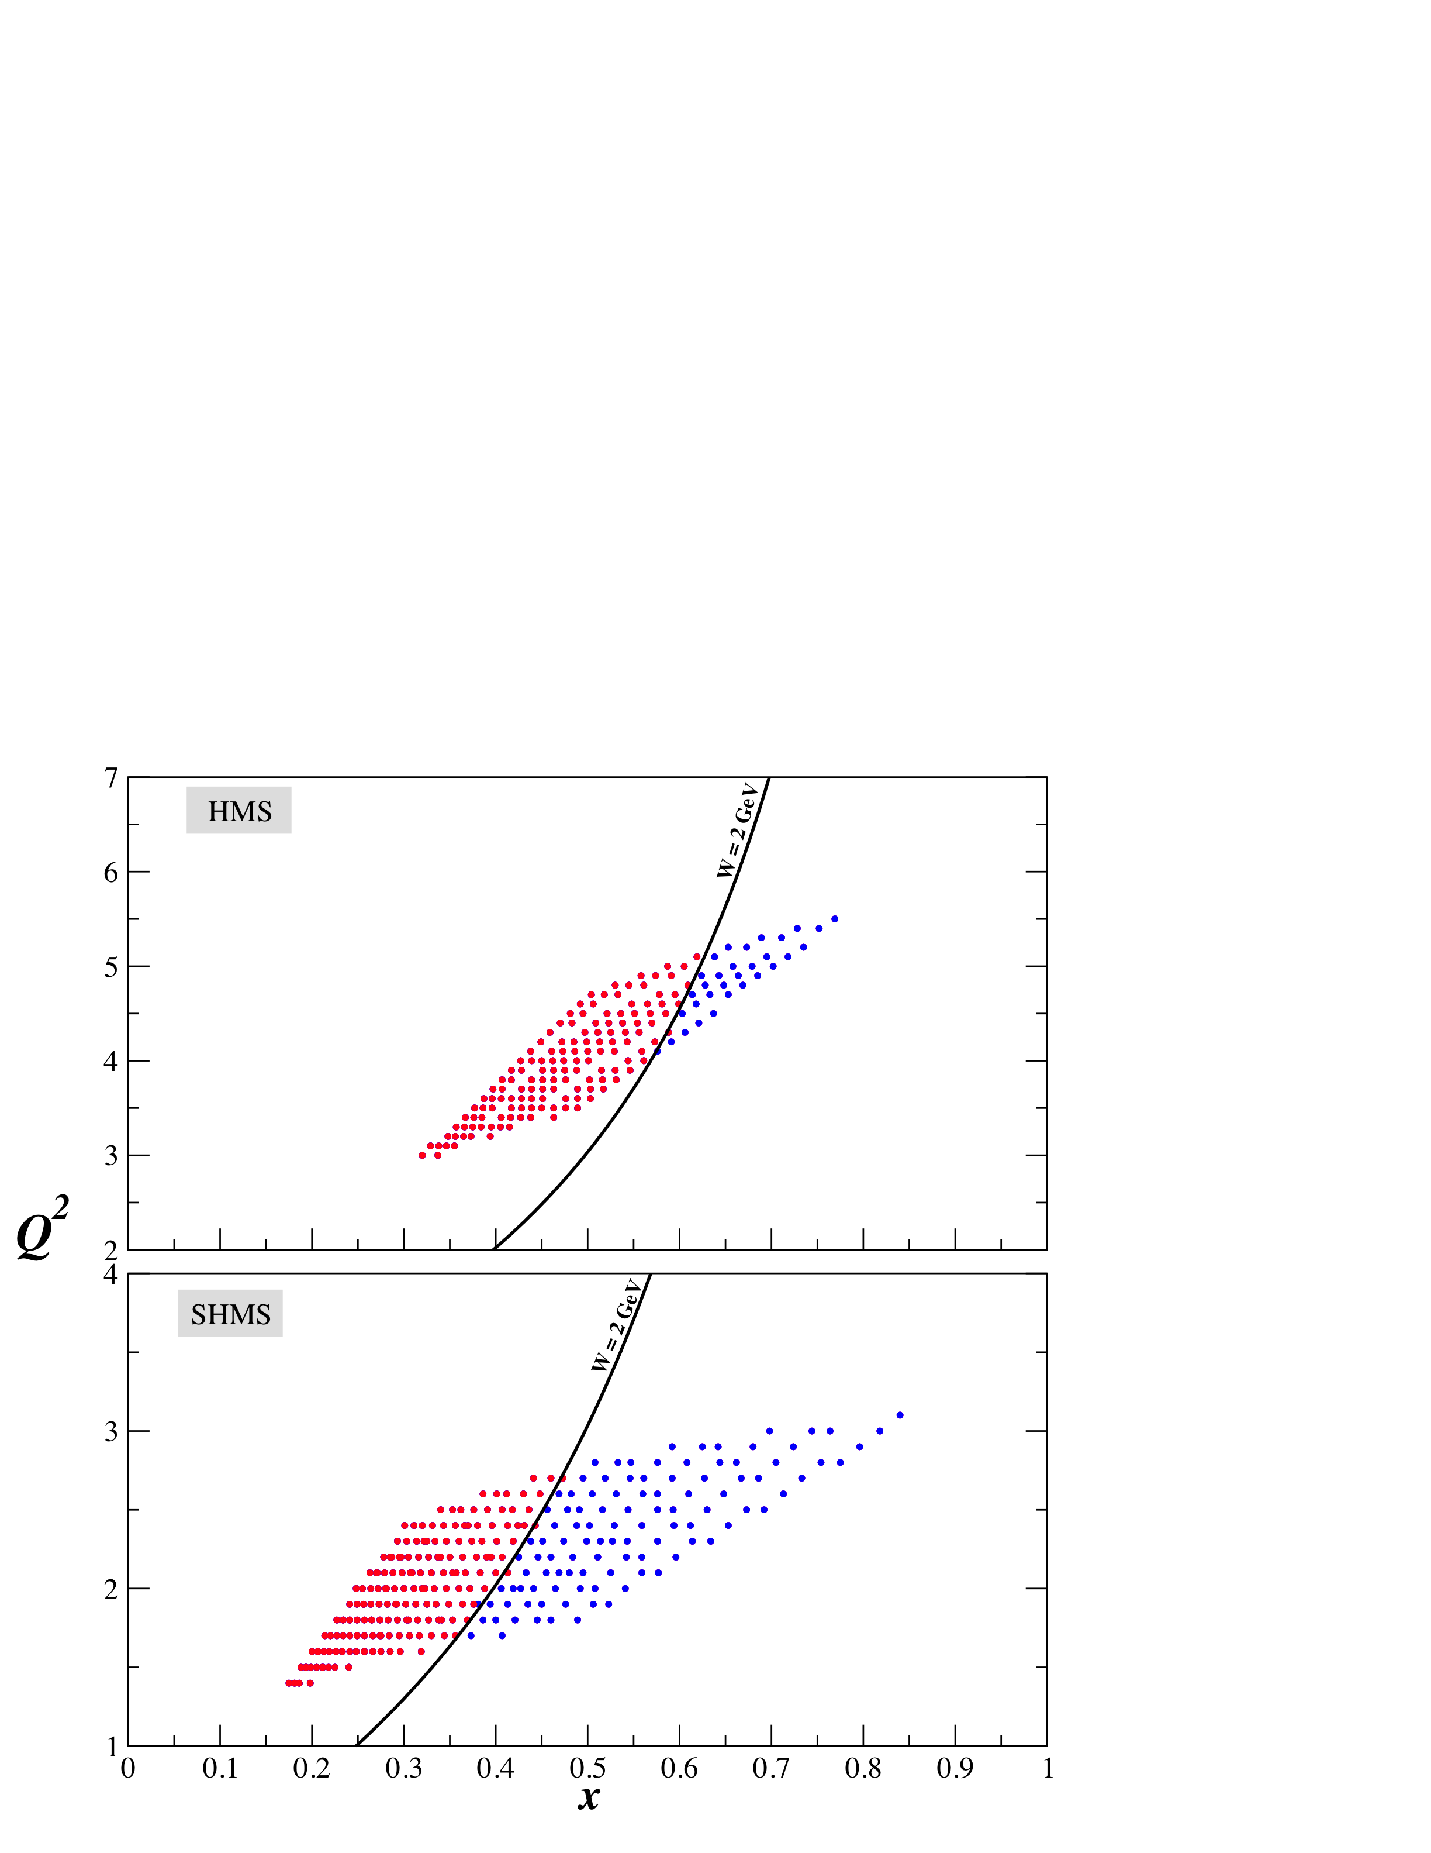
Kinematics
Hermes
W>1.8 GeV
This experiment
W>2 GeV

Slide 32
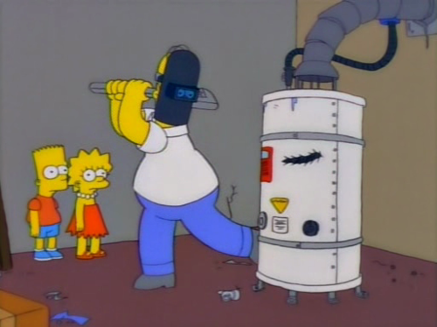
Polarized Target
poltarg
circa 2008

Slide 33
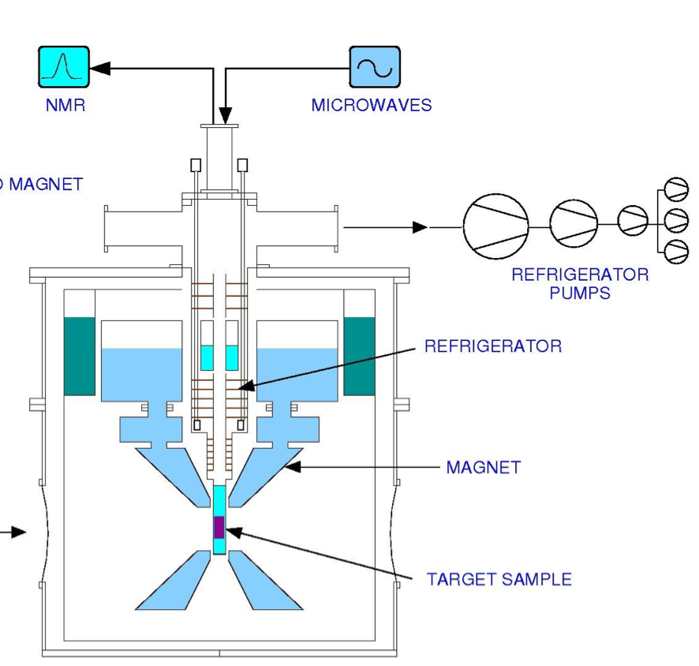
Polarized Target
Dynamic Nuclear Polarization of ND₃
5 Tesla @ 1 K
SLAC, GEN1,2, RSS, SANE, g2p
fig. courtesy C. Keith

Slide 34
Polarized Target
Dynamic Nuclear Polarization of ND₃
5 Tesla @ 1 K
SLAC, GEN1,2, RSS, SANE, g2p
Extensive Recent Improvements
UVa
Coils refurbished at Oxford
JLab Target Group
New Refrigerator
New Target Insert
New Rotary pumps
New Pump controls
New Target motion control
New Rotating seal
fig. courtesy C. Keith

Slide 35
Polarized Target
Standard performance at 5T/1K, 115 nA
Max P_{z} ≈ 50%
Average In-beam P_{z} ≈ 35%
Average In-beam P_{zz} ≈ 9.5%

Slide 36
Polarized Target
Assumed for this proposal
Max P_{z} ≈ 60%
Average In-beam P_{z} ≈ 42%
Average In-beam P_{zz} ≈ 13.7 %
Need incremental improvement in ND₃ target performance.
Assumed
Standard Performance
42% Average vector polarization
3.3 cm target cell length
Packing Fraction of 0.8
35% Average vector polarization
3.0 cm target cell length
Packing Fraction of 0.55

Slide 37
Projected Results

Slide 38
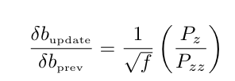
Changes from proposal
Major
1) Neglected a Factor of 1/f in rates (TAC review).
2) Assumed rates depended on P_{z} instead of P_{zz} (self-discovered).
Net effect: factor of ≈5 increase in stat error.

Slide 39
Changes from proposal
Major
1) Neglected a Factor of 1/f in rates (TAC review).
2) Assumed rates depended on P_{z} instead of P_{zz} (self-discovered).
To account for this, we need compensating increase in target performance.
<P_{z}> improve from 35% => 42%.
Packing Fraction improve from 0.55 to 0.80
Slight increase in target length
Net effect: factor of ≈5 increase in stat error.
and dropped one kinematic point (x=0.4) to allow higher Q² at x=0.3
Minor
Move spectrometers out slightly to accomodate downstream helium bag.

Slide 40
OLD rates calculation
We originally evaluated relative uncertainties on b1.
This is model dependent.
Kumano’s model is largest prediction for b1.
consequently gives the most optimistic prediction for uncertainties.
To bring in line with other prediction we scaled by arbitrary factor (1/5).

Slide 41
OLD rates calculation
We originally evaluated relative uncertainties on b1.
This is model dependent.
Kumano’s model is largest prediction for b1.
consequently gives the most optimistic prediction for uncertainties.
To bring in line with other prediction we scaled by arbitrary factor (1/5).
We provide the table on next page of old values as requested by PAC for reference.
But we are now using absolute errors which are model-independent, as suggested
by the TAC

Slide 42
OLD rates calculation (incorrect)
Working with relative uncertainty introduces a model dependence
If we had directly used Kumano’s model for b₁:
x | Rates (kHz) | b1±db1 (x10⁻²) | db1/b1 (%) | Time (days) | ε
0.3 | 0.477 | -0.33±0.072 | 22.0 | 0.6 | 0.00126
0.4 | 0.143 | -0.38±0.083 | 22.0 | 0.5 | 0.00259
0.5 | 0.025 | -0.25±0.062 | 24.6 | 1.1 | 0.00366

Slide 43
OLD rates calculation (incorrect)
Working with relative uncertainty introduces a model dependence
Using Kumano’s model for b₁:
x | Rates (kHz) | b1±db1 (x10⁻²) | db1/b1 (%) | Time (days) | ε
0.3 | 0.477 | -0.33±0.072 | 22.0 | 0.6 | 0.00126
0.4 | 0.143 | -0.38±0.083 | 22.0 | 0.5 | 0.00259
0.5 | 0.025 | -0.25±0.062 | 24.6 | 1.1 | 0.00366
We chose Kumano’s model scaled by 1/5 for b₁:
x | Rates (kHz) | b1±db1 (x10⁻²) | db1/b1 (%) | Time (days) | ε
0.3 | 0.477 | -0.065±0.014 | 22.0 | 15.7 | 0.00025
0.4 | 0.143 | -0.075±0.017 | 22.0 | 12.5 | 0.00052
0.5 | 0.025 | -0.051±0.012 | 24.6 | 28.1 | 0.00073

Slide 44
OLD rates calculation (incorrect)
Working with relative uncertainty introduces a model dependence
Using Kumano’s model for b₁:
x | Rates (kHz) | b1±db1 (x10⁻²) | db1/b1 (%) | Time (days) | ε
0.3 | 0.477 | -0.33±0.072 | 22.0 | 0.6 | 0.00126
0.4 | 0.143 | -0.38±0.083 | 22.0 | 0.5 | 0.00259
0.5 | 0.025 | -0.25±0.062 | 24.6 | 1.1 | 0.00366
Listed in the proposal
Kumano’s model scaled by 1/5 for b₁ in the expression of ε:
x | Rates (kHz) | b1±db1 (x10⁻²) | db1/b1 (%) | Time (days) | ε
0.3 | 0.477 | -0.065±0.014 | 22.0 | 15.7 | 0.00025
0.4 | 0.143 | -0.075±0.017 | 22.0 | 12.5 | 0.00052
0.5 | 0.025 | -0.051±0.012 | 24.6 | 28.1 | 0.00073

Slide 45
Working with relative uncertainty introduces a model dependence
Using Kumano’s model for b₁:
x | Rates (kHz) | b1±db1 (x10⁻²) | db1/b1 (%) | Time (days) | ε
0.3 | 0.477 | -0.33±0.072 | 22.0 | 0.6 | 0.00126
0.4 | 0.143 | -0.38±0.083 | 22.0 | 0.5 | 0.00259
0.5 | 0.025 | -0.25±0.062 | 24.6 | 1.1 | 0.00366
For the time requested, we scaled Kumano
by factor of
five since all other models are much smaller.
Kumano’s model scaled by 1/5 for b₁ in the expression of ε:
x | Rates (kHz) | b1±db1 (x10⁻²) | db1/b1 (%) | Time (days) | ε
0.3 | 0.477 | -0.065±0.014 | 22.0 | 15.7 | 0.00025
0.4 | 0.143 | -0.075±0.017 | 22.0 | 12.5 | 0.00052
0.5 | 0.025 | -0.051±0.012 | 24.6 | 28.1 | 0.00073

Slide 46
Summary
All conventional models predict b1≈0 at moderate x.
Large values of b₁ in this region would serve as clean signature of exotic effects in nuclei.
1st data from HERMES indicates very intriguing behavior, but are only about 2σ from 0.
HMS/SHMS in Hall C with polarized ND₃ target.

Slide 47
Summary
All conventional models predict b1≈0 at moderate x.
Large values of b₁ in this region would serve as clean signature of exotic effects in nuclei.
1st data from HERMES indicates very intriguing behavior, but are only about 2σ from 0.
HMS/SHMS in Hall C with polarized ND₃ target.
Novel type of experiment at JLab: we made mistakes in the original rate estimations.
We are now using the exact method recommended by the TAC, and have had our results doublechecked by one of our TAC reviewers.
With 28 days we can perform a very precise (3.7σ) measurement of b₁ for 0.3 < x < 0.5
with much smaller kinematic binning than HERMES.

Slide 48
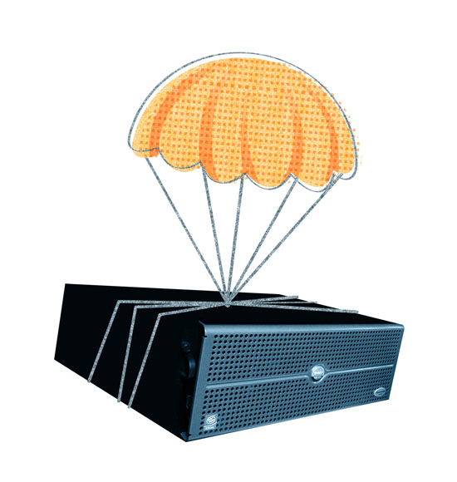
backups

Slide 49
Enhancing Deuteron Polarization
Significant potential for dramatic increase in deuteron Polarization above the assumed 15%
ND₃ max polarization expected to increase with increased magnetic field.
Technique of RF Hole Burning achieved 30% Tensor polarization in initial tests
at UVa
We don’t assume these improvements yet, because R&D will be needed to implement.

Slide 50
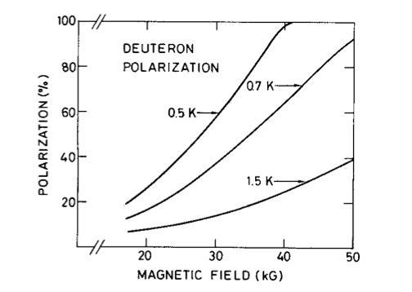
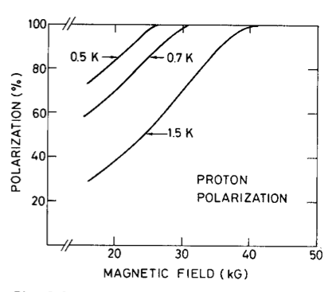
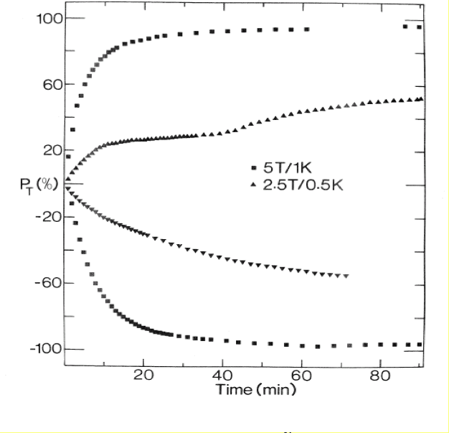
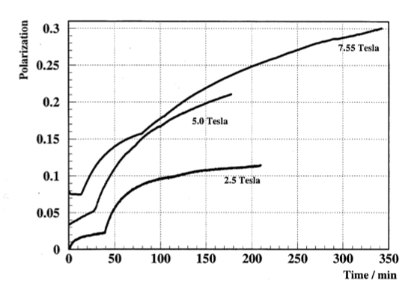
Proton Max polarization saturates
before 5T @1K
Deuteron Max polarization not expected
to saturate until B~8T for 1K
W. de Boer CERN 74-11 (1974)
CR^{V} complex
NH3 :clear improvement with B
LiD 1K: clear improvement with B
NH₃
D. Day, 2010 poltarg
workshop, JLab
Stephen Bultmann, D. Crabb
Y. Prok, UVa tests (2000)

Slide 51
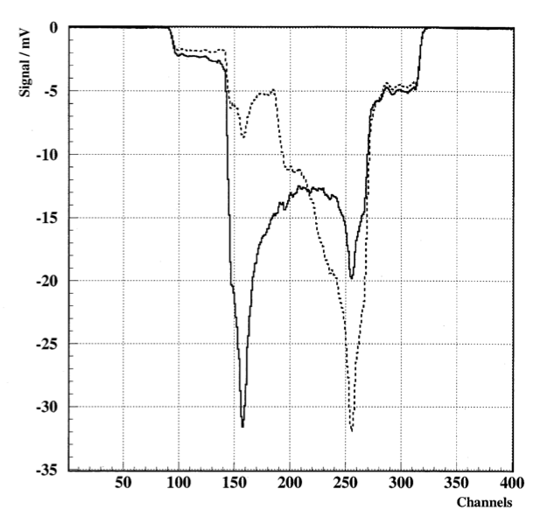
RF Hole Burning
ND₃ at 1 K in 5T field.
RF saturation of the NMR line
Directly enhances the tensor
polarization
P_{zz} ≈ 30% !!
Very promising, but more
R&D needed
Stephen Bultmann, D. Crabb
Y. Prok, UVa tests (2000)

Slide 52
Systematics
Source | (%)
Target polarization | 10.3
Dilution/Packing fraction | 5.0
Radiative correction | 4.0
Acceptance | 4.0
Charge determination | ≤ 1.0
VDC efficiency | ≤ 1.0
PID detector efficiencies | ≤ 1.0
Software cut efficiency | ≤ 1.0
Energy | 0.5
Total | 12.9
Measurement is statistics limited

Slide 53
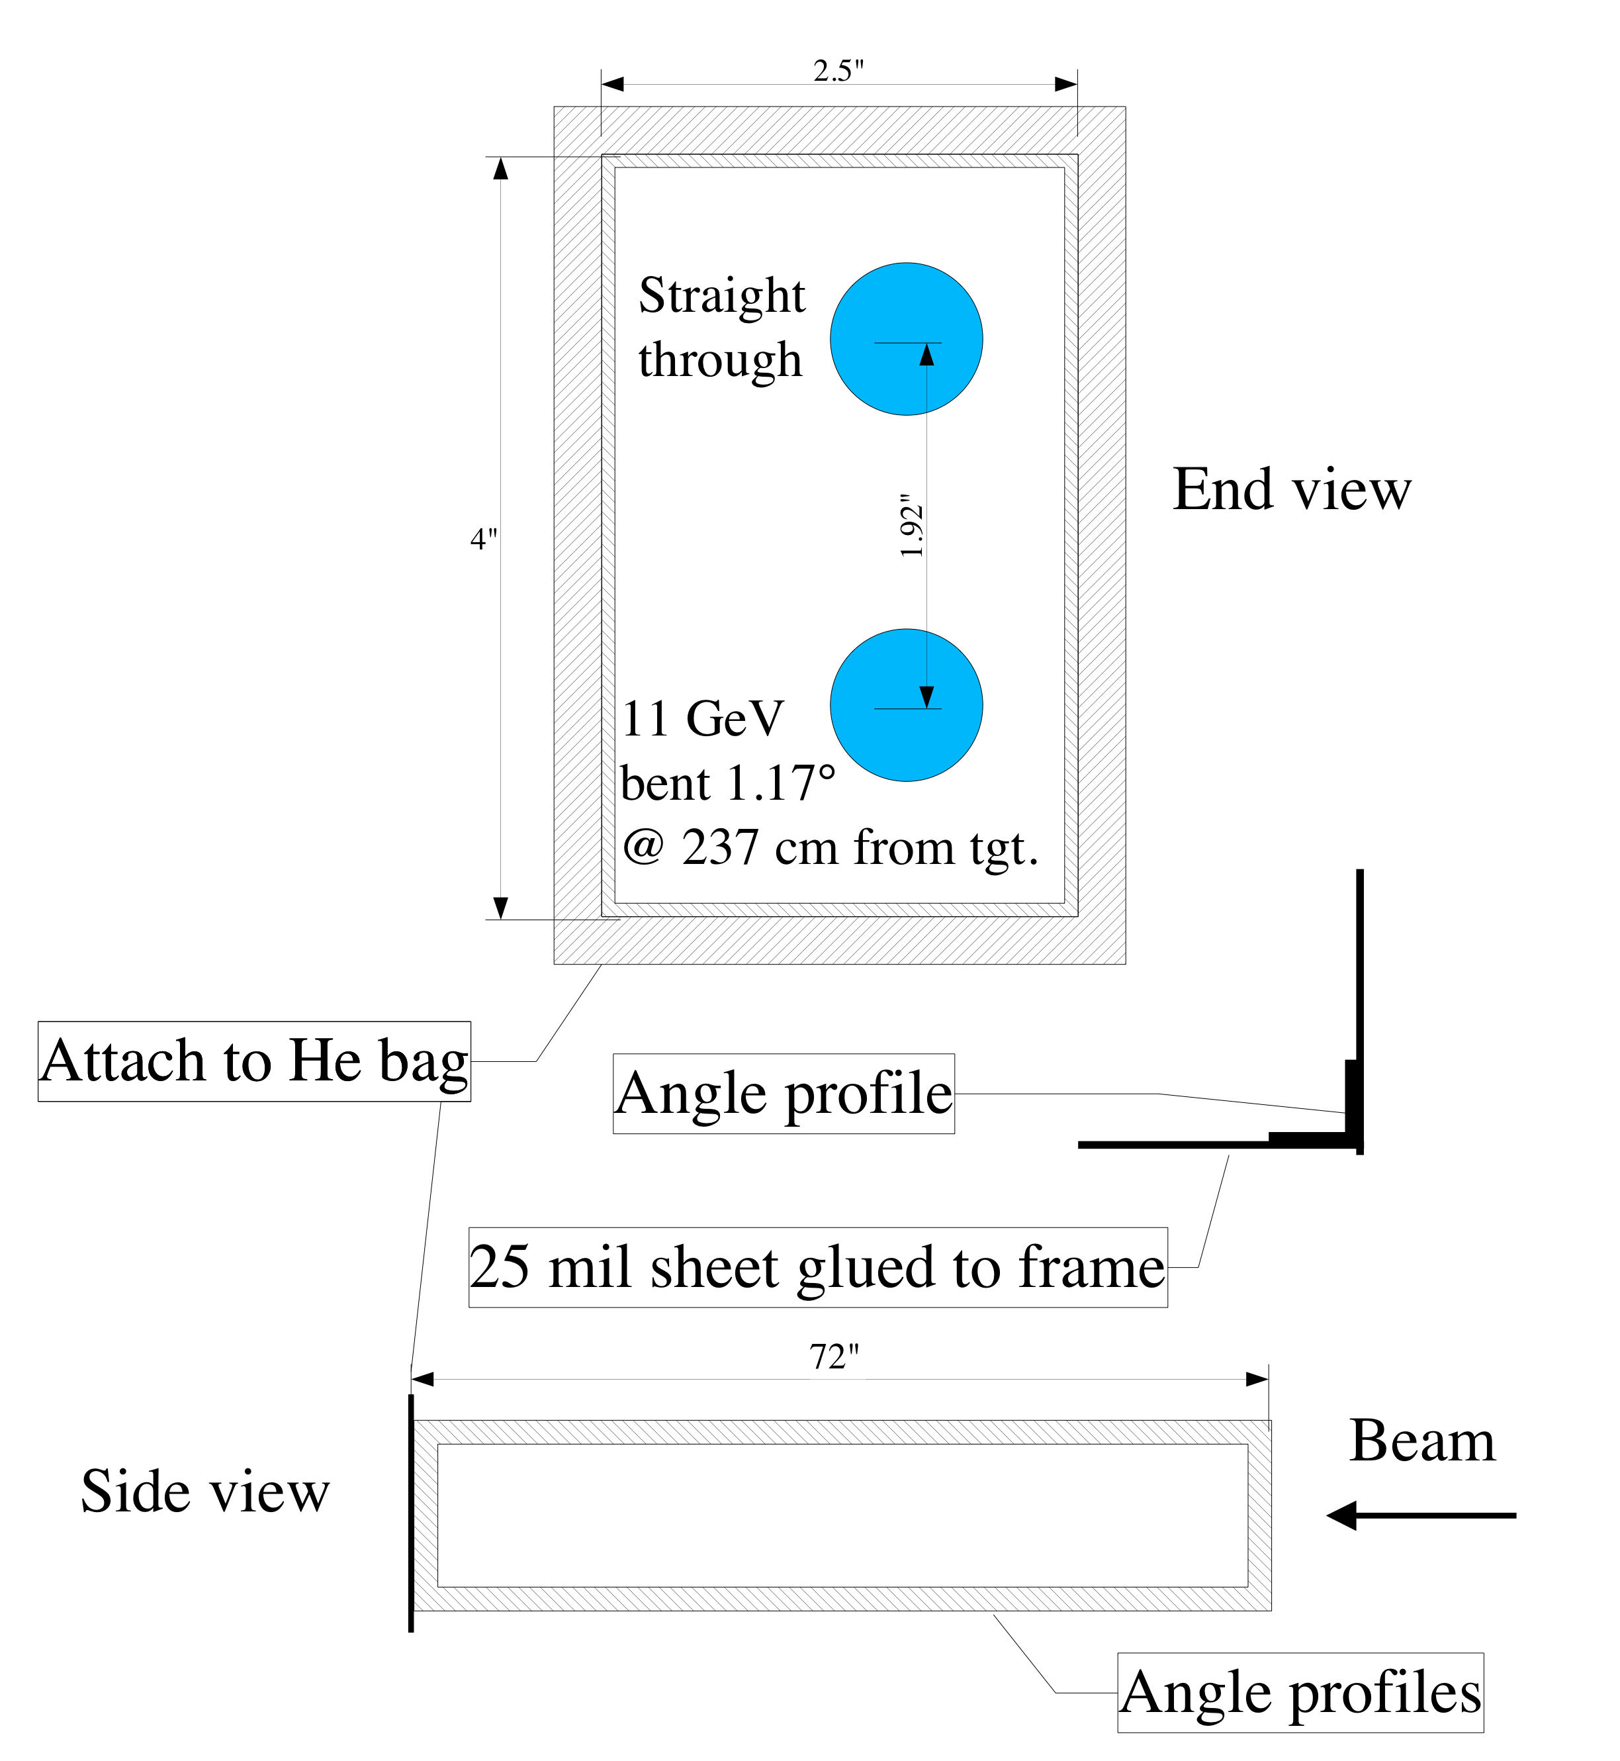
Helium Box
Target field deflects the beam by 1.17º

Slide 54
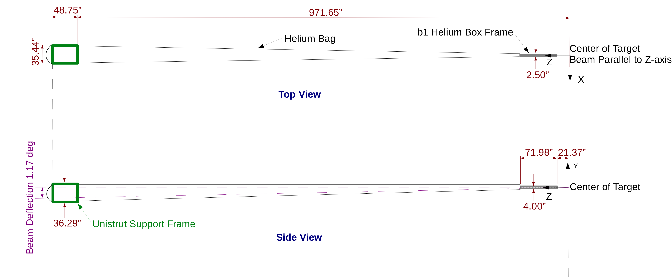
Downstream Helium Bag
Thanks P. Brindza & M. Fowler

